Slide 1
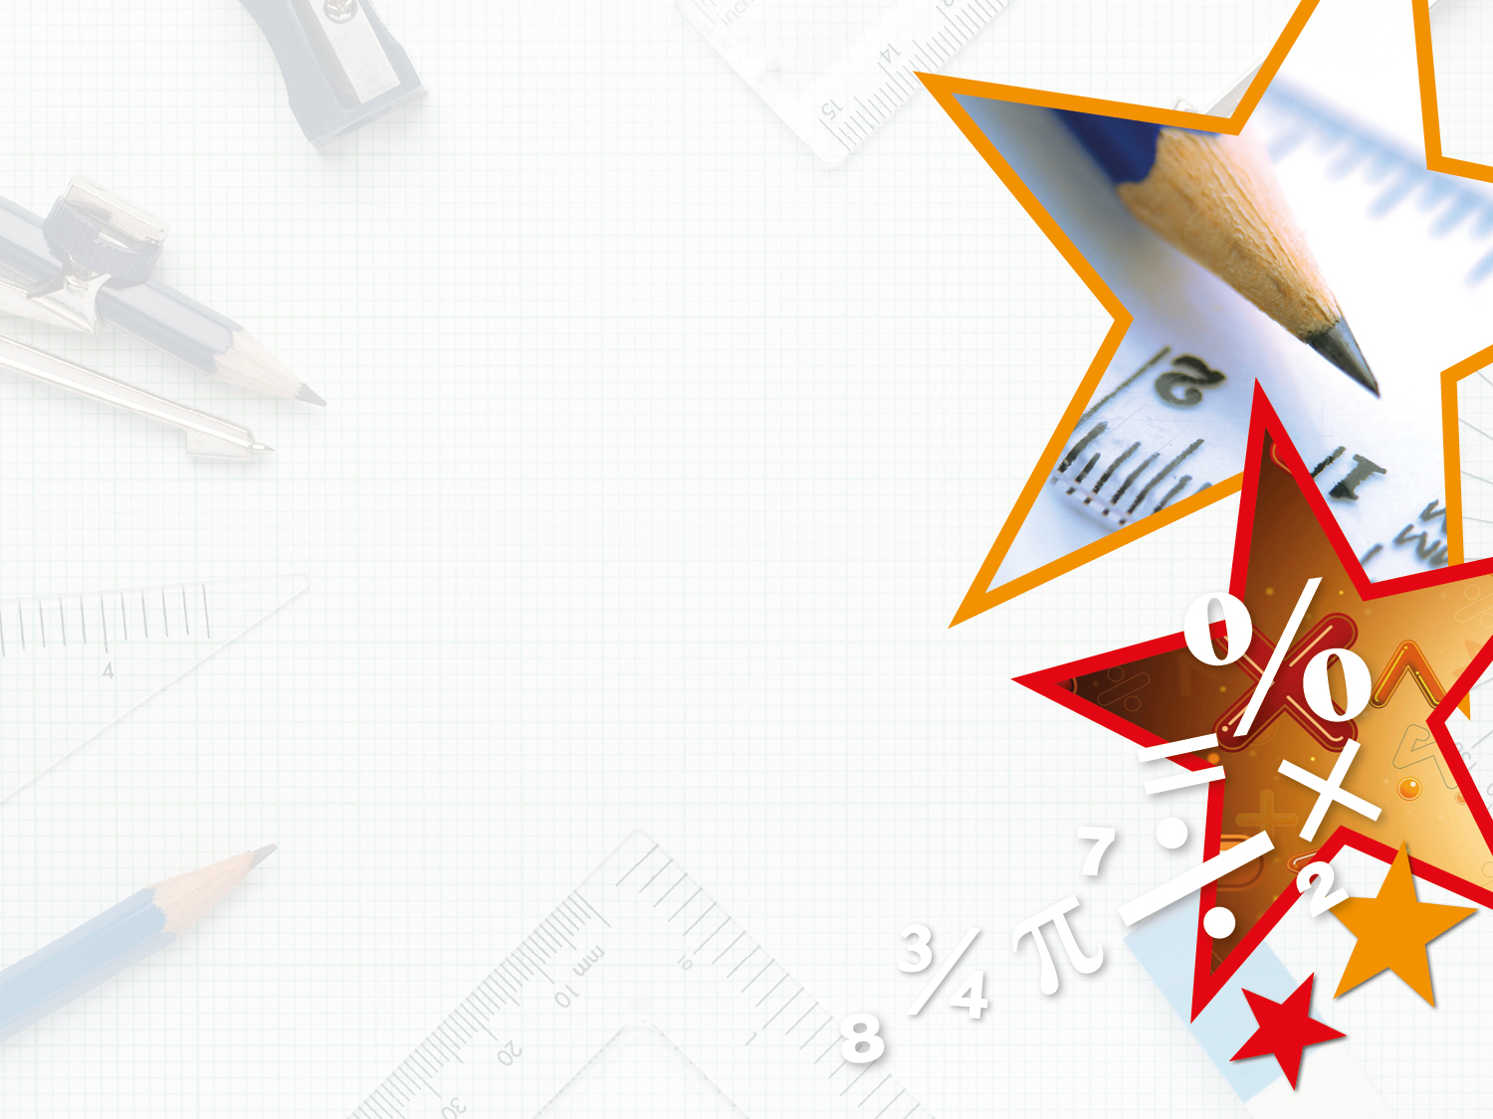
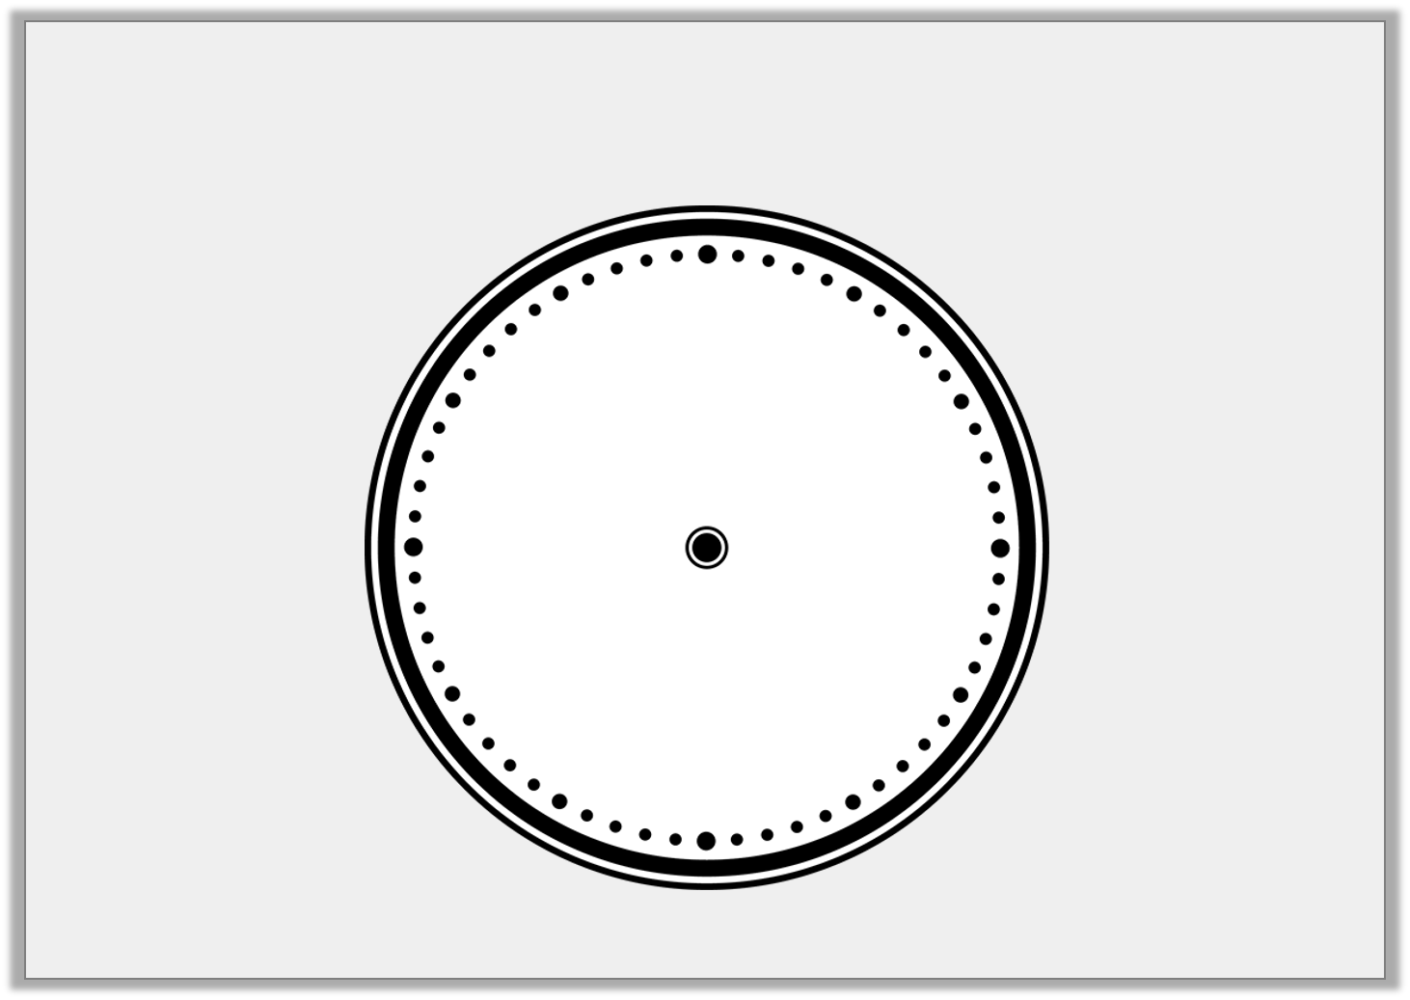


Introduction
Label the clock.
10
4
3
6
2
7
1
11
5
9
12
8
Minute hand
Hour hand
Y2
© Classroom Secrets Limited 2018

Slide 2
Introduction
Label the clock.
12
11
1
10
2
Minute hand
9
3
Hour hand
8
4
7
5
6
Y2
© Classroom Secrets Limited 2018

Slide 3
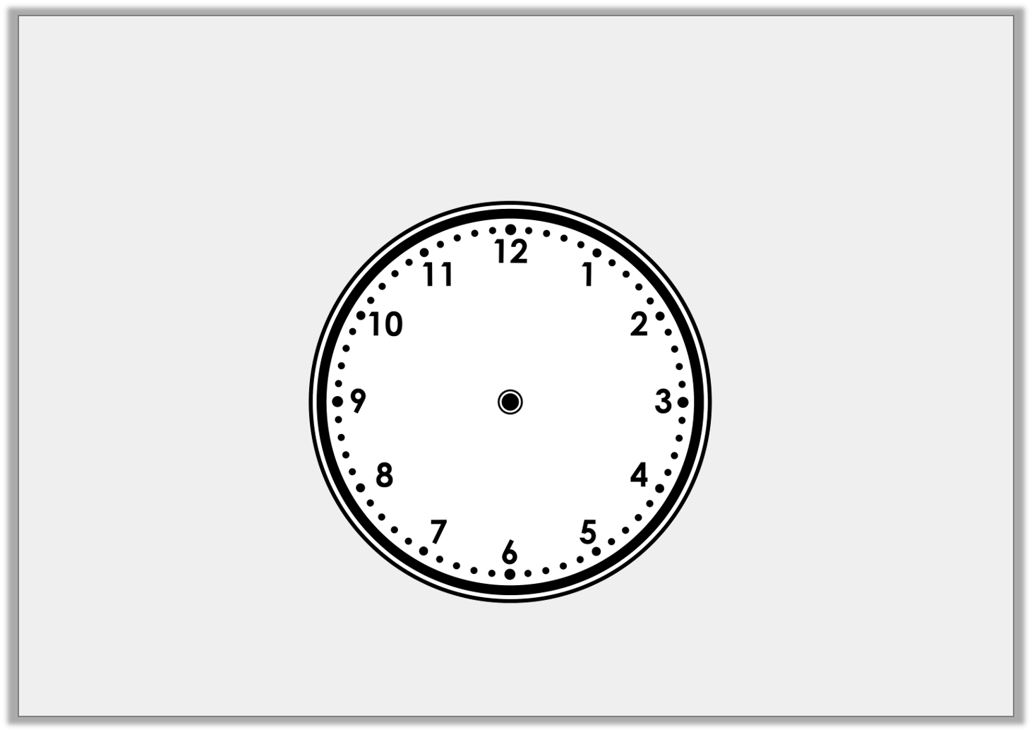
Varied Fluency 1
Write the time shown on this clock.
Y2
© Classroom Secrets Limited 2018

Slide 4
Varied Fluency 1
Write the time shown on this clock.
Half past 12
Y2
© Classroom Secrets Limited 2018

Slide 5
Varied Fluency 2
Draw the missing hands on the clock so that it shows the correct time written beneath it.
Half past 6
Y2
© Classroom Secrets Limited 2018

Slide 6
Varied Fluency 2
Draw the missing hands on the clock so that it shows the correct time written beneath it.
Half past 6
Y2
© Classroom Secrets Limited 2018

Slide 7
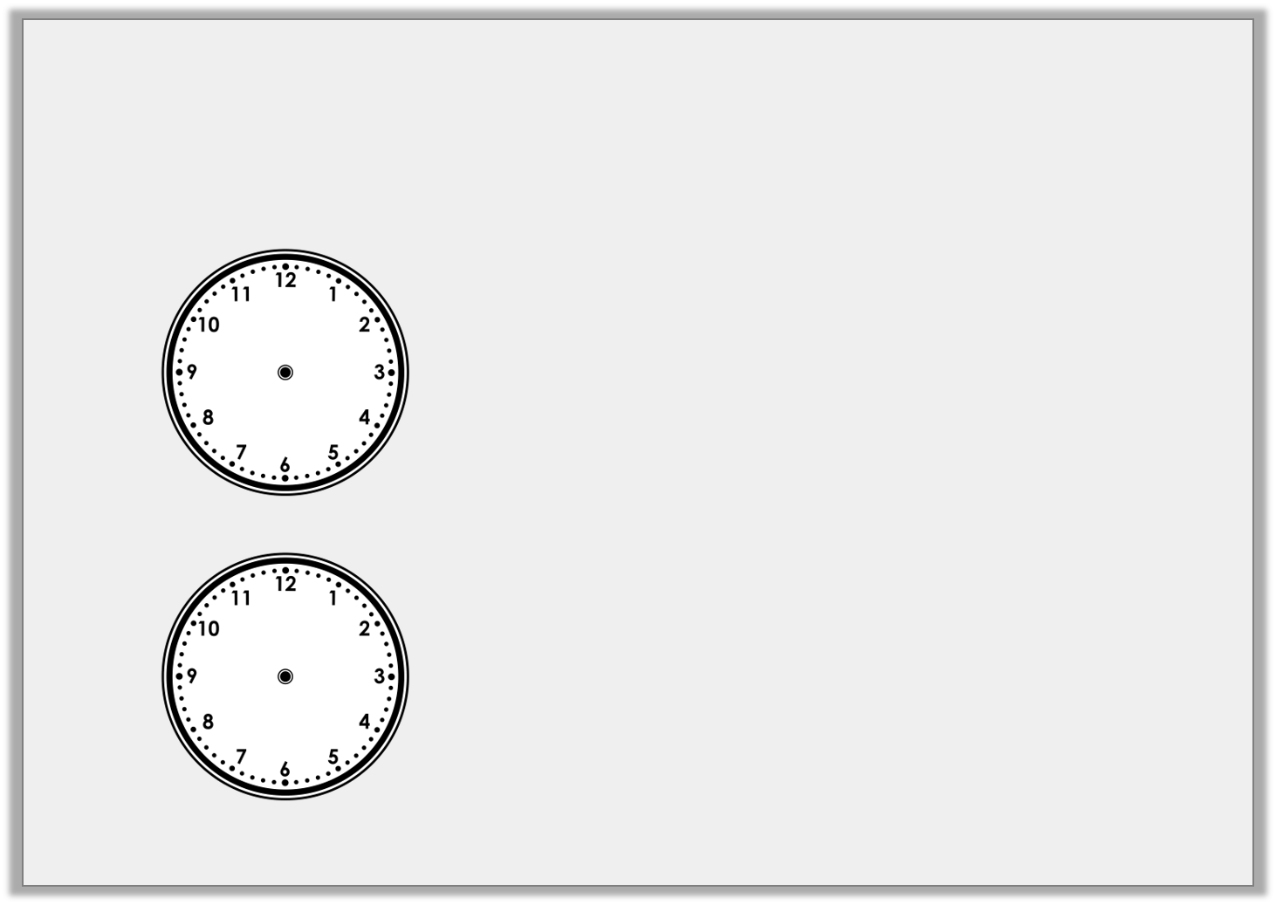
Varied Fluency 3
Draw a line to match the clocks to the correct
written time.
Half past12
3 o’clock
Half past 6
Half past 12
3 o’clock
Half past 6
Y2
© Classroom Secrets Limited 2018

Slide 8
Varied Fluency 3
Draw a line to match the clocks to the correct
written time.
Half past12
3 o’clock
Half past 6
Half past 12
3 o’clock
Half past 6
Y2
© Classroom Secrets Limited 2018

Slide 9
Varied Fluency 4
Draw a line to match the clocks to the correct
written time.
Eat lunch
Go home
Go to school
Y2
© Classroom Secrets Limited 2018

Slide 10
Varied Fluency 4
Draw a line to match the clocks to the correct
written time.
Eat lunch
Go home
Go to school
Y2
© Classroom Secrets Limited 2018

Slide 11
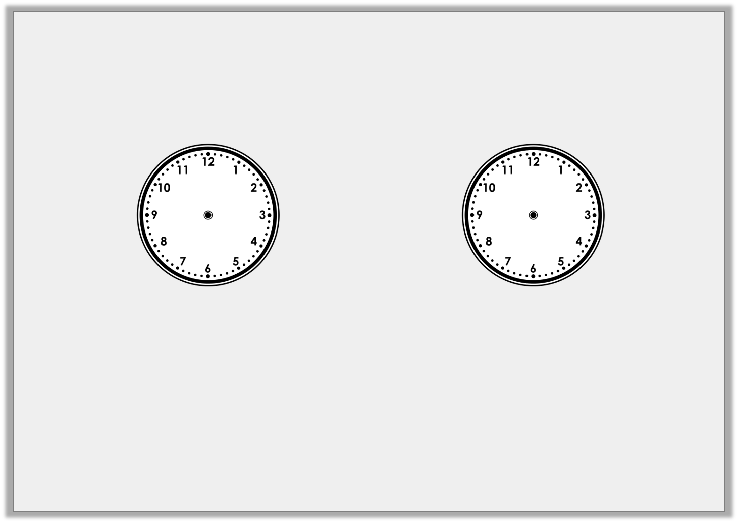
Problem Solving 1
Match the clocks to the time
and the most likely event.
Half past 8 |  | Half past 3 |  | 12 o’clock
Having lunch |  | Going to school |  | Going home
Y2
© Classroom Secrets Limited 2018

Slide 12
Problem Solving 1
Match the clocks to the time
and the most likely event.
Half past 8 |  | Half past 3 |  | 12 o’clock
Having lunch |  | Going to school |  | Going home
Y2
© Classroom Secrets Limited 2018

Slide 13
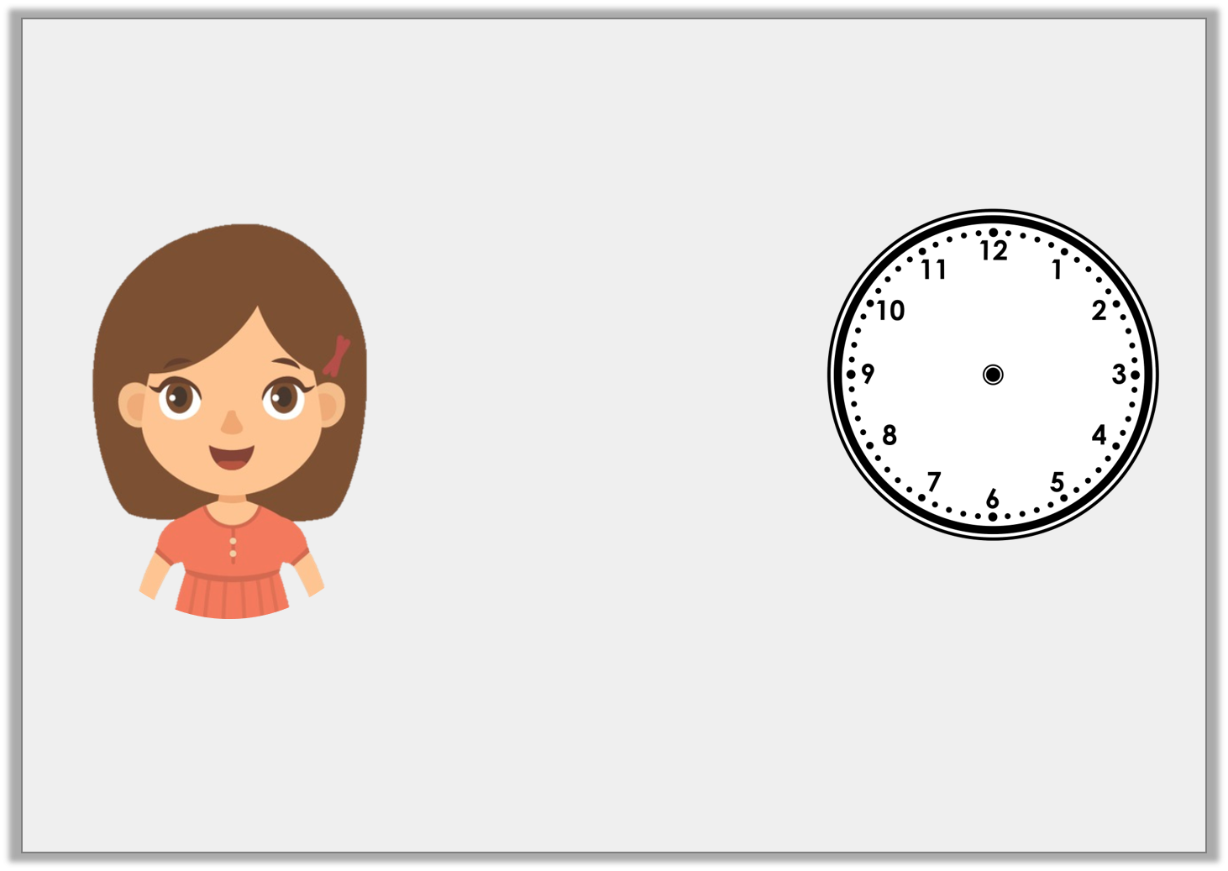
Reasoning 1
Jen is trying to tell the time.
Is Jen right? How do you know?
It’s 5 past 6.
Y2
© Classroom Secrets Limited 2018

Slide 14
Reasoning 1
Jen is trying to tell the time.
Is Jen right? How do you know?
Jen is wrong because…
It’s 5 past 6.
Y2
© Classroom Secrets Limited 2018

Slide 15
Reasoning 1
Jen is trying to tell the time.
Is Jen right? How do you know?
Jen is wrong because she has mixed up the hour hand and the minute hand. It is half past 5.
It’s 5 past 6.
Y2
© Classroom Secrets Limited 2018

Slide 16
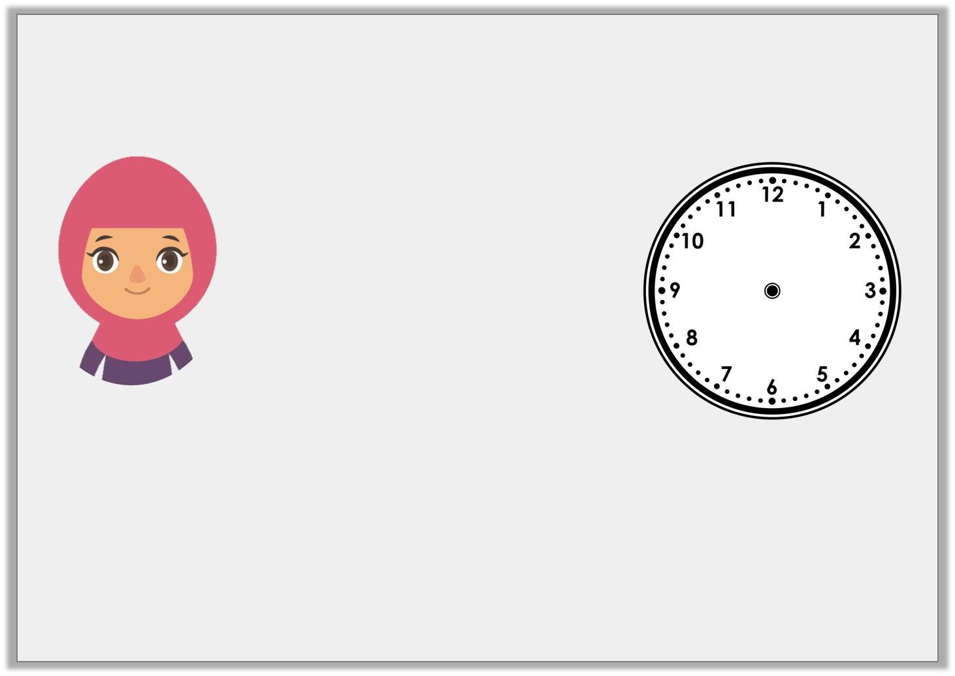
Reasoning 2
The hands have fallen off this clock. Aisha says:
Is Aisha right? How do you know?
Aisha is right about… but wrong about…
It’s half past 4 so the minute hand should be pointing down and the hour hand should be at 4.
Y2
© Classroom Secrets Limited 2018

Slide 17
Reasoning 2
The hands have fallen off this clock. Aisha says:
Is Aisha right? How do you know?
Aisha is right about the minute hand but wrong about the hour hand. If it is half past then then the hour hand should be between 4 and 5.
It’s half past 4 so the minute hand should be pointing down and the hour hand should be at 4.
Y2
© Classroom Secrets Limited 2018

