Slide 1
Les pronoms personnels
We are going to revise personal pronouns.
First we are going to write the date in a sentence. Pay attention to the questions about the different parts of the date. Are they asked in the same way as last week?
After we will watch a video.

Slide 2
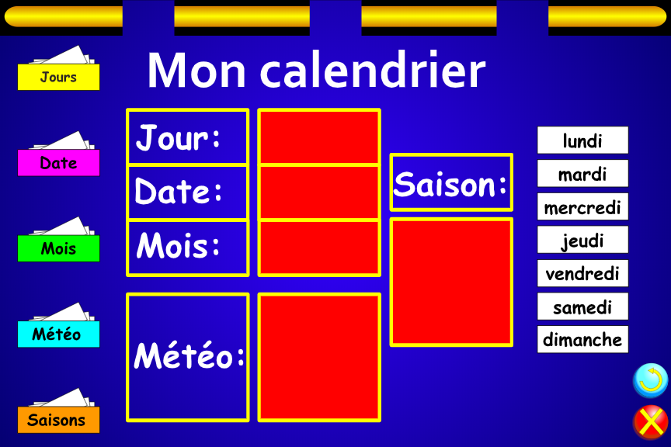
Quel jour sommes-nous?

Slide 3
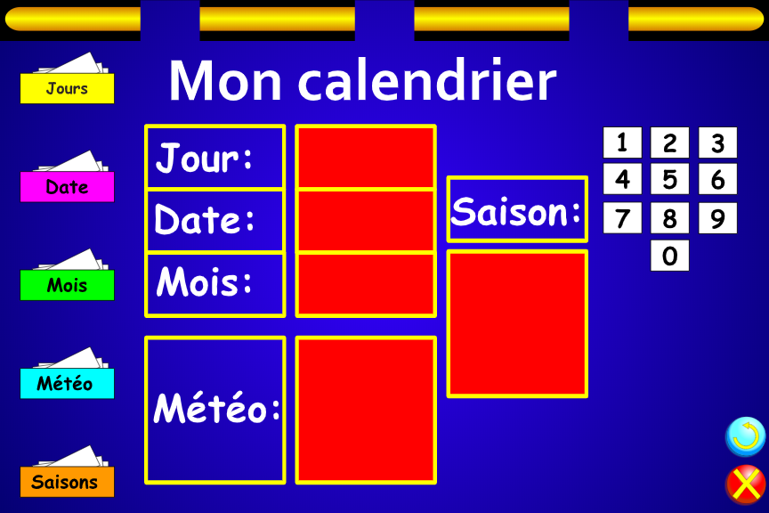
Aujourd’hui est le combien?

Slide 4
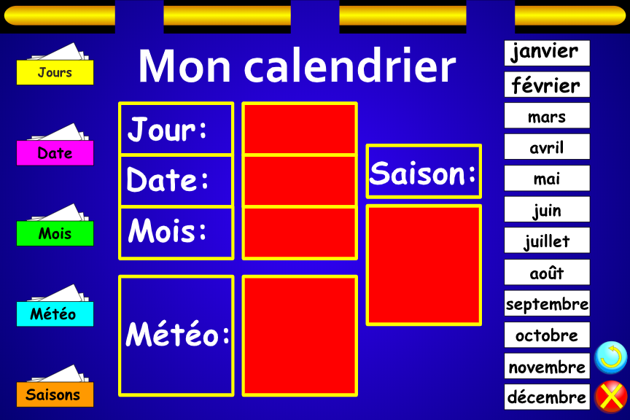
Nous sommes quel mois?

Slide 5
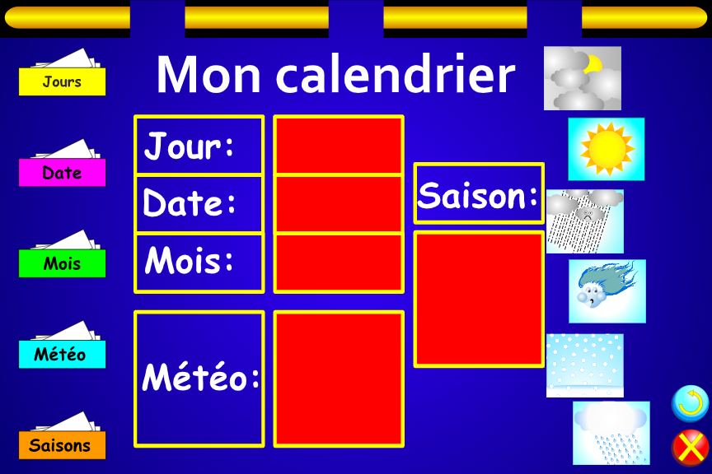
Quel temps fait-il Aujourd'hui?
Il fait
gris
Il fait beau
Il fait mauvais
Il fait du vent
Il neige
Il pleut

Slide 6
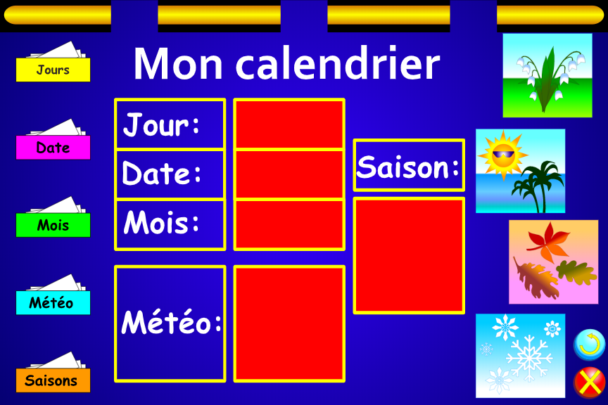
Quelle est la saison?
C'est le
printemps
C'est
l’ete
C'est
l’automne
C'est
l’hiver

Slide 7
Write the date in a sentence
Aujourd'hui nous sommes ………… .
C’est le ... juin 2020.
Il fait ………… et c'est ………...

Slide 8
Les pronoms personnels sujet
To say who or what does the action of a verb we can use personal pronouns instead a noun.
Personal pronouns can be
in the first, second or third person
they can be masculine, feminine or neutral
they can be singular or plural.
A verb will have different endings or forms depending on who does the action.

Slide 9
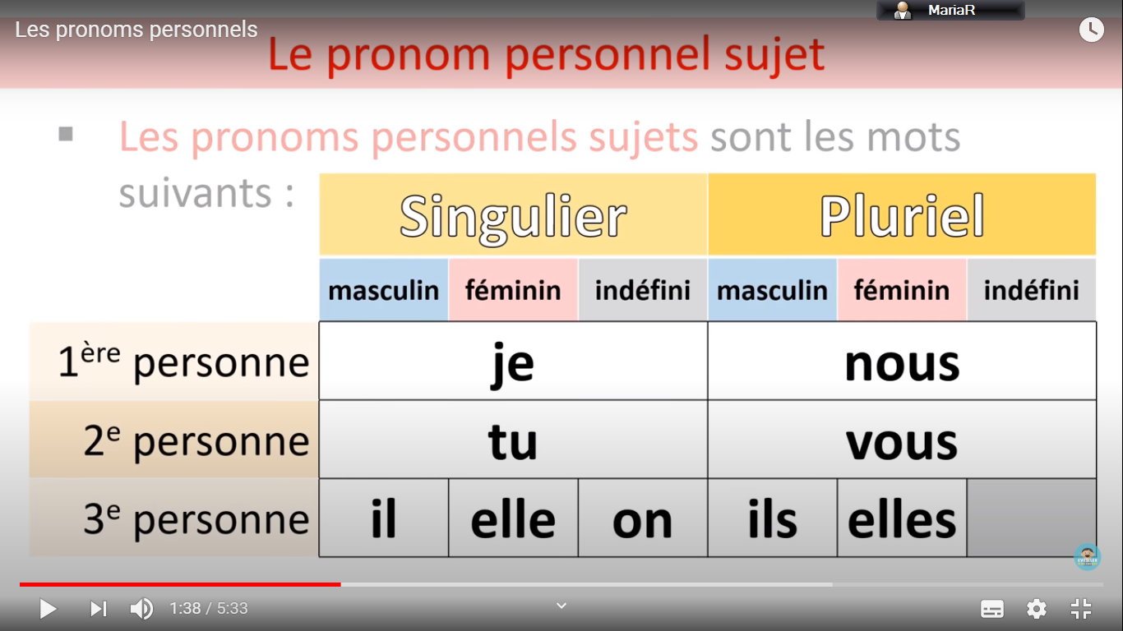
The following words are French personal pronouns

Slide 10
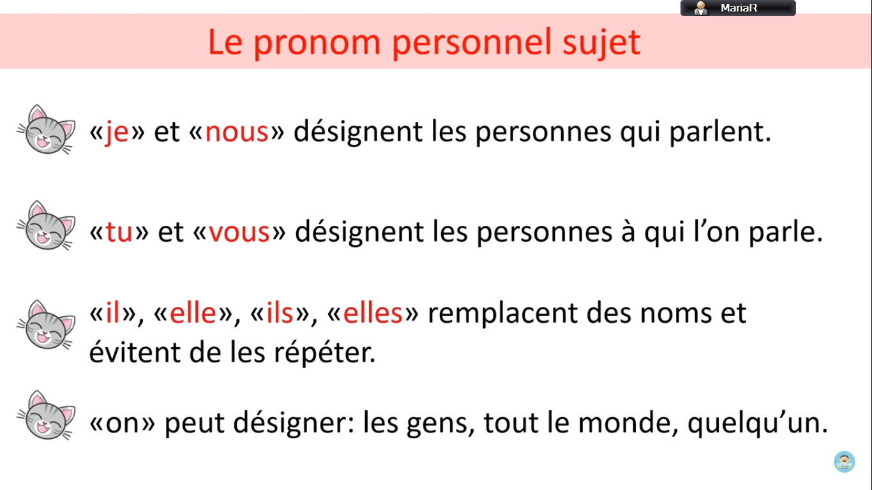
Je and nous define the people that is talking
Tu and vous define the people to whom we are talking
Il , elle, ils and elles replace nouns and avoid their repetition
On can be the people, everybody, somebody

Slide 11
Let’s watch a video
https://www.youtube.com/watch?v=0BscwFbjJPk

Slide 12
Let’s revise the pronouns
je
tu
il
nous
vous
ils
elles
I
you (sg)
he
we
you (pl)
they (m/pl + mixed) they (f/pl)

Slide 13
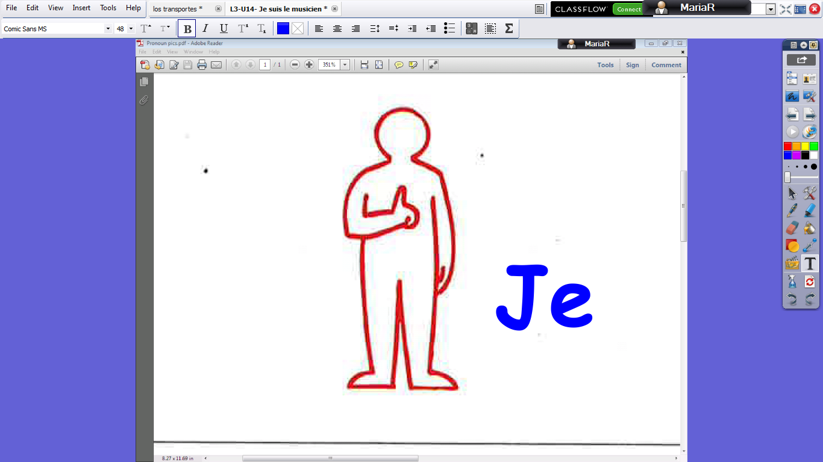

Slide 14
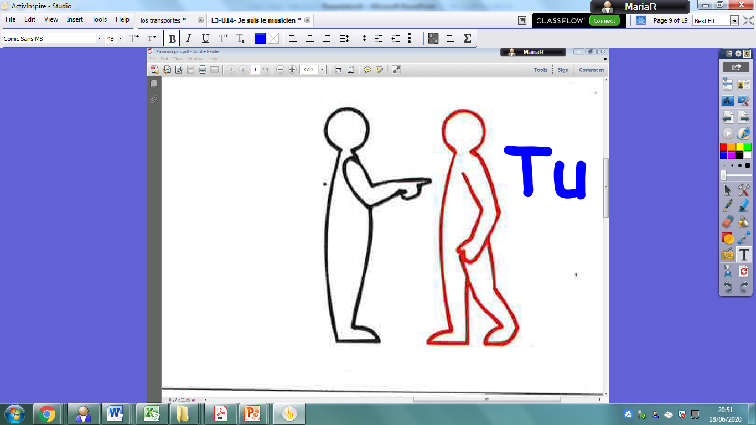

Slide 15
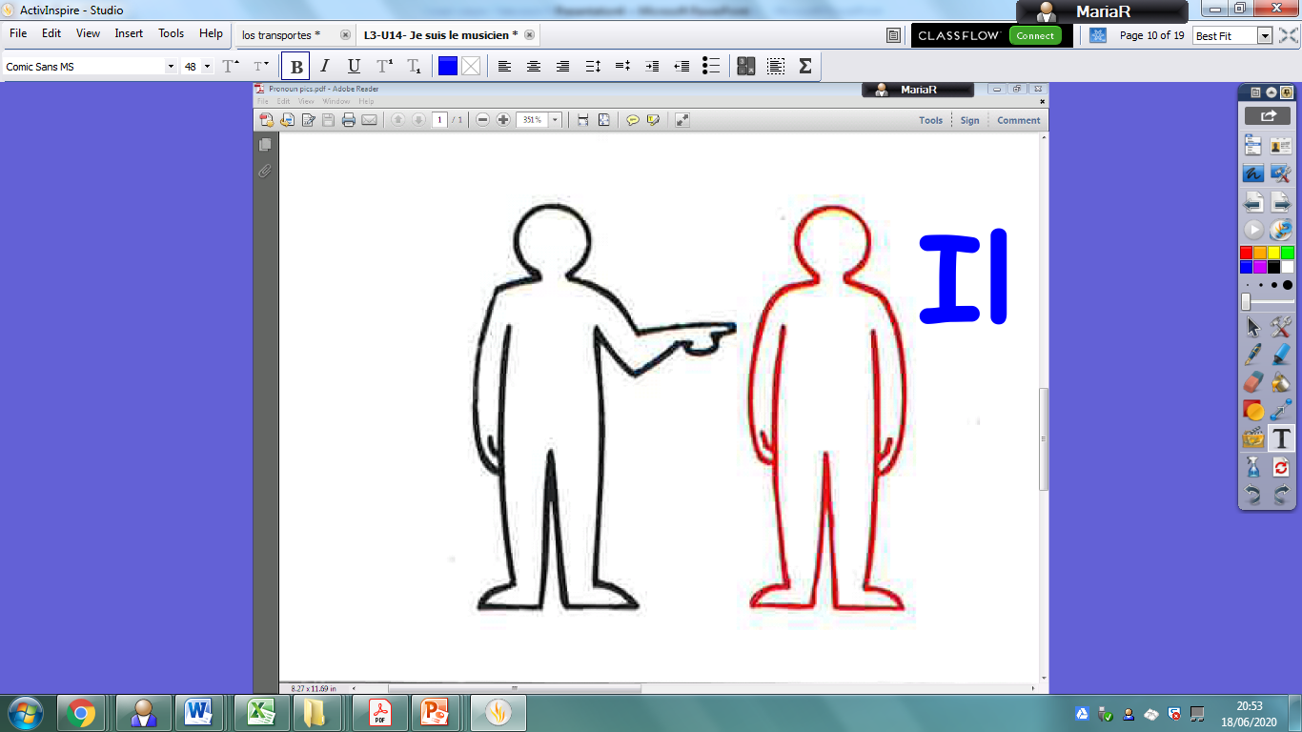

Slide 16
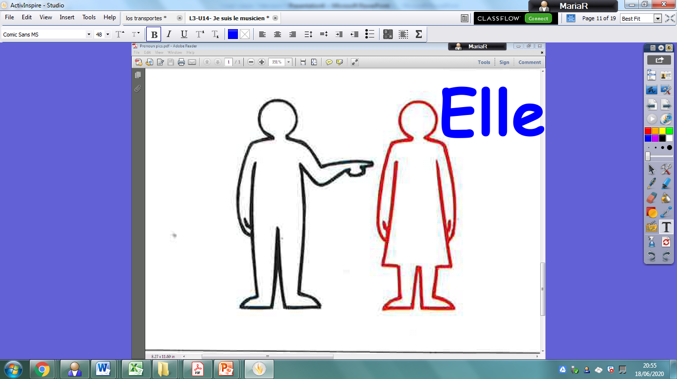

Slide 17
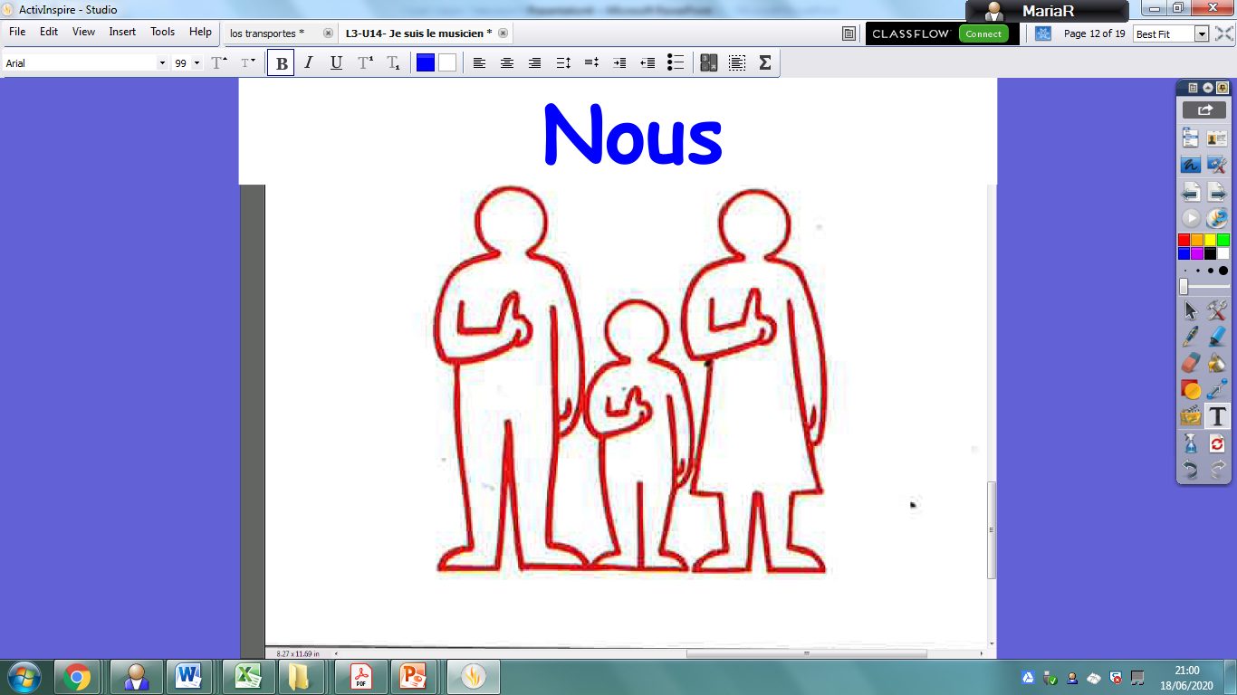

Slide 18
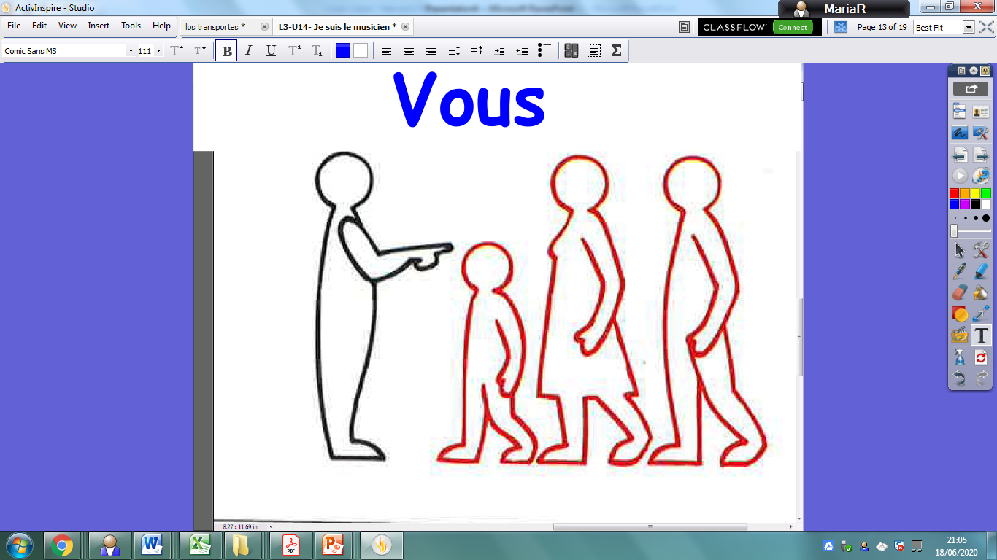

Slide 19
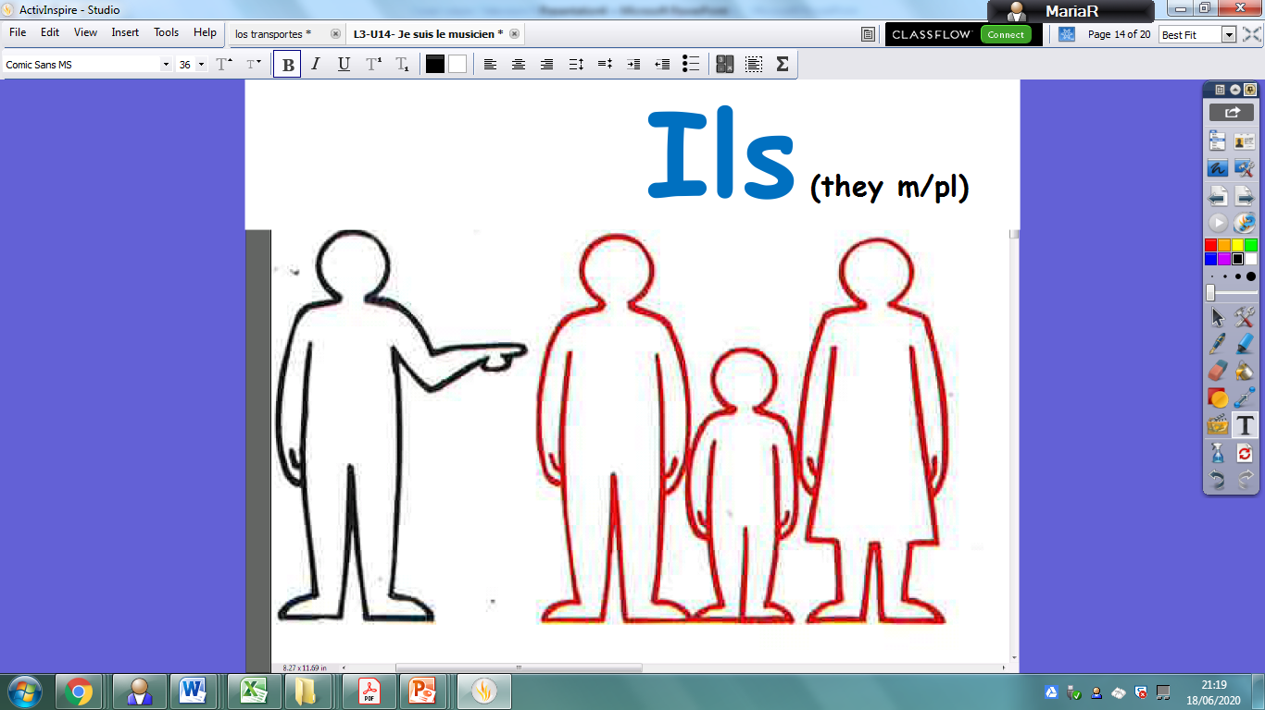

Slide 20


Slide 21
