Slide 1
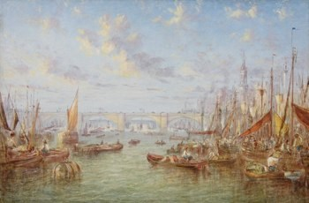
Victorian Era and River Thames

Slide 2
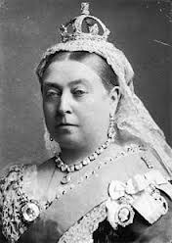
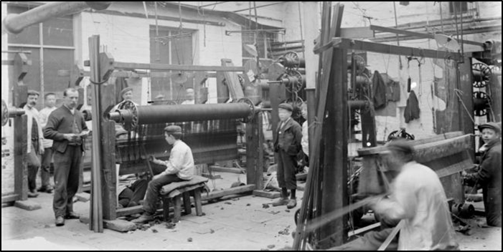
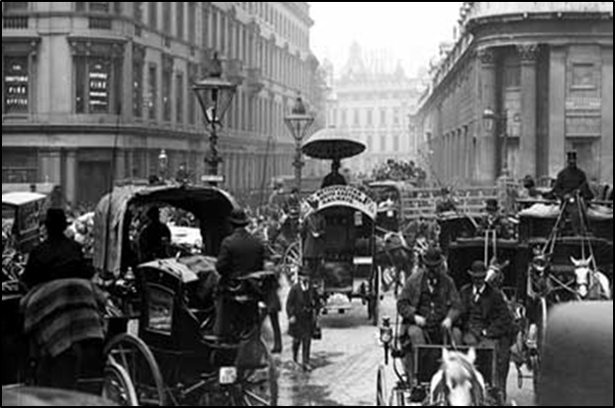
Who were the Victorians?
Victorian times means during Victoria’s rule. The time was Queen Victoria was on the throne. She ruled for 64 years!
There was no electricity, instead gas lamps or candles were used for light.
There were no cars. People either walked, travelled by boat or train or used coach horses to move from place to place.
Britain managed to build a huge empire during the Victorian period. It was also a time of tremendous change in the lives of British people. In 1837 most people lived in villages and worked on the land; by 1901, most lived in towns and worked in offices, shops and factories.

Slide 3
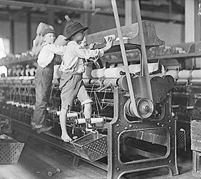
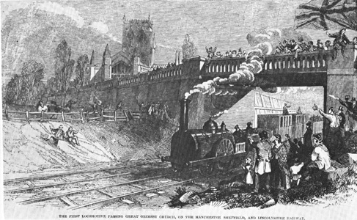
During Queen Victoria’s reign:
Britain became the most powerful and richest country in the world, with the largest empire that had ever existed, ruling a quarter of the world's population.
Towns and cities got piped water, gas and, by the end of the century, electricity!
The number of people living in Britain more than doubled from 16 million to 37 million, causing a huge demand for food, clothes and housing.
Factories and machines were built to meet this demand and new towns grew up, changing the landscape and the ways people lived and worked.
Railways, originally built to transport goods, meant people could travel easily around the country for the first time. Railways brought new foods to towns and cities.
Let’s have a look how River Thames was used before all these changes.

Slide 4
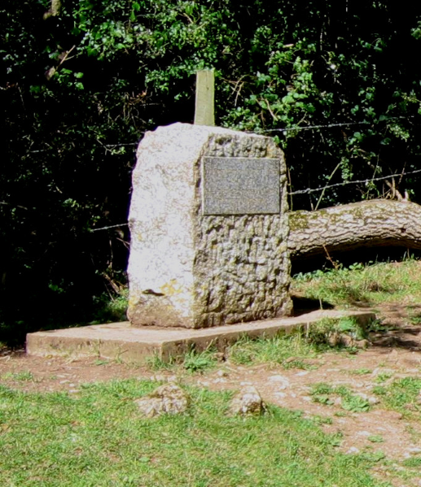
River Thames
Where Does it Start?
The source of the River Thames (referred to as ‘Thames Head’) is 3.5 miles south west of Cirencester. It is the longest river entirely in England.
It is marked by a large stone which says:
'The conservation of the River Thames 1857 - 1974.
This stone was placed here to mark the source of the River Thames.'
Did you know…
The source of the Thames is 108.5m above sea level.

Slide 5
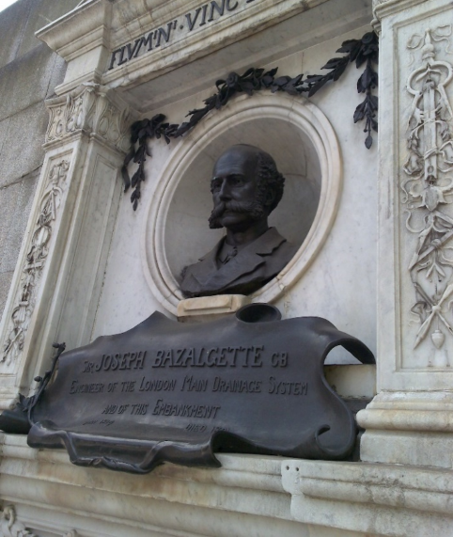
River Thames was the source of drinking water. It acted a a water- highway through England. Many people relied on the river. Visit the site: http://www.avictorian.com/thames.html to find the ways the River Thames was used in Victorian era.
For many years, most of the city’s rubbish, food and toilet waste was dumped in the river! In 1858, the smell coming from the river was so disgusting that Parliament (which is on the banks of the Thames) had to be suspended. Consequently, the government decided to find a way to rid the Thames of sewage. Along came Sir Joseph Bazalgette who built a sewerage system for London.

Slide 6
Activity
After you’ve explored how Victorians used River Thames
Draw and explain its uses.

Slide 7
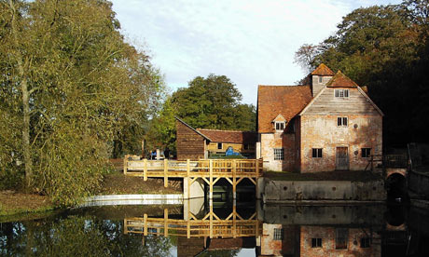
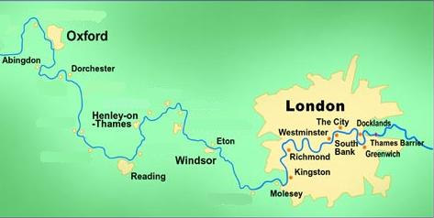
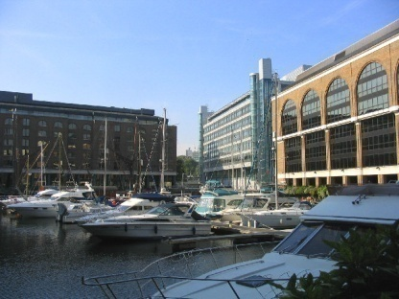
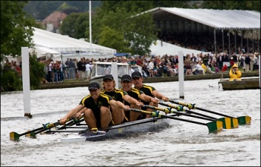
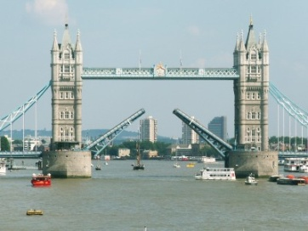
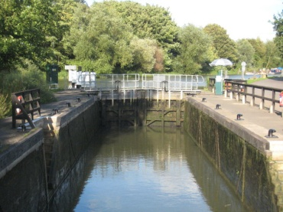
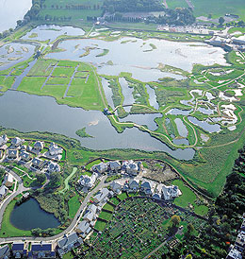
Interesting to know…
River Thames

Slide 8
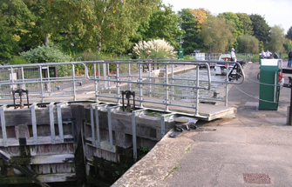
Interesting to know…
Abingdon Lock
This is the oldest lock in England.
Locks are like stairs – they let boats go up and down the river easily.

Slide 9
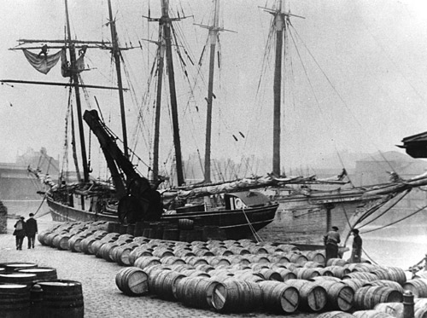
Interesting to know…
The London Docks
This used to be where expensive goods like spices and cloth were shipped in from across the world.
Now, the docks have been made into marinas for people to keep their yachts, and luxury flats.

Slide 10
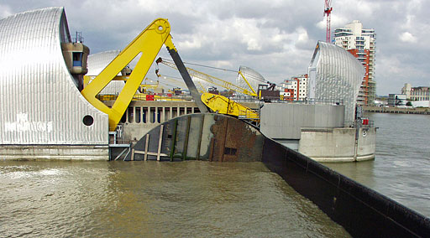
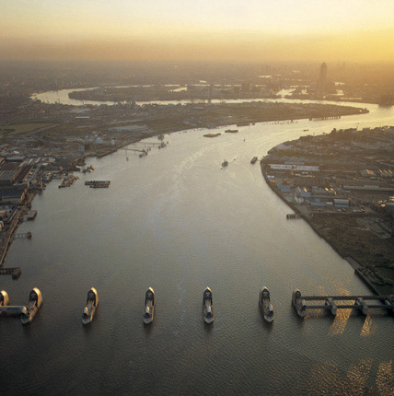
Interesting to know…
The Thames Barrier
The Thames Barrier is downstream of central London.
It was built in 1982 to prevent high tides flooding Greater London.
This was built to protect the River Thames from flooding from the sea.
It is a set of gates that lie in the water across the river, which stop the tides from the sea affecting the river.

Slide 11
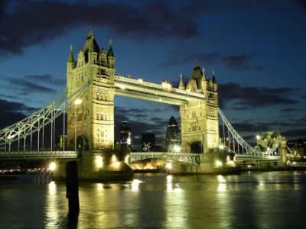
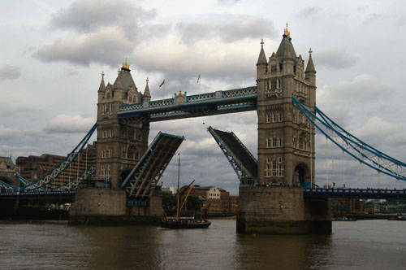
Interesting to know…
Tower Bridge
Tower Bridge was opened in 1894, and at the time was the largest bascule bridge in the world. The bascules are the two central lower parts that lift up for tall boats and ships to pass under the bridge.
The gates open at set times to allow ships in and out of London.
Did you know…
It took 8 years to build, 432 construction workers and 11000 tons of steel. It is an iconic building in London and is known around the world as well as playing host to events such as the London Marathon.

Slide 12
Interesting to know…
London Bridge
Often confused with Tower Bridge, the original bridge was built in 1830 and made famous by the song ‘London Bridge is Falling Down’.
Did you know…
In 1967 it was dismantled (it was not able to cope with the increasing traffic) and sold to Robert P. McCulloch from London, who had it moved brick by brick and reconstructed in Arizona, USA.

Slide 13
Challenges:
Draw and write explanation of one way that people use the River Thames today.
Draw a map of the River Thames and plot the locations of the bridges
Create a Timeline of The River Thames

Slide 14
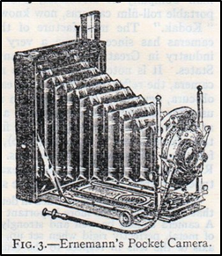
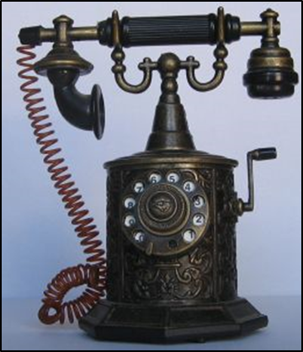
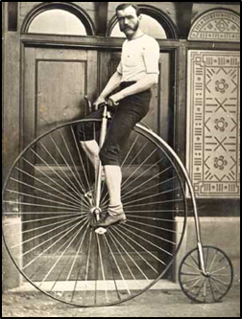
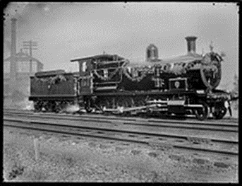
What effect did Victorian era have on the world?
The Victorian era was a time of great industrial, political, trade, scientific and military progress for Great Britain. Inventions that enabled information to be shared, distances to be shortened and machines to be powered, all of which helped to create a new, modern era sometimes referred to as the Industrial Revolution. Here are just a few of the inventions:
Photographs
Telephones
Cars
Bicycles
Stamps
Steam Trains

