Slide 1
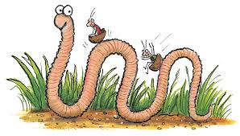
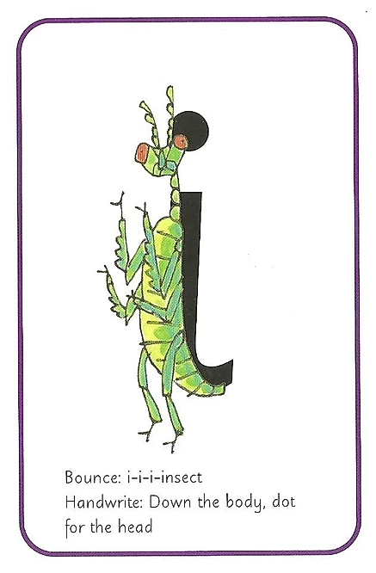
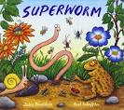
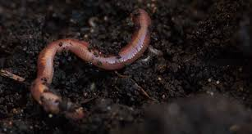
LEARNING FROM HOME
Nursery– Week Beginning 4.5.2020
This week’s book focus is ‘Superworm’
https://www.youtube.com/watch?v=7Jnk3XApKBg
Click on the above link to listen to the story on YouTube.
Who was the author?
Advised Timetable:
Read a story every day.
Practise writing your name every day.
Complete a phonics and numeracy activity every day.
Complete at least 1 activity from other areas each day.
Take part in rhyme time every day.
Phonics Sound ‘i’
The rhyme for letter formation: Down the insects body and dot for the head!
Can you look around your house and find things beginning with that sound?
Can you practise writing ‘i’?
Numeracy: Counting bugs
https://www.youtube.com/watch?v=le5OZCqvRIU
Can you count how many bugs there are altogether?
How many fingers do you have on one hand?
Can you sing along?
Have a go at writing the finger number and drawing the bugs.
Literacy: Story time!
What do you think the story will be about?
Listen to the story.
Why is he called Superworm?
What happened in the story?
What was your favourite part?
Expressive art and design
Get Creative and Recycle!
Can you collect some recycling materials and make a home for a worm?
What's going to be in your worm house?
How are you going to stick it together?
Physical development
Can you dig in your garden and find a worm?
How does a worm move?
Can you move like a worm?

