Slide 1
Science
Living Things and Their Habitats
Year One
Science | Year 5 | Living Things and Their Habitats | Making New Plants 1 | Lesson 1

Slide 2
Making New Plants

Slide 3
Aim
I can describe how some plants reproduce.
Success Criteria
I can explain the difference between sexual and asexual reproduction.
I can identify the function of the parts of a flower.
I can describe ways that plants are pollinated in order to reproduce.

Slide 4
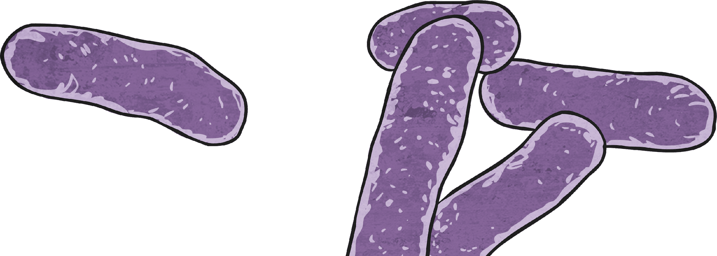
Reproduction
Sexual reproduction requires two parents to make one offspring.
All living things need to make more of themselves so that their species does not die out.
Reproduction is the process by which new living things are made.
There are two types of reproduction: sexual and asexual.
Asexual reproduction needs only one parent, which creates offspring that are exact copies of the parent.

Slide 5
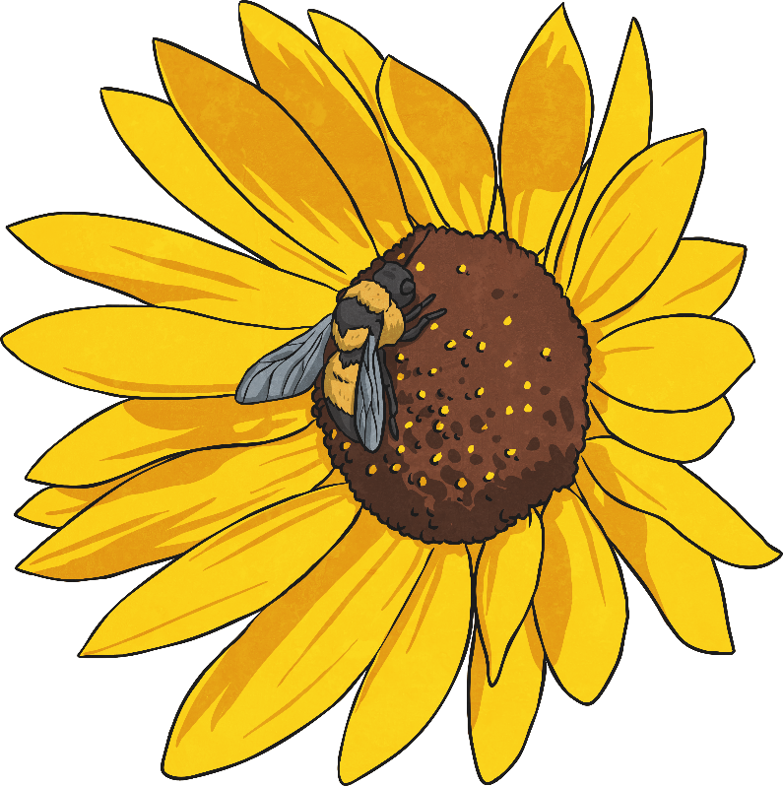
Reproduction
In this lesson, you will learn more about sexual reproduction in plants.
Living things that use sexual reproduction have sex cells called gametes. These are split into male gametes and female gametes. In some living things, the male and female are separate, but in other living things one organism contains both male and female gametes.
In plants, the male gametes are contained in the pollen and the female gametes are called ovules.
Sexual reproduction happens when a male gamete and a female gamete join. This is called fertilisation.
Sexual reproduction produces offspring that are similar to both parents, but not identical to either.

Slide 6
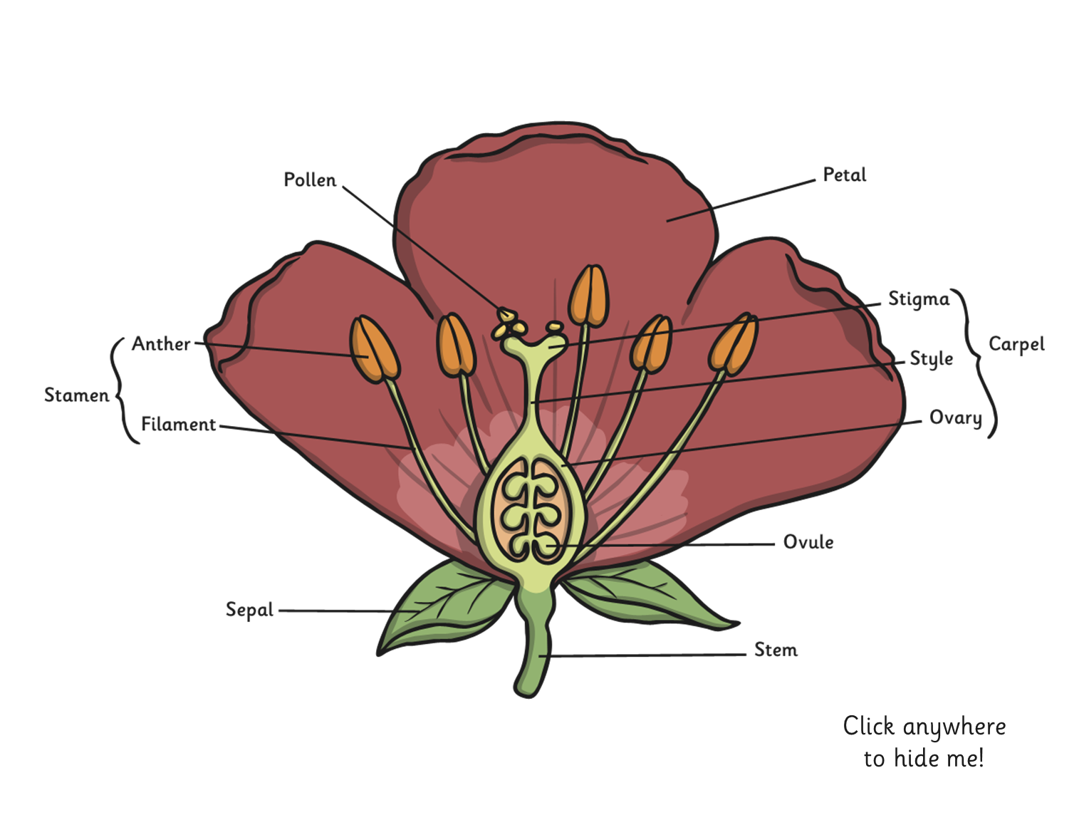
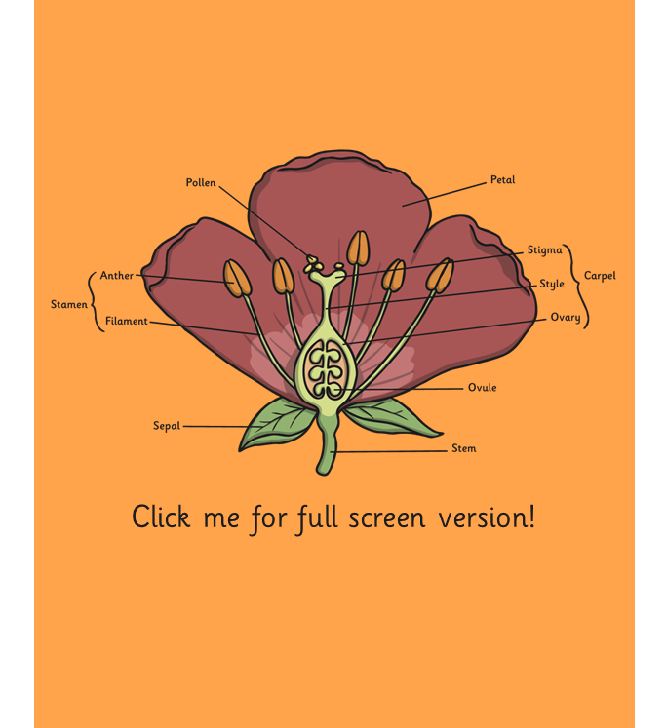
Insect or Wind?
Parts of a flower
In pollination, pollen from the stamen is transferred to the stigma. A pollen tube then grows down through the style to the ovary. The pollen travels down the pollen tube and fuses with an ovule in the ovary. This is fertilisation.
Although flowers contain both the male gametes (in pollen) and the female gametes (ovules), most plants cannot fertilise themselves. They rely on other ways of transferring the pollen to the stigma; this starts the pollination and fertilisation process.
Two ways that flowers can be pollinated are by insect or by the wind.

Slide 7
Aim
I can describe how some plants reproduce.
Success Criteria
I can explain the difference between sexual and asexual reproduction.
I can identify the function of the parts of a flower.
I can describe ways that plants are pollinated in order to reproduce.

Slide 8
Now complete the tasks. You may do them in a separate google document or in your home learning book
This video will help you with your last activity on pollination
https://youtu.be/_sGaZlv8_0g

