Slide 1
Year 5 – Summer Block 2 – Properties of Shape
Regular and Irregular Polygons
© Classroom Secrets Limited 2018

Slide 2
Introduction
Discuss these statements about polygons.
Are they true or false?
True | False
They have 5 or more sides
They are made up of straight lines
They are 3D shapes
They are 2D shapes
They are a closed shape (no gaps)
They can have curved sides
They include open shapes
© Classroom Secrets Limited 2018

Slide 3
Introduction
Discuss these statements about polygons.
Are they true or false?
True | False
They are a closed shape (no gaps)
They are 3D shapes
They include open shapes
They are made up of straight lines
They can have curved sides
They are 2D shapes
They have 5 or more sides
© Classroom Secrets Limited 2018

Slide 4
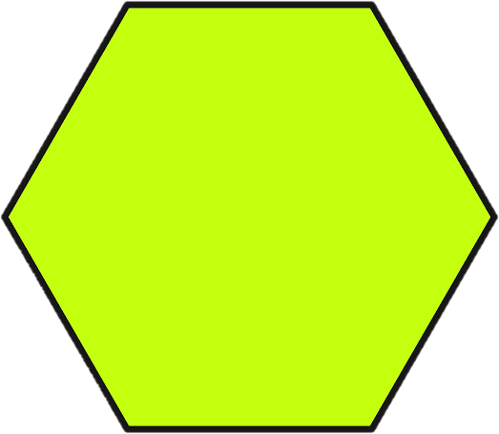
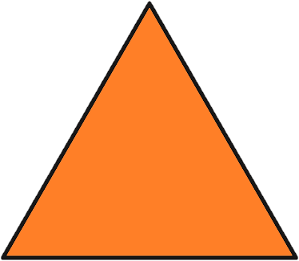
Varied Fluency 1
Circle the regular polygons.
© Classroom Secrets Limited 2018

Slide 5
Varied Fluency 1
Circle the regular polygons.
© Classroom Secrets Limited 2018

Slide 6
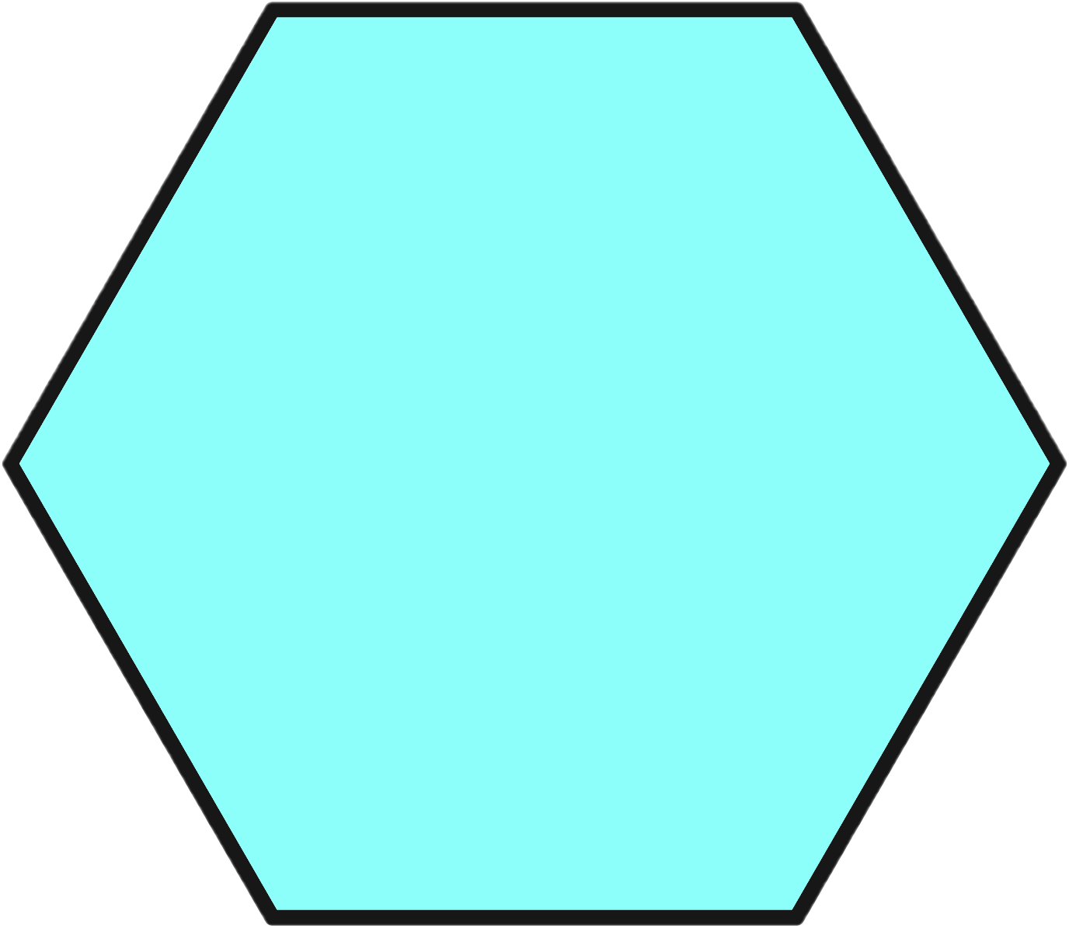
Varied Fluency 2
Identify the name of this shape.
Use a ruler and a protractor to decide whether
it is a regular or irregular polygon.
© Classroom Secrets Limited 2018

Slide 7
Varied Fluency 2
Identify the name of this shape.
Use a ruler and a protractor to decide whether
it is a regular or irregular polygon.
This is a hexagon. It is a regular polygon.
© Classroom Secrets Limited 2018

Slide 8
Varied Fluency 3
This is a regular octagon.
True or false?
© Classroom Secrets Limited 2018

Slide 9
Varied Fluency 3
This is a regular octagon.
True or false?
False.
This is an irregular octagon as there are angles and sides of different lengths.
© Classroom Secrets Limited 2018

Slide 10
Varied Fluency 4
Draw a regular pentagon.
Measure the length of each side and the size of each angle to make sure that they are equal.
© Classroom Secrets Limited 2018

Slide 11
Varied Fluency 4
Draw a regular pentagon.
Measure the length of each side and the size of each angle to make sure that they are equal.
You should have drawn a 5-sided shape.
The sides should all be the same length and all angles should measure 108°.
© Classroom Secrets Limited 2018

Slide 12
Reasoning 1
Has Toni sorted these shapes correctly? Explain your answer.
 | Regular Polygon | Irregular Polygon
Has 5 sides
Not 5 sides
A
B
D
E
F
C
© Classroom Secrets Limited 2018

Slide 13
Reasoning 1
Has Toni sorted these shapes correctly? Explain your answer.
Toni has not sorted the polygons correctly because…
 | Regular Polygon | Irregular Polygon
Has 5 sides
Not 5 sides
A
B
D
E
F
C
© Classroom Secrets Limited 2018

Slide 14
Reasoning 1
Has Toni sorted these shapes correctly? Explain your answer.
Toni has not sorted the polygons correctly because C and E are both irregular polygons as they have sides and angles of different sizes.
 | Regular Polygon | Irregular Polygon
Has 5 sides
Not 5 sides
A
B
D
E
F
C
© Classroom Secrets Limited 2018

Slide 15
Reasoning 2
Jade says:
Is Jade correct? Explain your answer.
A rhombus and a square are both regular polygons because they both have sides of equal length.
© Classroom Secrets Limited 2018

Slide 16
Reasoning 2
Jade says:
Is Jade correct? Explain your answer.
Jade is incorrect…
A rhombus and a square are both regular polygons because they both have sides of equal length.
© Classroom Secrets Limited 2018

Slide 17
Reasoning 2
Jade says:
Is Jade correct? Explain your answer.
Jade is incorrect. A square is a regular polygon as it has sides of equal length and each angle measures 90°.
However, a rhombus may have 4 sides of equal length, but it does not have 4 angles of equal size.
A rhombus and a square are both regular polygons because they both have sides of equal length.
© Classroom Secrets Limited 2018

Slide 18
Problem Solving 1
How many regular polygons can you see in this shape?
© Classroom Secrets Limited 2018

Slide 19
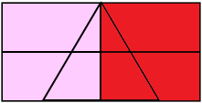
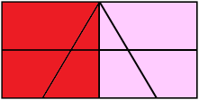
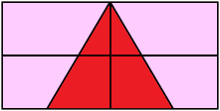
Problem Solving 1
How many regular polygons can you see in this shape?
3 regular polygons (2 regular squares and 1 regular triangle).
© Classroom Secrets Limited 2018

