Slide 1
Sunday, 06 November 2016
Minerals from the soil
WALT:
To understand where plants get the water and minerals they need and why they need them.
Level 5
recall where plants get minerals from
Level 6
describe why farmers and gardeners use fertilisers
Level 7
Explain why some plants do not need soil to survive and explain how minerals enter the plant via the roots.
state one use of minerals in a plant

Slide 2
Sunday, 06 November 2016
Go back to your leaf from last lesson…
What does the bubble wrap represent?
- It represents the stoma on the bottom of the leaf, where gases enter and leave
What does the sellotape represent?
- It represents the waxy top layer of a leaf

Slide 3
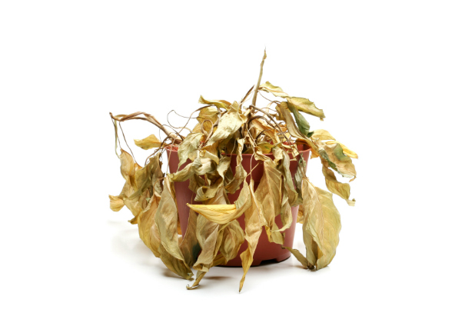
Sunday, 06 November 2016
THERE HAS BEEN A MURDER!
Barry the bush was found DEAD in his apartment last night.
It is up to you to investigate the clues and evaluate the cause of Barry’s death.
Use the evidence around the room to help you decide how Barry died.

Slide 4
Sunday, 06 November 2016
So… how did Barry die?
He was on the windowsill, so he had enough sunlight.
His soil was damp, so he had enough water.
The levels of CO₂ in the room were high…
The soil he was using was out of date…

Slide 5
Sunday, 06 November 2016
So… how did Barry die?
Barry died because he did not have enough minerals.
There was a lack of nitrogen in the soil he was using.
This caused his leaves to turn yellow, meaning he had less chlorophyll.
Because he had less chlorophyll, he couldn’t photosynthesise.
The levels of CO2 were high because he couldn’t photosynthesise.
He couldn’t use the energy from the sun to break down the CO2 and water into glucose.
He was feeling hungry all the time because he couldn’t use photosynthesis to make food.

Slide 6
Sunday, 06 November 2016
But… who murdered Barry???
Barry had recently had a fight with his friend, Simon the Sunflower.
A yellow flower had been spotted delivering soil to Barry’s apartment.
The soil in Barry’s apartment was fake – it didn’t contain enough nitrogen for Barry.
Simon the Sunflower murdered Barry by giving him fake soil with not enough minerals in it so that Barry couldn’t photosynthesise!

Slide 7
Sunday, 06 November 2016
Simon is now where he belongs…thanks to you!

Slide 8
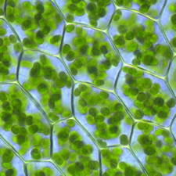
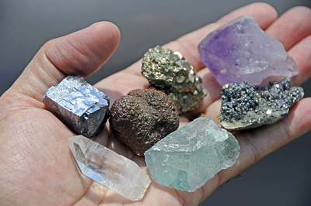
Sunday, 06 November 2016
What do plants need to survive?
Chlorophyll
Water
Carbon dioxide
Oxygen
Minerals

Slide 9
Sunday, 06 November 2016
Why do farmers add fertilisers to the ground?
Use page 45 in the student book to help answer.
Think about…
What do minerals do for a plant?
What would happen if there were no minerals?
How will this make the farmer earn more money?
EXTENSION: Use the sheet at the front to explain how water gets from the soil to the leaf of the plant.

Slide 10
Sunday, 06 November 2016
Plant fertilisers are often called ‘plant food’, but this is incorrect!
Do you agree or disagree?
Be prepared to share your answer!

