Slide 2
Today we are going to write a postcard.
First let’s do the date and wheather

Slide 3
Quel jour sommes-nous?

Slide 4
Aujourd’hui est le combien?

Slide 5
Nous sommes quel mois?

Slide 6
Quel temps fait-il Aujourd'hui?
Il fait
gris
Il fait beau
Il fait mauvais
Il fait du vent
Il neige
Il pleut

Slide 7
Quelle est la saison?
C'est le
printemps
C'est
l’ete
C'est
l’automne
C'est
l’hiver

Slide 8
Write the date in a sentence
Aujourd'hui nous sommes ………… .
C’est le ... juin 2020.
Il fait ………… et c'est ………...

Slide 9
J'écris une carte postale
I write a postcard
Today we are writing a postcard from a
holiday in a planet of our choice.
Lis et regarde l'exemple.
Read and look at the example on the next page.

Slide 10
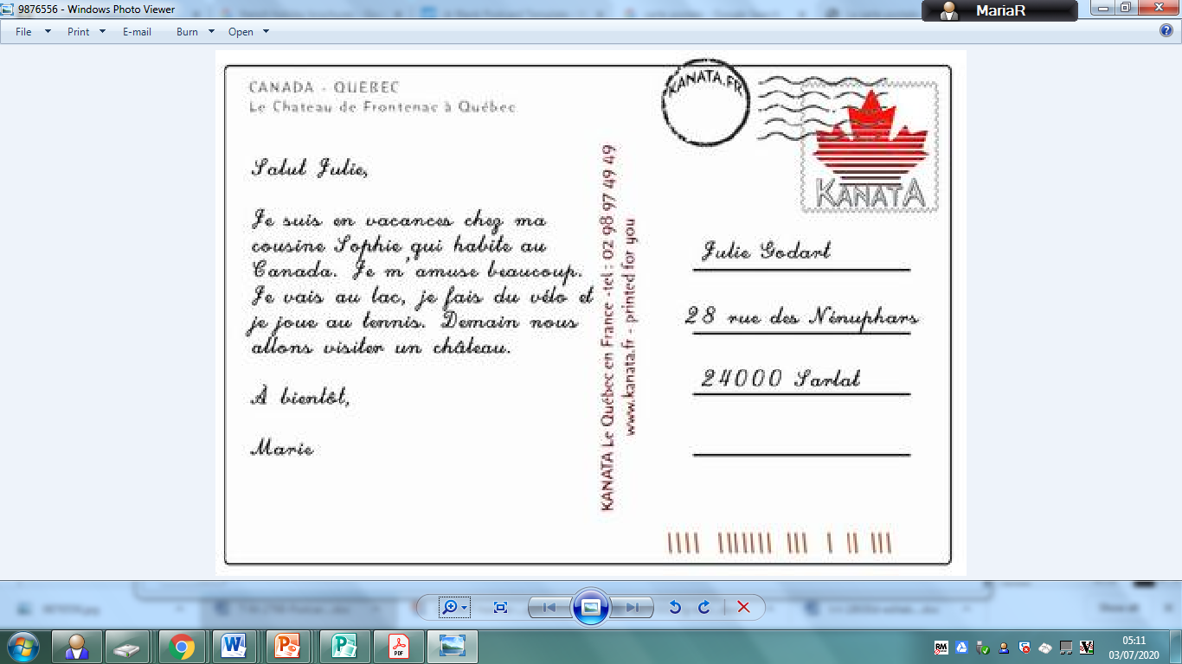
Regarde! Une carte postale! 1) Lis la carte postale. 2) Ecris toi aussi une carte postale. Ecris où tu es, ce que tu fais, quel temps il fait, si tu t'amuses bien ...
Hi Julie,
I am on holidays at my
cousin’s Sophie that lives
in Canada. I’m having a
great time. I go to the
lake, I ride a bike and play tennis. Tomorrow we are going to visit a castle.
See you soon,
Marie

Slide 11
What do you think needs to be included in a postcard?
Space for a picture (on the front)
Blank lines for an address.
Space to write about your holiday.
postcard
The name and address of who you’re sending it to.
Some writing to say what you’ve been doing on your holiday.
Space in the top right corner for a stamp.

Slide 12
A stamp in the top right corner.
Dear Tom,
We are having lots of fun on holiday. Yesterday, we went to the beach. I made a huge sandcastle and ate lots of ice cream.
Today we went to a theme park. We went on lots of scary rides but it was lots of fun!
Tomorrow we are going to go on a boat trip. I hope we see dolphins!
From Anna x
Lines for writing the address.
Tom Hill
123 High Street
Clifftop Town
HT13 4TW
Space to write about your holiday – what you have done and what you will be doing.
The name and address for who you are sending the postcard to.

Slide 13
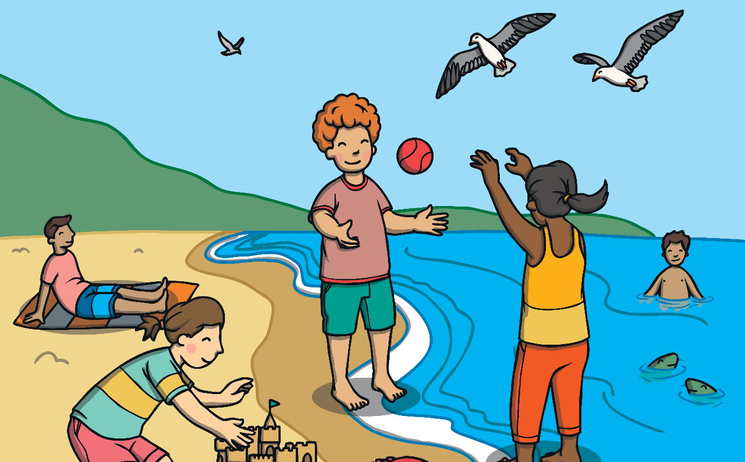
A picture on the front of your postcard showing where you are on holiday.
Dear Tom,
We are having lots of fun on holiday. Yesterday, we went to the beach. I made a huge sandcastle and ate lots of ice cream.
Today we went to a theme park. We went on lots of scary rides but it was lots of fun!
Tomorrow we are going to go on a boat trip. I hope we see dolphins!
From Anna x
Tom Hill
123 High Street
Clifftop Town
HT13 4TW

Slide 14
What might you write about in a postcard?
Maybe what you have done so far and what you are going to do?
Hier, nous sommes allés sur la planète Terre..
Yesterday we went to planet earth.
Demain, nous prendrons une fusée pour Vénus. Tomorrow we will go to Venus on a rocket.

Slide 15
STS
1) Lis la carte postale.
Read the postcard. 2) Décider à qui vous écrivez.
Decide who you are writing to.
3) Ecris ta carte postale. Write your postcard
où tu es
(Where are you?)
ce que tu fais
(What are you doing?)
quel temps il fait
(What’s the wheather like?)
si tu t'amuses bien
(Are you having a good time?)
4) Dessiner une image pour le
devant de la carte postale.
Draw a picture for the front of
the postcard.
Salut Julie,
Je suis en vacances chèz
Ma cousine ​​Sophie qui habite à Pluton. Je m’amuse beaucoup. Je regarde les étoiles je joue au tennis avec des météorites et fais du vélo sur la voie lactée.
Demain nous allons visiter une petite planète appelée Mercure.
À bientôt,
Marie
Julie Broyer
18 Rue de la Victoire
10189 Paris

