Slide 2
Aim
I can compare the life cycles of plants, mammals, amphibians, insects and birds.
Success Criteria
I can identify the stages of a bird’s life cycle.
I can describe the similarities and differences between different plants’ and animals’ life cycles.

Slide 3
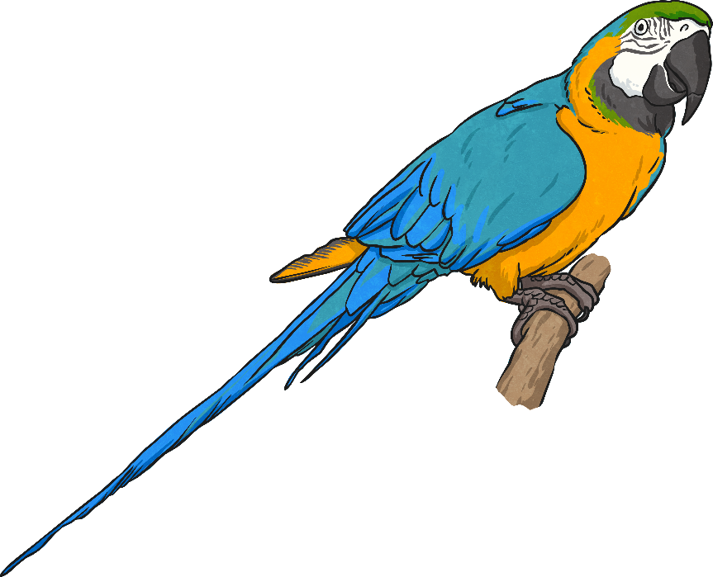
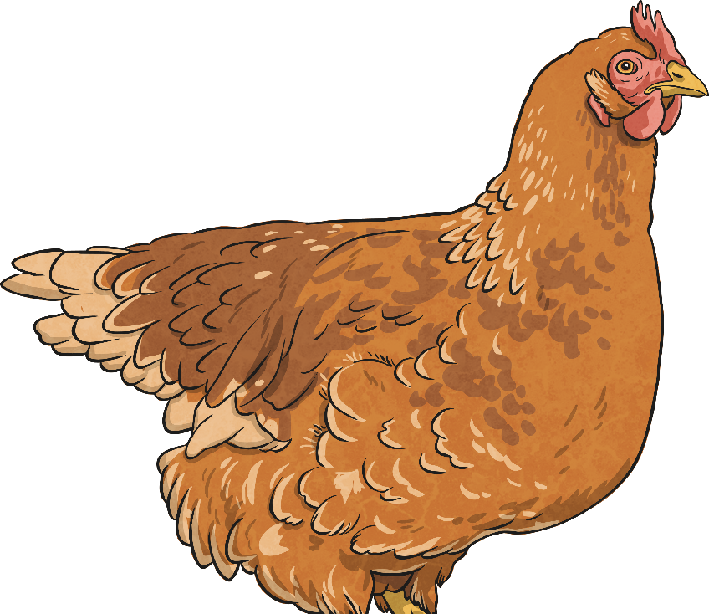
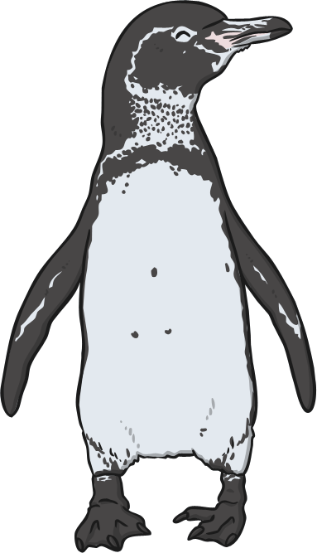
What is an Egg?
All species of birds lay eggs. If the eggs are fertilised, they will contain the bird embryo, which will develop inside the egg until it is ready to hatch.
The chicken eggs that people eat are not fertilised, so they do not contain baby chickens. However, we can explore chicken eggs to find out more about them.
What parts of an egg can you name? Tell your partner.

Slide 4
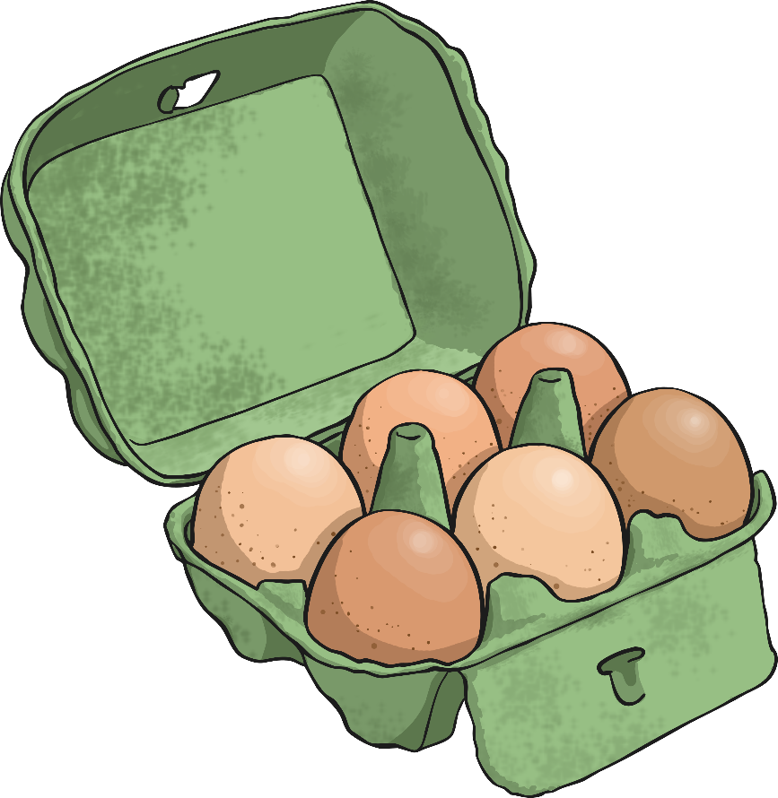
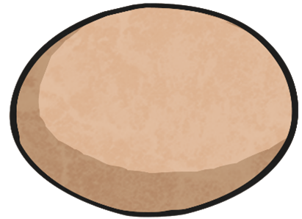
What is an Egg?
Look closely at the outside of your egg. What is this part of the egg called? What is it for?
Now crack it open. What parts of the egg can you identify? What is their function?

Slide 5
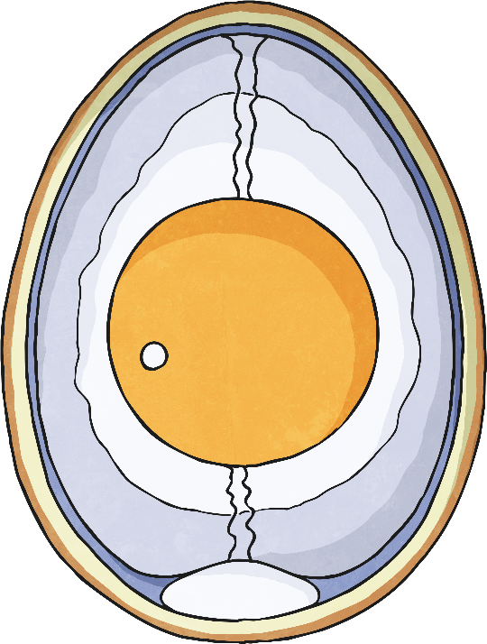
Parts of an Egg
Can you identify all these parts in the egg you have cracked open?
Chalaza - Cords that keep the yolk in the centre.
Shell membranes - The inner and outer shell membranes separate to form the air cell.
Germinal disc - If an egg is fertilised, the sperm enter through the germinal disc and travel to the centre of the yolk, where an embryo is formed.
Shell - Protects the inside of the egg. It contains thousands of small holes to allow air to move through the shell.
Albumen - The albumen is made of water and protein. It cushions the yolk and provides nutrition for a developing embryo.
Yolk - Contains proteins and fats that provide the main source of nutrition for the embryo.

Slide 6
Life Cycle of a Bird
The egg is a key stage in the life cycle of a bird. Can you put all the stages in order to show the life cycle?
The adults mate and reproduce.
The egg hatches, and the adults provide food for the chick.
A fertilised egg is laid by the female.
The young bird leaves the nest and continues to grow into an adult.
The chick grows and develops.

Slide 7
Life Cycle of a Bird
A fertilised egg is laid by the female.
The adults mate and reproduce.
The egg hatches, and the adults provide food for the chick.
The young bird leaves the nest and continues to grow into an adult.
How did you do?
The chick grows and develops.

Slide 8
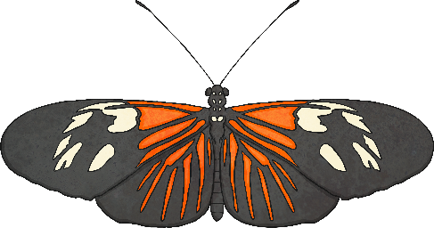
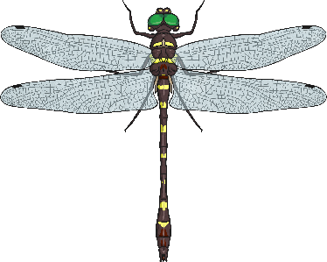
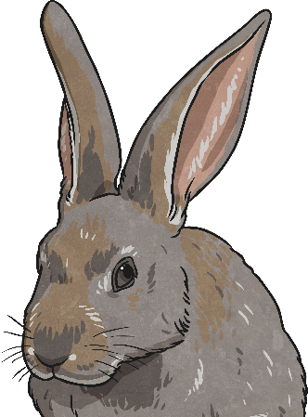
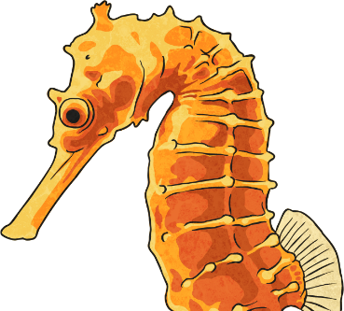
Comparing Life Cycles
Different plants and animals all have different life cycles. Their life cycles share some similarities and have some differences between them.
Watch this clip to see which stages of the life cycles of living things you can spot.
http://www.bbc.co.uk/education/clips/zp62tfr

Slide 9
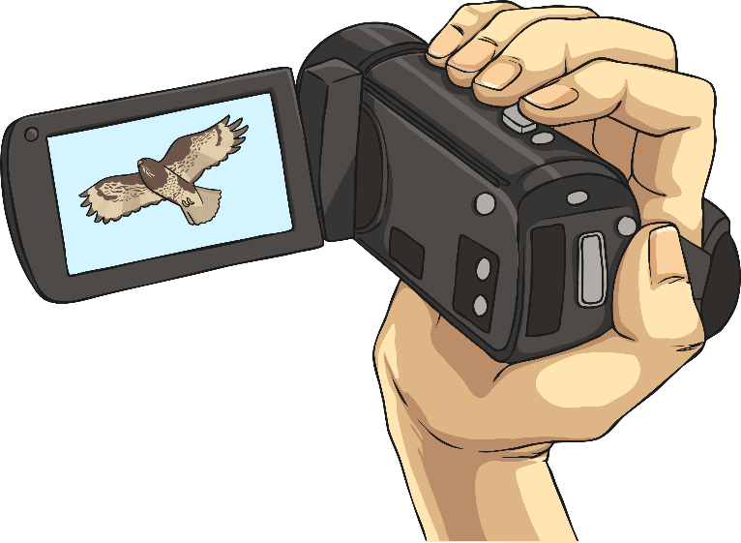
Life - Activity
You will take on the role of a wildlife documentary presenter. You have been asked to narrate a programme called 'Life', all about the life cycles of different living things and the way they reproduce.
Make sure you include the life cycles of plants, mammals, birds, insects and amphibians.
Use the planning sheet to write a script of what you would say. If you can, try to film it and upload it to Google Classroom.

Slide 10
Aim
I can compare the life cycles of plants, mammals, amphibians, insects and birds.
Success Criteria
I can identify the stages of a bird’s life cycle.
I can describe the similarities and differences between different plants’ and animals’ life cycles.

