Slide 1
Science
Living Things and Their Habitats
Year One
Science | Year 5 | Living Things and Their Habitats | Making New Plants 2 | Lesson 2

Slide 2
Making new plants
Part Two

Slide 3
Aim
I can describe how some plants reproduce.
Success Criteria
I can describe asexual reproduction in plants.
I can identify advantages and disadvantages to sexual and asexual reproduction in plants.
I can explain different ways to make new plants.

Slide 4
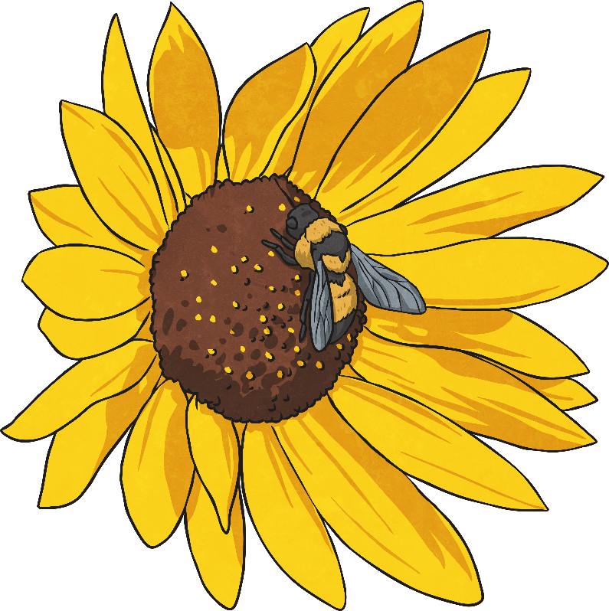
Asexual Reproduction
Some plants use sexual reproduction to make seeds, which grow to make new plants. These plants need pollen (containing the male gamete or sex cell) from one flower to fuse with the ovule (the female gamete) of another flower, which makes a seed.
However, some plants use asexual reproduction to make new plants.
Unlike sexual reproduction, asexual reproduction only needs one parent plant to make new plants.
Because there is only one parent plant, there is no fusion of gametes, and no mixing of genetic information. The new plants are identical to the parent plant. They are clones.

Slide 5
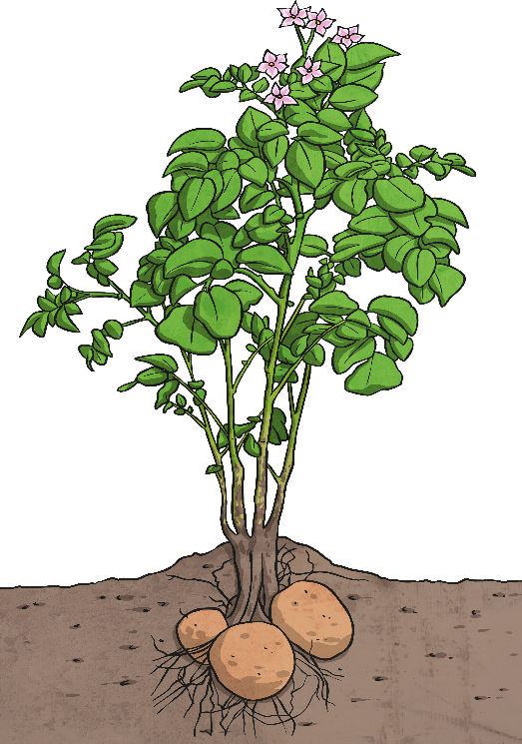
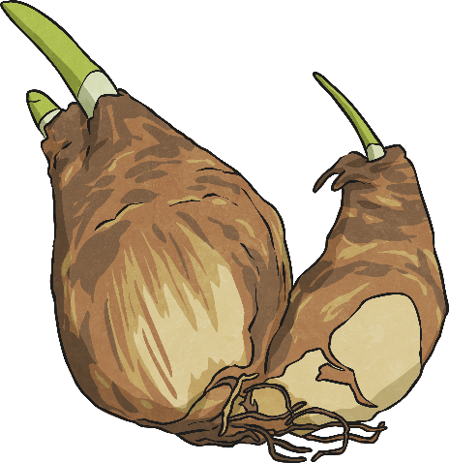
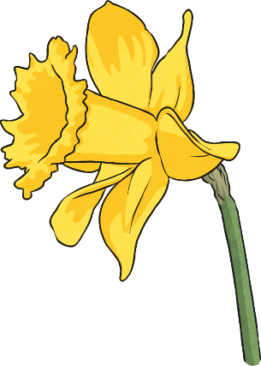
Plants That Use Asexual Reproduction
Other plants produce side branches or runners with new plantlets on. The roots of each plantlet grow down into the soil, and the plantlets will grow to form new plants identical to the parent.
Spider plants and strawberries are examples of plants that reproduce this way.
Daffodil bulbs store energy underground. Once the daffodil plant has died back, the bulb develops side shoots that will grow into new daffodils for next year.
Potato plants grow tubers underground during the spring and summer. These tubers will grow into new plants the following spring if they are left undisturbed.

Slide 6
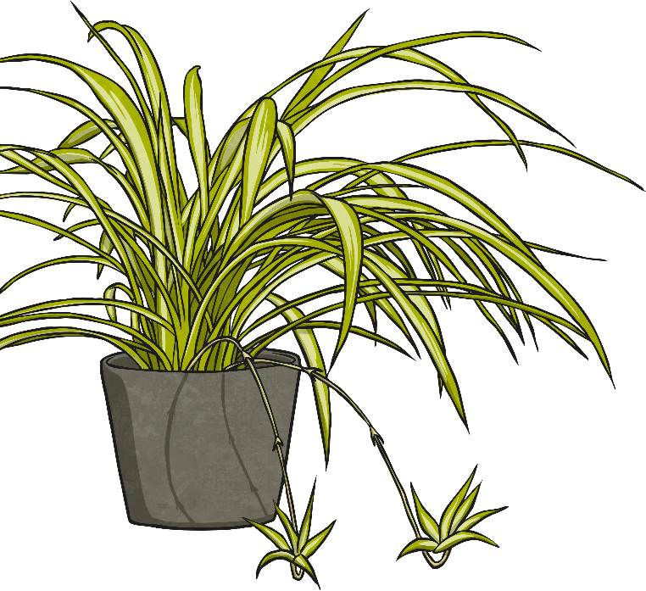
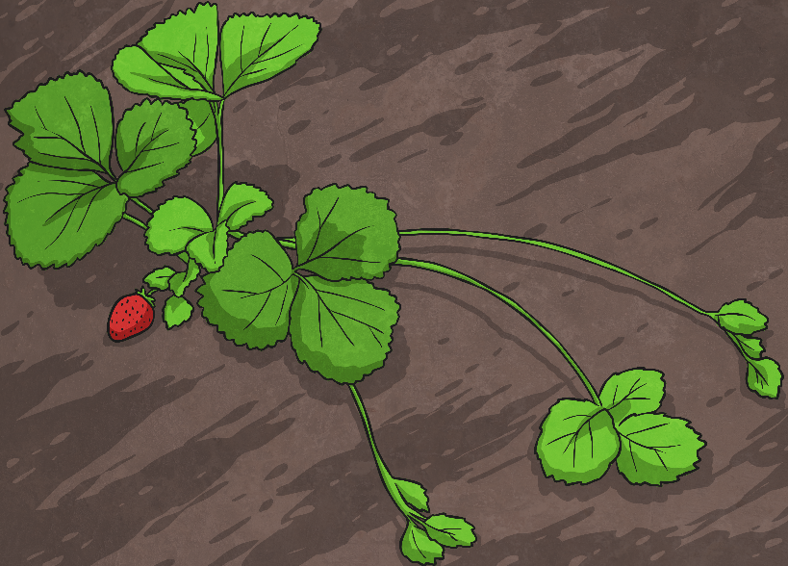
Plants That Use Asexual Reproduction
Some plants develop bulbs or tubers underground. These bulbs or tubers will develop into new plants for the following year. The new plants will be genetically identical to the parent plant.
Daffodils and potatoes are examples of plants that reproduce this way.
Strawberry plants send out runners with small plantlets on. These will each grow into a new strawberry plant.
Spider plants send out branches with baby plantlets on. Each plantlet will grow into a new plant.

Slide 7
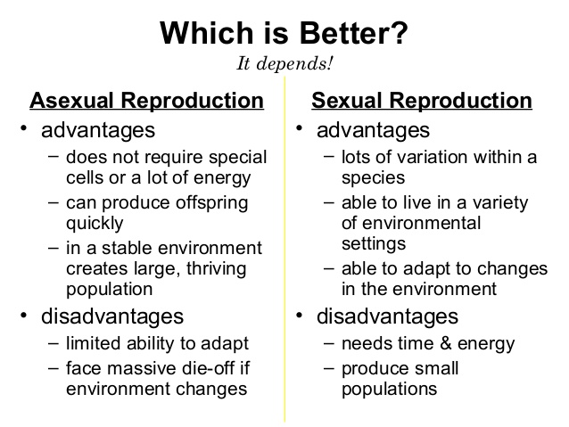
Advantages and Disadvantages
There are advantages and disadvantages to plants using sexual or asexual reproduction. Have a look at the statements on your activity sheet and decide which statements belong in each category.

Slide 8
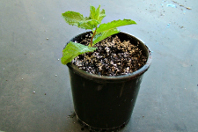
New plants from cuttings
Taking Cuttings
Many plants reproduce asexually such as the spider plant or strawberry. These plants would be genetically identical (clones) to the parent plant. Plant breeders can take advantage of this by taking ‘cuttings’ (taking a piece of a plant to make more plants)
Taking cuttings is a fantastic way to make new plants from the ones that are already in your garden. It’s called ‘propagating’ and it means to grow a plant from the stem of another plant.
It’s best to take cuttings when the plant isn’t flowering and when there is nice new growth such as at the beginning of spring. Plants that are sick or stressed will probably not produce very good cuttings.
Watch these to see how cuttings are done!
https://youtu.be/9Oo5FH7CoyI
https://youtu.be/TLCiB1vQnyQ
Taking Cuttings
Taking cuttings is a fantastic way to make new plants from the ones that are already in your garden. It’s called ‘propagating’ and it means to grow a plant from the stem of another plant. It’s inexpensive and it’s fun!
It’s best to take cuttings when the plant isn’t flowering and when there is nice new growth such as at the beginning of spring. Plants that are sick or stressed will probably not produce very good cuttings.

Slide 9
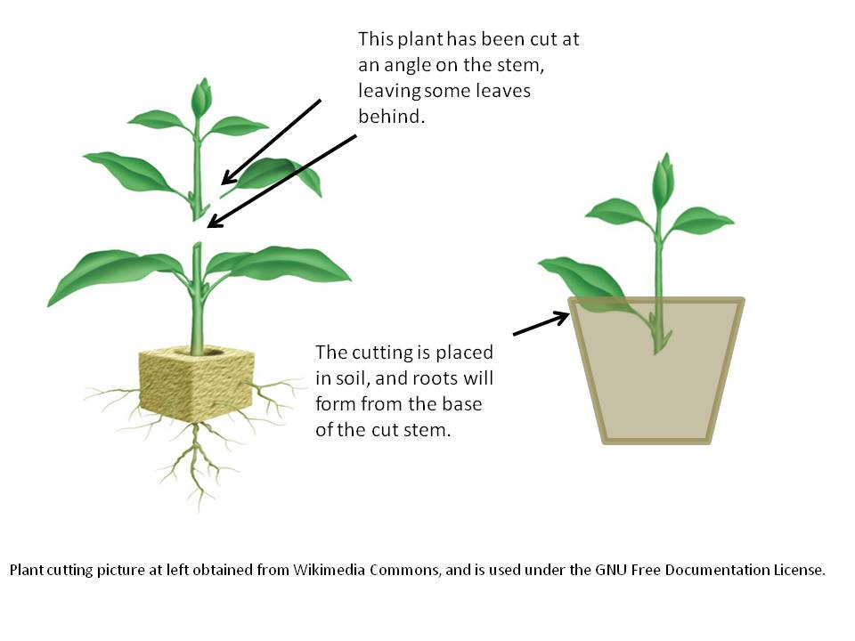

Slide 10
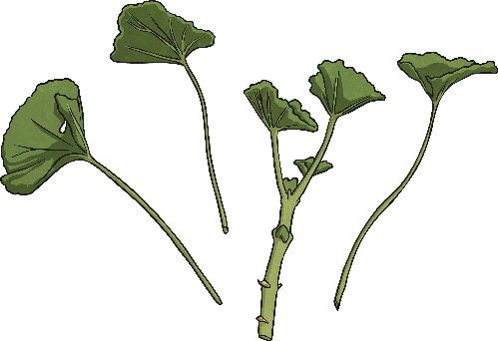
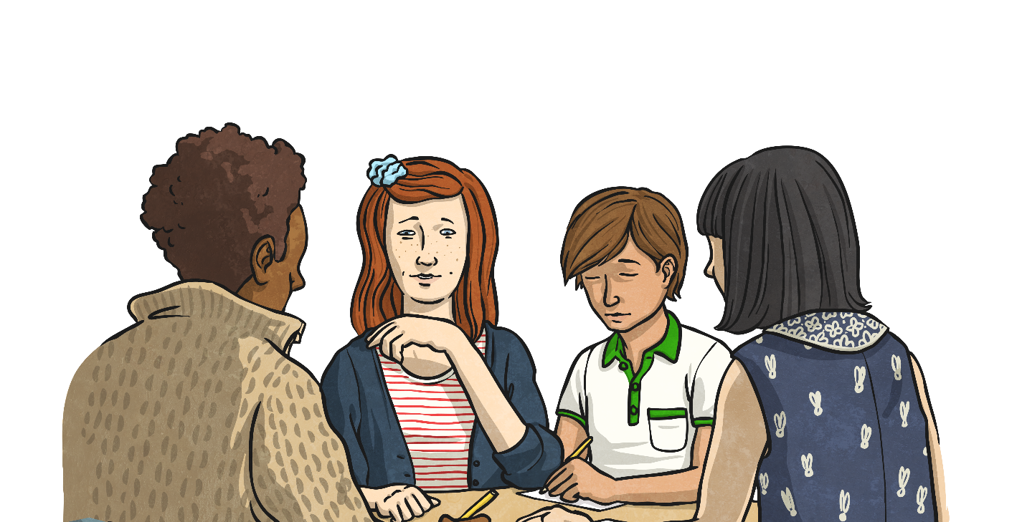
What’s New?
Tell your partner three new things you have learnt today.
Include two things about asexual reproduction and one thing about taking plant cuttings.

Slide 11
Aim
I can describe how some plants reproduce.
Success Criteria
I can describe asexual reproduction in plants.
I can identify advantages and disadvantages to sexual and asexual reproduction in plants.
I can explain different ways to make new plants.

