Slide 1
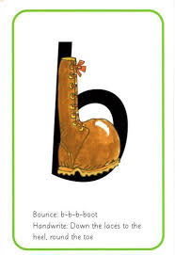
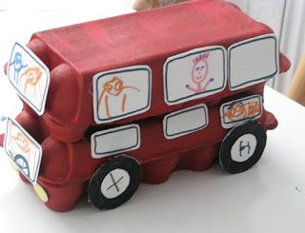
LEARNING FROM HOME
Nursery– Week Beginning 1.6.2020
This week’s book focus is ‘Naughty Bus’
https://www.youtube.com/watch?v=sqQ1BAEj1oE
Click on the above link to listen to the story on YouTube.
Who was the author?
Advised Timetable:
Read a story every day.
Practise writing your name every day or other familiar sounds.
Complete a phonics and numeracy activity every day.
Complete at least 1 activity from other areas each day.
Take part in rhyme time every day.
Literacy:
What do you think the ‘Naughty Bus’ will be about?
Can you remember what happens in the story?
Talk about your favourite parts of the story.
Numeracy activity:
Can you go on a counting walk?
What shapes are the windows, doors and wheels?
What colour are they?
How many wheels does it have?
Phonics Sound ‘b’
The rhyme for letter formation:
Down the laces to the heel, round the boot!
Can you look around your house and find things beginning with that sound?
Can you practise writing ‘b’?
Expressive art and design:
What transport can you see and hear outside the window?
Can you make own bus using junk modelling?
What shapes do you need?
Physical development
https://www.youtube.com/watch?v=EtXObwSbtDs
Can you sing along and do the actions for the Wheels on the Bus?

