Slide 1
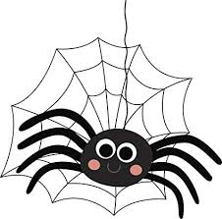


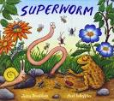
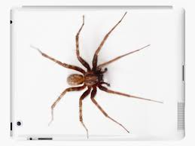
LEARNING FROM HOME
Nursery– Week Beginning 11.5.2020
This week’s book focus is ‘Superworm’
https://www.youtube.com/watch?v=7Jnk3XApKBg
Click on the above link to listen to the story on YouTube.
Who was the author?
Advised Timetable:
Read a story every day.
Practise writing your name every day.
Complete a phonics and numeracy activity every day.
Complete at least 1 activity from other areas each day.
Take part in rhyme time every day.
Phonics Sound ‘w’
The rhyme for letter formation:
Down up, down up!
Can you look around your house and find things beginning with that sound?
Can you practise writing ‘w’?
Numeracy: Can you draw a spider
How many legs do you think a spider has?
Can you count how many it has to find out?
Can you sing ‘Incy Wincy Spider’?
Have a go at writing the numbers!
Can you count backwards?
Literacy:
Can you recap the story ‘Super Worm?’
What characters are in the story?
What happens in the beginning?
What happens in the middle?
What happens in the end?
Physical development
https://www.youtube.com/watch?v=YAJynCIsNUg
Do the cations to the rhyme!
How does a spider move?
Can you move like a spider?
Expressive art and design
Get Creative and Recycle!
Can you collect some recycling materials and make a spider?
What will you use for the body and legs?
How are you going to stick it together?

