Slide 1
World War 2: Propaganda

Slide 2
Learning Intentions
By the end of today you should be able to:
Explain what propaganda is and why it was important during WW2.
Use a propaganda slogan from WW2 and design a poster using this slogan.
Use planning effectively to create interesting poster designs.

Slide 3
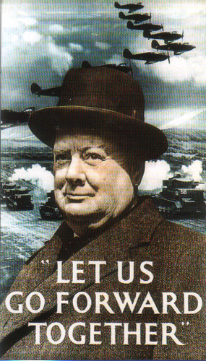
Look at the poster:
1.Who is in the poster?
2.What message is it putting across?
3.How would it make people feel?

Slide 4
Propaganda
Propaganda was used to influence the public in different ways. Propaganda was usually posters displayed on the streets or leaflets.
German aircraft would often drop leaflets from the sky, to influence British people that their government was wrong.
Why do you think posters the best way to get information to the British public?

Slide 5
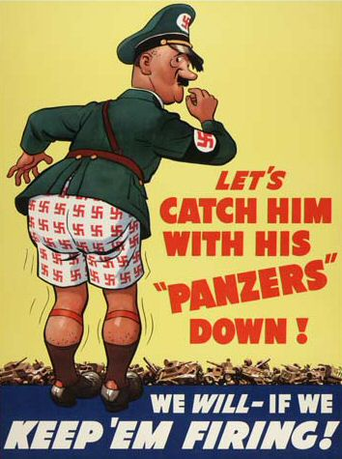
Who is in the picture?
What message is the poster putting across?
What would this poster influence the public into thinking?

Slide 6
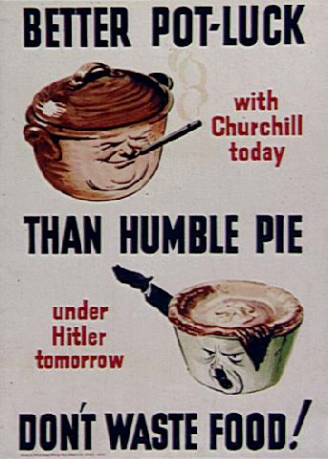
What does the poster mean by humble pie?
What is the poster encouraging people to do?

Slide 7
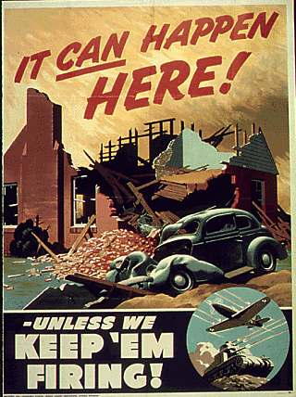

Slide 8
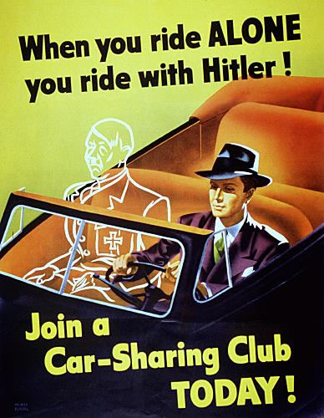

Slide 9
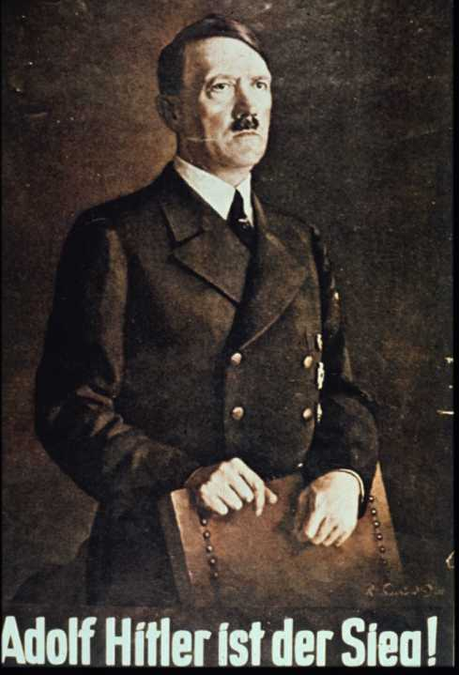
German Propaganda
What do you think it says down the bottom of the poster?
What was the purpose of this poster?

Slide 10
German Propaganda
The German government often displayed propaganda to influence the German population that Jewish people were weak.
They also used posters to make the concentration camps or ‘work camps’ fun and interesting places to be.

Slide 11
Think……
Why do you think propaganda a vital weapon during the war?

Slide 12
Propaganda Slogans
‘Dig for Victory’
‘Make do and Mend’
‘Keep Calm and Carry on’
‘Tittle Tattle lost the battle’

Slide 13
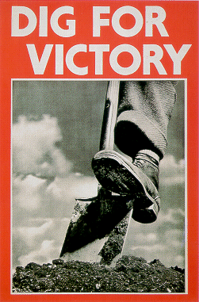

Slide 14
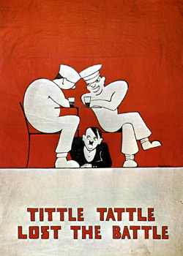

Slide 15
