Slide 1
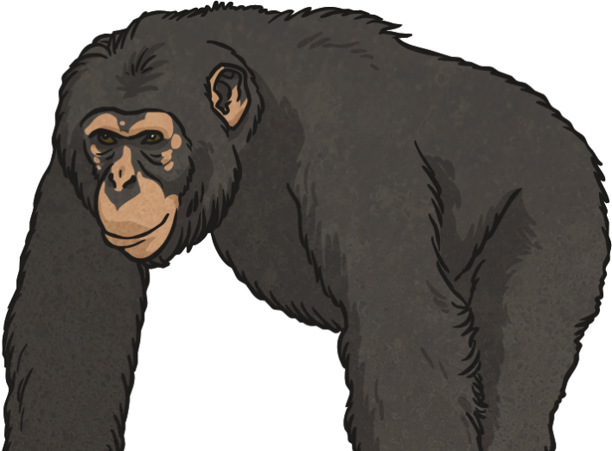
Chimpanzees in Danger
100 years ago there were around 1 million chimpanzees in Africa. Scientists believe that there are now less than 200 000 left in the wild. The species has already disappeared from 4 African countries, and chimpanzees are nearing extinction in several other countries.
What do you think is causing them to be endangered?

Slide 2
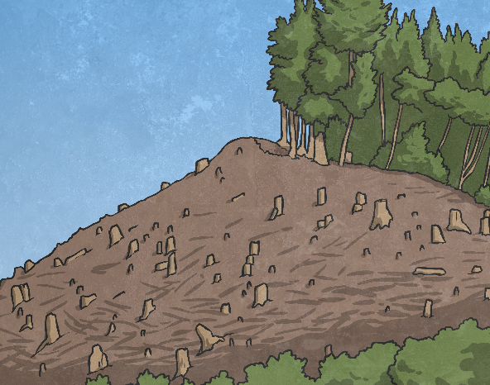
Chimpanzees in Danger
There are many threats to the survival of the chimpanzee species:
Wars and conflict in the areas in which the chimpanzees live also cause habitat loss and can result in deaths of chimpanzees.
Poachers hunt and kill chimpanzees for bush meat, which is sold to people living in cities.
Baby chimpanzees are taken illegally to be exotic pets.
Chimpanzees lose their habitats when forests are cut down for timber or to clear space for farming.
Diseases can affect chimpanzees, and can drastically reduce their population.
All these threats prevent the chimpanzee life cycle from continuing in its normal way. This will eventually lead to the species becoming extinct.

Slide 3
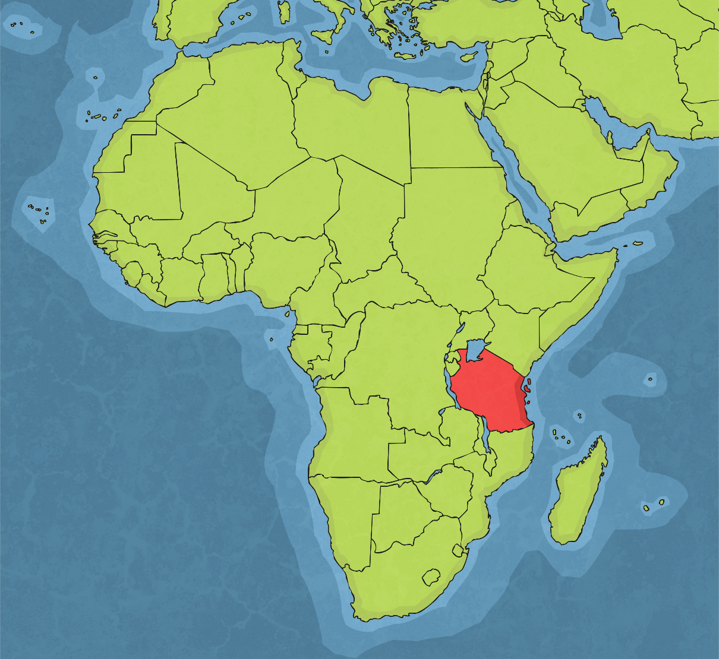
Asking for Help
Chimpanzees do still live in Tanzania, and the Gombe Stream chimpanzees are still living in the area where they were originally observed by Jane Goodall.
The Jane Goodall Institute was set up by Goodall to protect the wild chimpanzees that are left in Africa.
The Institute supports sanctuaries and public education programmes to protect chimpanzees in the wild. It raises money for these programmes and developments through donations from the public.

Slide 4
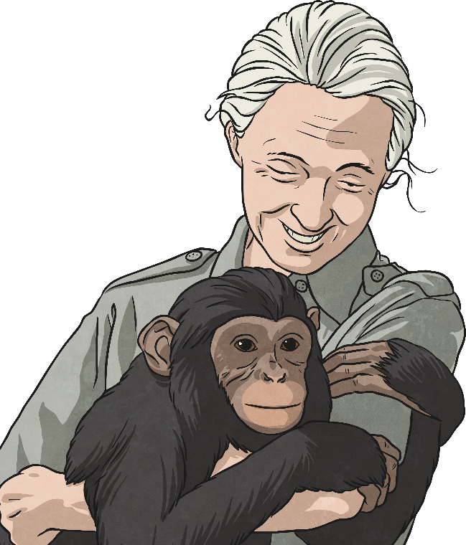
Asking for Help - Activity Two
Imagine that you have been asked to create an advert to ask people to help the Jane Goodall Institute save endangered chimpanzees by donating some money.
In your advert, you should tell people about Jane Goodall and why chimpanzees are endangered.
You can choose what your advert should look like. You may be able to design a poster or leaflet, or act out a television or radio advert.
Use the Advert Activity Sheet to plan your ideas.
Please help save the chimpanzees!

Slide 5
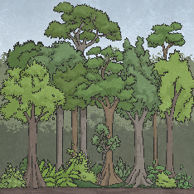
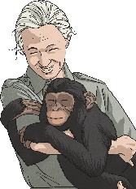
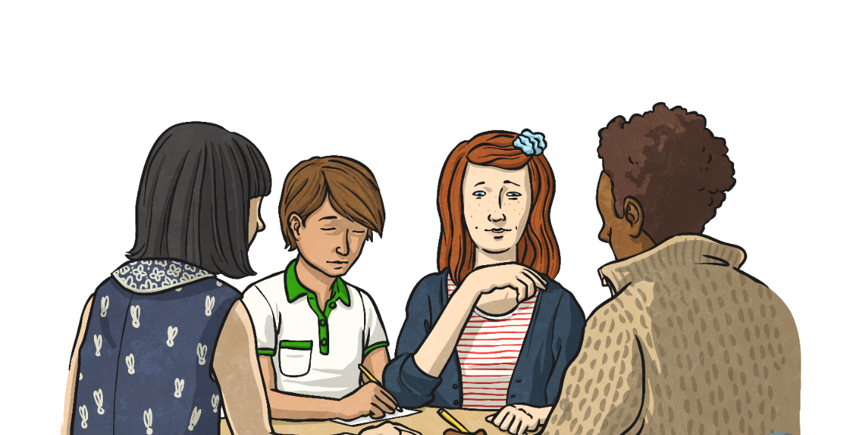
Evaluation - Activity Three
Evaluate your advert:
Does the advert tell you about Jane Goodall?
Does it inform you about chimpanzees and why they are endangered?
Think of two good things about your advert..
Think of one change that would make your advert even better.
Show your advert to another person. What do they think?

Slide 6
Use the advert planning sheet to help you complete your advert and evaluation.
If you do it in your home learning, remember to upload it to Google classroom.

