Slide 2

Newspapers have a range of features that attract the reader.
Can you think of any of these features?
Next
Next

Slide 3


the name of the newspaper at the top;
A newspaper report must include…
Next
an interesting headline and sub-headline;
an introductory paragraph that includes the five Ws;
Next
writing in the third person and past tense;
Next
Next
quotes written as direct speech;
captions for
all pictures;
“
Next
”
Next
a conclusion paragraph
to explain what might
happen next.
facts about the main events;
Next
Next

Slide 4

A newspaper report must include…
write the name of the newspaper at the top?
HEADLINE
create an interesting headline and sub-headline?
Newspapers use the headline to try to grab the readers’ attention. It might even use a pun, rhyme or alliteration. Which one of these catchy headlines makes you want to read more?
start with an introductory paragraph that includes
five Ws?
write in the third person and past tense?
Next
use quotes written as
direct speech?
add captions to all pictures?
“
”
finish with a conclusion paragraph to explain what might happen next?
include facts about the main events?

Slide 5
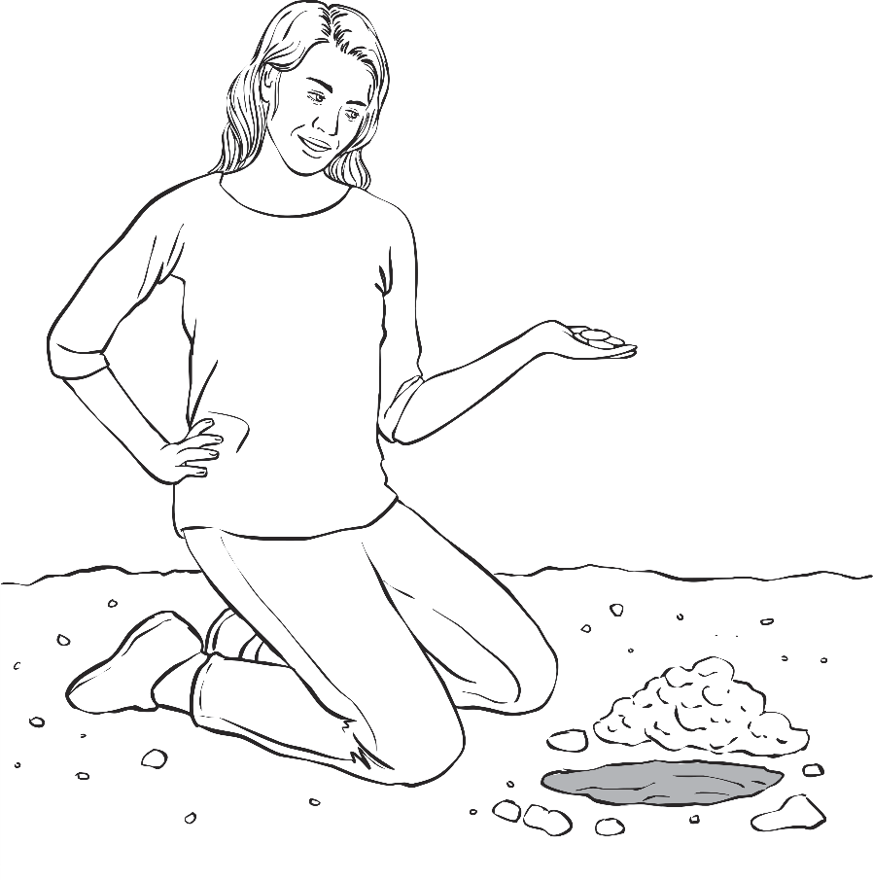
HEADLINE
ROMAN COIN SURPRISE FOR MRS SHIP
Newspapers use the headline to try to grab the readers attention. It might even use a pun, rhyme or alliteration. Which one of these catchy headlines makes you want to read more?
Next

Slide 6
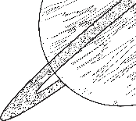
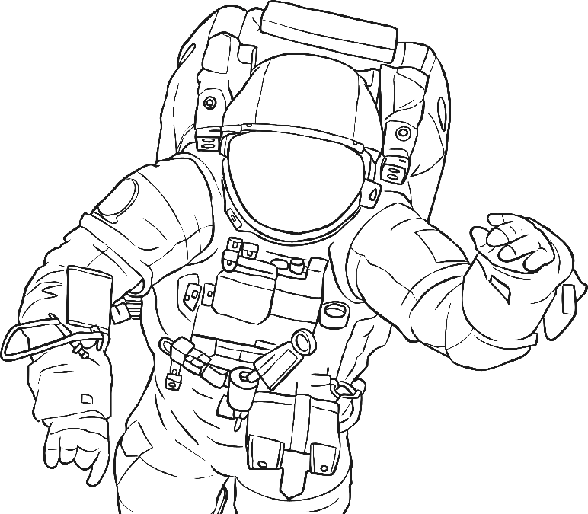
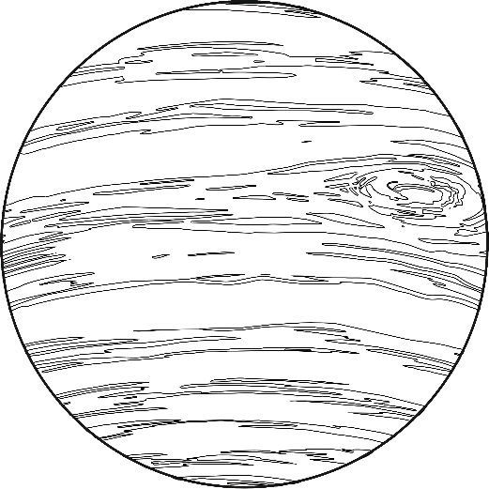
ROMAN COIN SURPRISE FOR MRS SHIP
BACK TO EARTH
WITH A BUMP!
Next

Slide 7
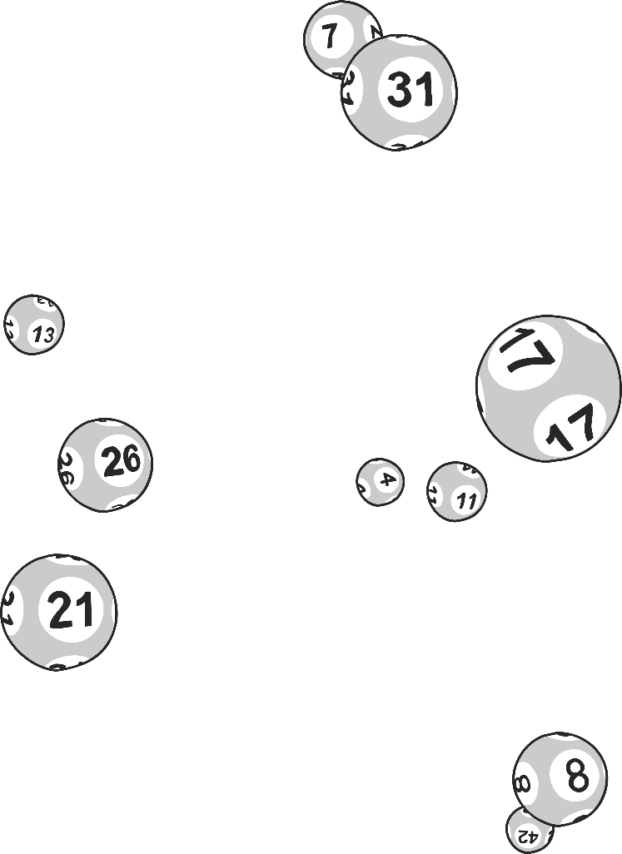
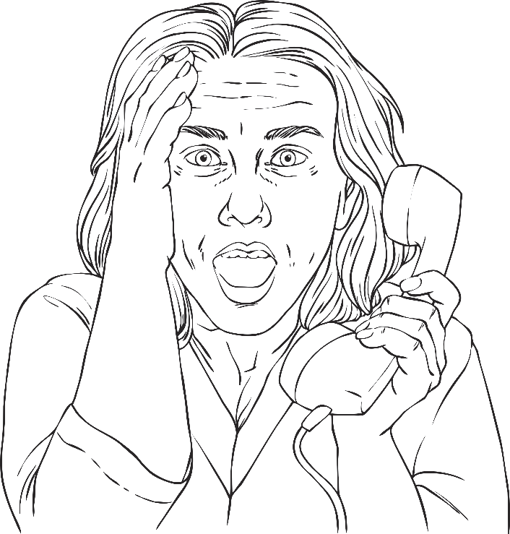
LUCKY LOTTERY WINNERS… WIN AGAIN!
BACK TO EARTH
WITH A BUMP!
Next

Slide 8
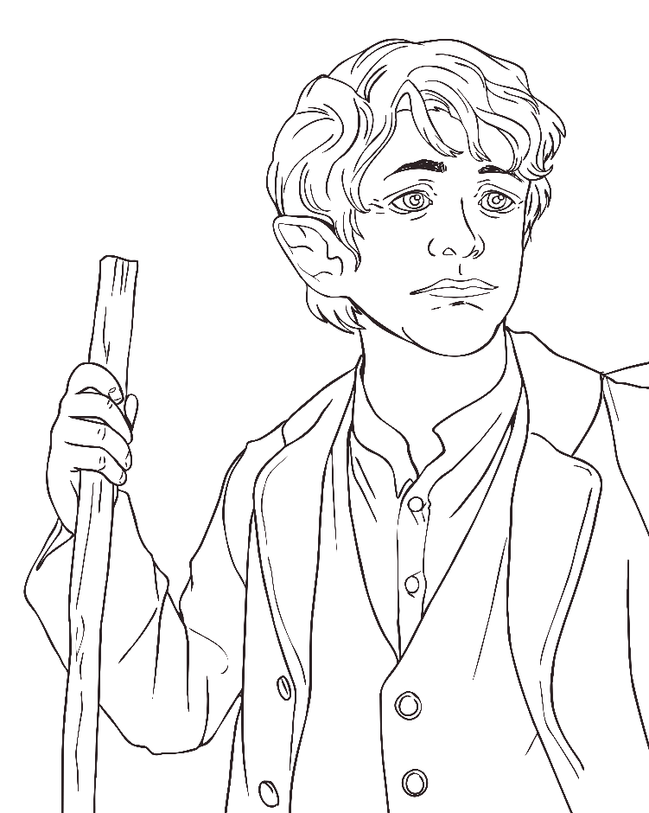
LUCKY LOTTERY WINNERS… WIN AGAIN!
BAGGINS IS BACK!
Next

Slide 9
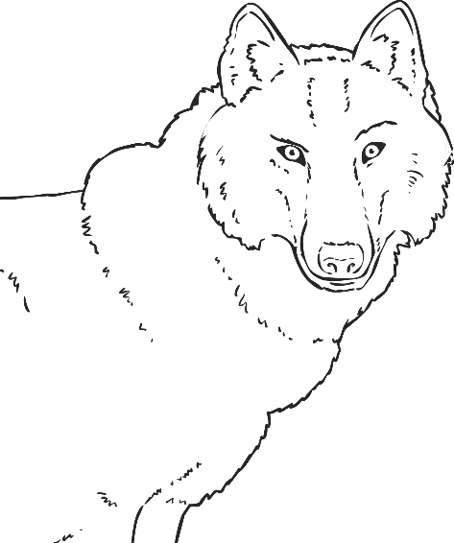
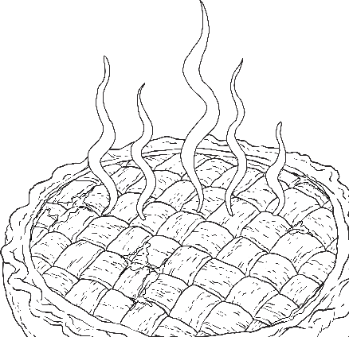
BAGGINS IS BACK!
WICKED WOLF
GETS HIS
JUST DESSERTS
Next

Slide 10
Introductory Paragraph
A newspaper report begins with an introductory paragraph that includes the five Ws.
Next
What
happened?
When did
it happen?
Where did
it happen?
Next
Next
Next
Who was involved?
Why did
it happen?
Next
Next

Slide 11
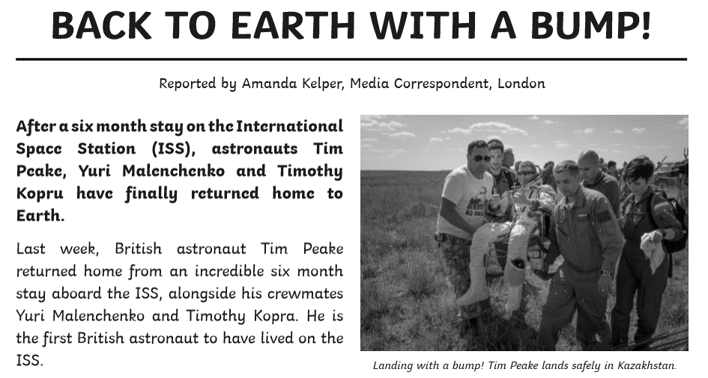
After a six month stay on the International Space Station (ISS), astronauts Tim Peake, Yuri Malenchenko and Timothy Kopra have finally returned home to Earth.
Last week, British astronaut Tim Peake returned home from an incredible six month stay aboard the ISS, alongside his crewmates Yuri Malenchenko and Timothy Kopra. He is the first British astronaut to have lived on the ISS.
Can you spot the five Ws in the start of this report?
Next

Slide 12
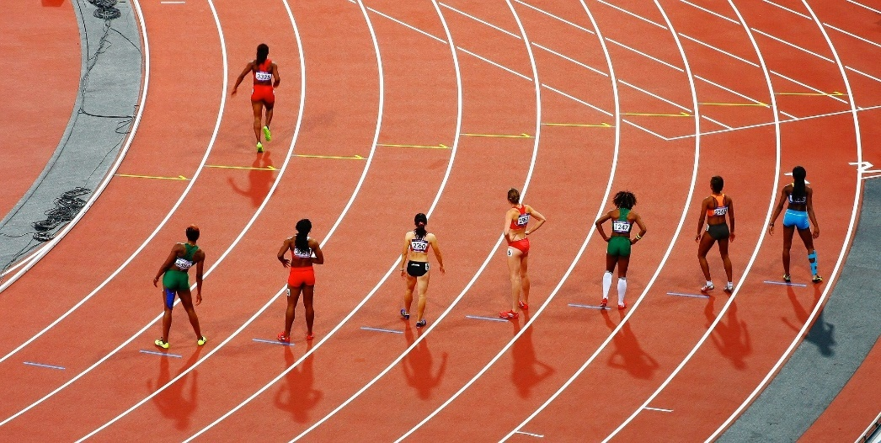
Captions and Pictures
Photos and captions will help to tell the story by giving the reader a snapshot of what has happened, where it happened
or who it happened to.
A caption explains to the reader what is happening in a picture. The caption is usually placed underneath
the picture.
Next
Next
What do you think
a report using this
picture would
be about?
Next

Slide 13

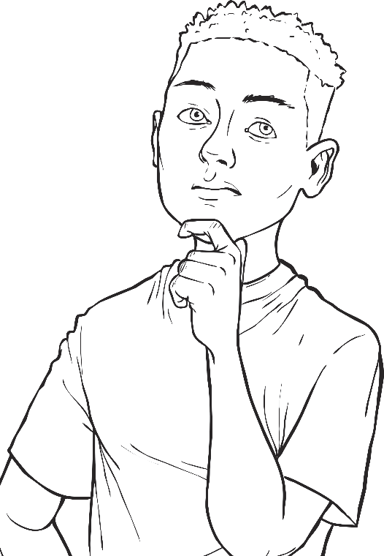
Facts about the Main Events
Captions and Pictures
A newspaper must give information that is factually correct about the events. Can you decide which of these sentences you think are facts and which are opinions?
Photos and captions will help to tell the story by giving the reader a snapshot of what has happened, where it happened
or who it happened to.
A caption explains to the reader what is happening in a picture. The caption is usually placed underneath
the picture.
What do you think
a report using this
picture would
be about?
Next

Slide 14
The man had a beard and wore a black coat.
I am the smartest person in the class.
Next
Next
Yellow is the best colour.
You shouldn’t go swimming in the sea.
Next
It took the runner 84 days to complete the extreme race.
Next
Mrs James lives at 103 Blake Drive.
Next
The truck arrived to pick up the jewels at 3 o’clock.
Next
Next

Slide 15
The man had a beard and wore a black coat.
Facts
Opinions
I am the smartest person in the class.
I am the smartest person in the class.
The man had a beard and wore a black coat.
Next
Next
Yellow is the best colour.
It took the runner 84
days to complete the extreme race.
Yellow is the best colour.
Next
Next
You shouldn’t go swimming in the sea.
You shouldn’t go
swimming in the sea.
It took the runner 84 days to complete the extreme race.
Next
Mrs James lives at
103 Blake Drive.
Next
Mrs James lives at 103 Blake Drive.
Next
The truck arrived to pick up the jewels at 3 o’clock.
The truck arrived to pick up the jewels at 3 o’clock.
Next

Slide 16
Write in the Third Person and Past Tense
Facts
Opinions
The man had a beard and wore a black coat.
I am the smartest person in the class.
Third Person
Write about what happened to others (e.g. he, she, they, them, it), not from your own perspective.
It took the runner 84
days to complete the extreme race.
Yellow is the best colour.
Past Tense
Newspaper articles are normally an example of a recount text. They are written in the past tense as the event has already taken place.
You shouldn’t go
swimming in the sea.
Mrs James lives at
103 Blake Drive.
The truck arrived to pick up the jewels at 3 o’clock.
Next

Slide 17
Quotes
Quotations tell us what has been said and who has said it. They can help to make the story credible by giving the reader the opinions of the people involved. Remember to use inverted commas!
“
”
Next

Slide 18
“We were all jumping around and dancing in the living room. We never believed it could happen again,” Alisha commented.
During these checks, Peake was asked how it felt to be home, “The smells of Earth are so strong and it’s wonderful to be back in the fresh air.”
Next
Next
“It’s a brilliant feeling. It’s been a long road. I’m happy, but I’m relieved. It’s great to be in the history books as one of the greatest. I’m proud of myself,” he told reporters.
“Sally asked me to stop working because I was about to hit whatever she’d seen. I hadn’t even spotted them,” commented builder Karl Webb.
Next
Next

Slide 19
Concluding Paragraph
A concluding paragraph is often used to tell the reader what might happen next.
Next

Slide 20
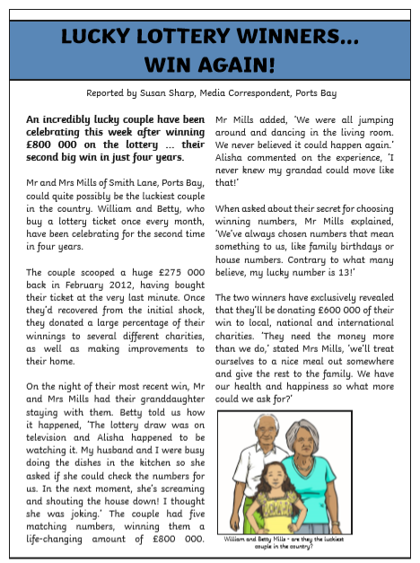
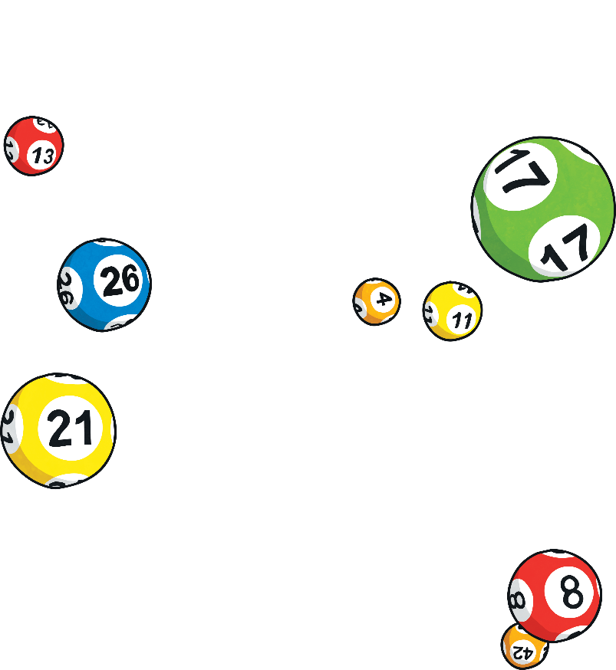
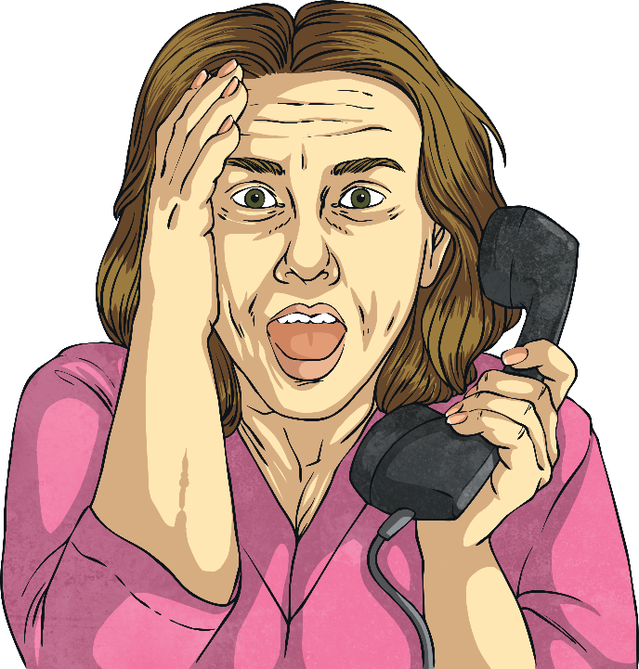
What do you think might happen next in this report about some very lucky lottery winners?
Click next to reveal what happened next.
The two winners have exclusively revealed that they’ll be donating £600 000 of their win to local, national and international charities. ‘They need the money more than we do,’ stated Mrs Mills, ‘we’ll treat ourselves to a nice meal out somewhere and give the rest to the family. We have our health and happiness so what more could we ask for?’
Next
Next

Slide 21
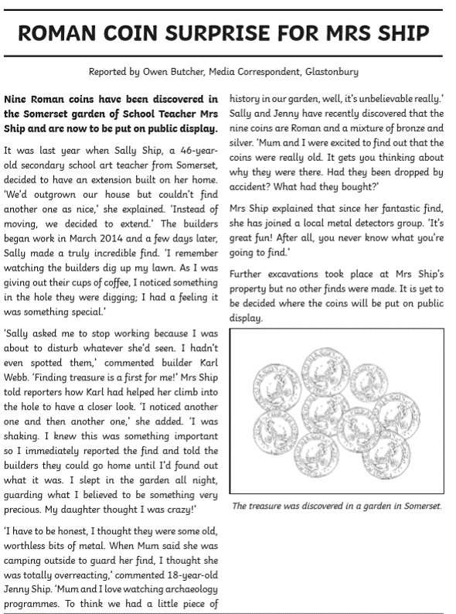
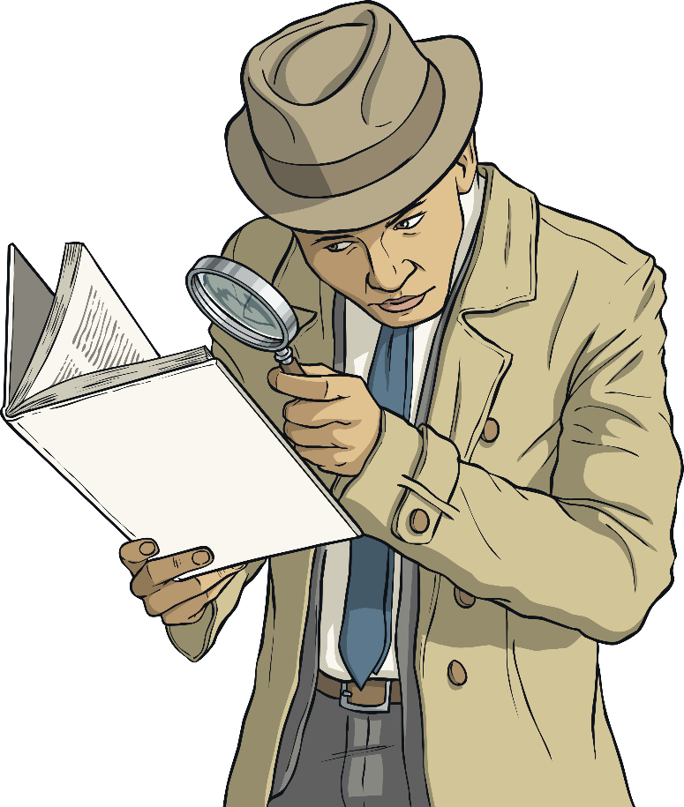

TWINKL TIMES
What features do you need to remember to include in your newspaper report?
Take a look at this example,
how many features can you find?
Next

Slide 22
TWINKL TIMES
What features do you need to remember to include in your newspaper report?
TWINKL TIMES
The name of the newspaper at the top of the page.
An interesting headline.
Take a look at this example,
how many features can you find?
Next
Next
Write in the third person and past tense.
An introductory paragraph
that includes the five Ws.
Next
Next
A final concluding paragraph explains what might happen next.
Facts about the main events.
Next
Next
Captions are added to pictures.
Quotes are written as direct speech.
Next
Next

Slide 23
write the name of the newspaper at the top?
Use this checklist to help you write your own newspaper report about Stanley stealing the sneakers in Holes.
A Newspaper Report Checklist
Did I…
Next
create an interesting headline and sub-headline?
start with an introductory paragraph that includes
the five Ws?
Next
write in the third person and past tense?
Next
Next
use quotes written as
direct speech?
add captions to all pictures?
“
Next
”
Next
finish with a conclusion paragraph to explain what might happen next?
include facts about the main events?
Next
Next

Slide 24
Main Activity:
Write a newspaper report using the following headlines (you can change them in you want):
Young boy found to be guilty of stealing famous trainers!
Young boy sent to camp for his crimes, stumbles across fortune and proves his innocence!
Make sure you include all the features of a newspaper report.
Look at the example in the folder for more help – it is even labelled with Y6 writing criteria. You might be able to magpie language features!

