Slide 2
Aim
To recognise the features of acrostic poems.
Success Criteria
I know that acrostics have a topic word hidden in the first letter of each line.
I can look for the poem’s theme by reading the first letters vertically.
I understand that acrostics don’t have to rhyme.

Slide 3

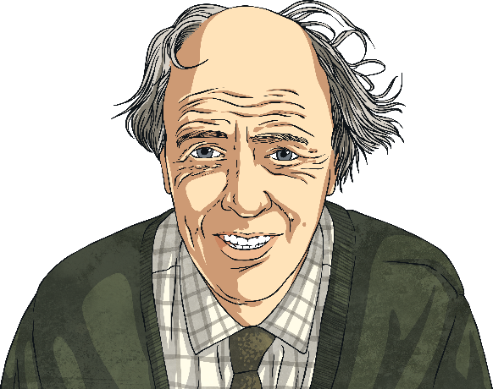
Acrostic Examples
What is each poem about?
R
O
A
L
D
D
A
H
L
Revolting rhymes
Oompa-Loompas
Angry farmers
Lazy aunts
Dangerous witches
Dream blower
Adventurous animals
Horrible headteacher
Lickable wallpaper
I
C
E
C
R
E
A
M
It’s my favourite food
Cold as the inside of a fridge
Every sunny day
Can’t wait
Running to the van
Empty out the money
‘Any sauce on that, love?’
Mmmmmm, yummy!

Slide 4
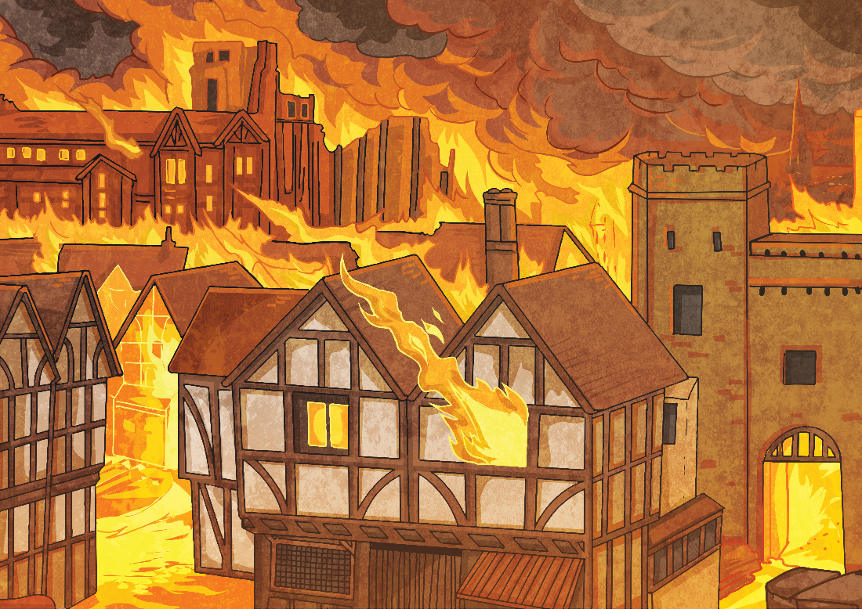
Acrostic Examples
What is the poem about?
Gigantic flames
Remember 1666
Every child knows
Ash floated everywhere
Thousands of homes destroyed
Flames all around
Inside the bakery
Red sky
Everything covered in soot
Over the city
From house to house
Lots of people escaped
On foot, by boat and carriage
Nearly every house
Demolished
On Pudding Lane – Help! Help! But
Not many people died.
G
R
E
A
T
F
I
R
E
O
F
L
O
N
D
O
N

Slide 5
Acrostic Features
What did you notice?
Poetic devices may be used.
The first letter of each line spells out the poem’s theme vertically – what’s this one about?
alliteration
simile
I
C
E
C
R
E
A
M
It’s my favourite food
Cold as the inside of a fridge
Every sunny day
Can’t wait
Running to the van
Empty out the money
‘Any sauce on that, love?’
Mmmmmm, yummy!
Lines can be different lengths

Slide 6



Let’s Try It!
How can we write an acrostic poem?
First, we need to choose a theme. I know, let’s have…
fireworks!
Then, we think of lots of words or phrases associated with that theme…
night
spectacular
smoke
bonfire
pop
bang
fizz
noise
crackle
rocket
stars
explosion
sparkle

Slide 7


Let’s Try It!
How can we write an acrostic poem?
Next, we write the letters of our theme word(s) vertically
down the page in CAPITAL LETTERS…
F
I
R
E
W
O
R
K
S
fireworks

Slide 8
Let’s Try It!
How can we write an acrostic poem?
Finally, we use our list of words and phrases to create each line. Don’t worry if you can’t think of them in order – it’s fine to go back and add any missing lines afterwards.
F
I
R
E
W
O
R
K
S
lames flicker in the bonfire
watch the sparks fly up
ockets zoom into the night
verywhere the smell of smoke
aiting for the next explosion
ohh... Ahhh… Wow!
oaring crowds of onlookers
aleidoscope of colours
eems to go on forever

Slide 9

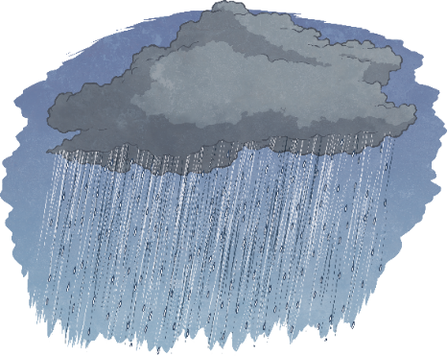

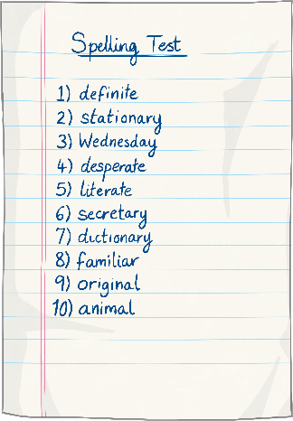

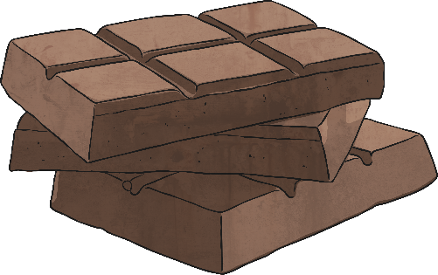
Your Turn!
Here are some themes for an acrostic.
Which one would you choose?
rain
autumn
Christmas
homework
chocolate
holidays

Slide 10
Plenary
What have you learnt about acrostics?
Acrostic poems have their theme or
title written down the page vertically
Write the theme letters in CAPITALS.
Each line starts with a letter of the theme word(s).
Acrostics don’t have to rhyme, but all the other poetic devices (alliteration, similes, rhythm, etc.) are great!

