Slide 1
CHRISTOPHER COLUMBUS
When people in Europe began to explore the rest of the world

Slide 2
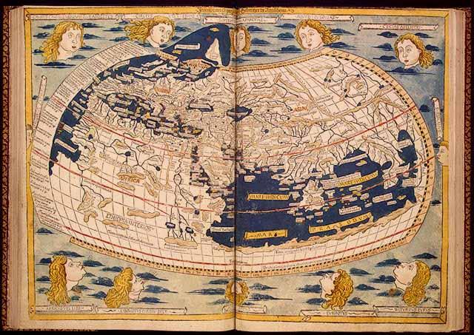
Map of world before explorations
The above map is the map of what people thought the world looked like before the 1400’s.

Slide 3
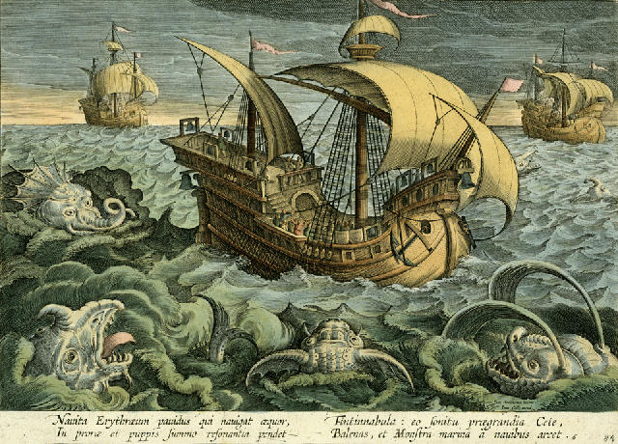
WHY did people not know what the world REALLY looked like?
People had no idea what the world really looked like because there was a fear of the unknown.
People believed that:
There were sea monsters
The further south you travelled you would boil
The world was flat and you would fall off the edge

Slide 4
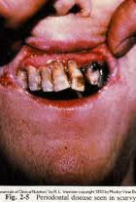
Another reason why
At this time, if people went on long sea journeys there was no way of keeping food fresh.
Without continued fresh food many sailors would develop an illness called scurvy.
Scurvy is caused by a lack of vitamin C. It resulted in people:
Losing teeth
Scaly, dry skin
Hair falling out
Bleeding in the muscles
Stopping of bone growth

Slide 5
Why explore?
There were three main reasons why Europeans wanted to explore
TRADE
RELIGION
EMPIRE BUILDING
Notes:
Ask students first

Slide 6
trade
Europeans had, up to this point in history, had trade links with India, China and the Spice Islands
Spices and silks were very valuable commodities in Medieval Europe because they were used in cooking, medicines and dye for clothes
Getting these goods would take months and years
Then the trade routes became dangerous with the growth of the
Turkish Empire
The Muslim Turks were enemies of the European Christians
The European population also began to rise and therefore there
was a greater demand on these goods

Slide 7
2. religion
At this time, most Europeans were Christian
Europeans believed it was there duty to spread the
message of the Christian God
As a result most of the ships that went on these journeys
brought with them priests and the aim was to convert people in the countries they conquered to Christianity

Slide 8
3. Empire building
Many European countries wanted to build empires
They wanted to control new lands and exploit the natural resources
Europeans thought that they were superior (better) than the people of the countries they conquered

Slide 9
What helped them explore?
New ship called a caravel
New navigational instruments

Slide 10
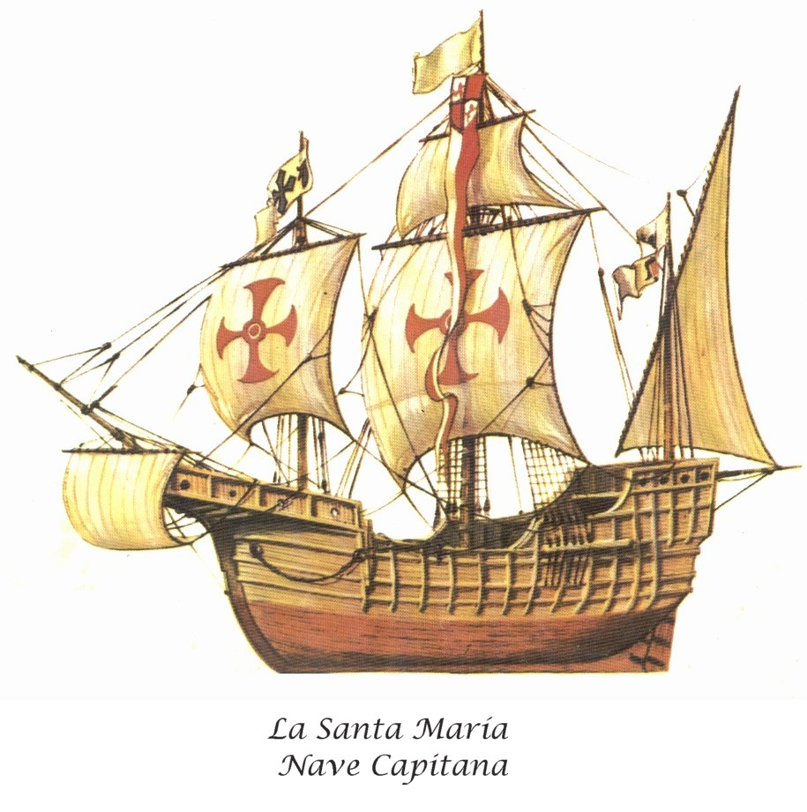
The caravel
The new ship was better able for the rough Atlantic Ocean
The ships were clinker built (over lapping timbers to withstand the strong Atlantic waves)
The ships also had lateen sails which made them easier to navigate

Slide 11
2. New instruments
The compass
The astrolabe
The quadrant
Portolan charts

Slide 12
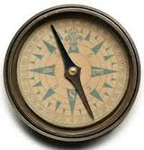
I. the compass
The compass allowed sailors to know which direction they were traveling in. The magnet will always point north if you’re north of the equator

Slide 13
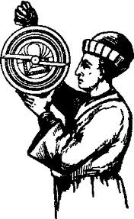
Ii. the astrolabe
The astrolabe measured the latitude by studying the sun during daylight hours

Slide 14
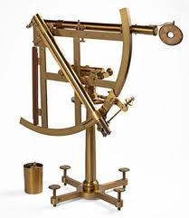
Iii. the quadrant
The quadrant was used to measure the latitude by studying the position of the stars in the night sky

Slide 15
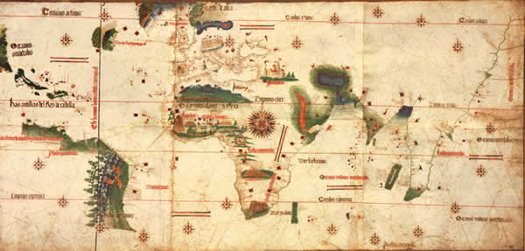
iv. Portolan charts
Portolan charts were maps of the sea. They recorded the shape of the coast line, winds and depth of water.
Log, line and knots was how sailors measured the speed of the ship.

Slide 16
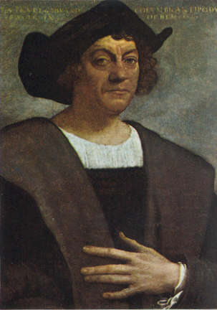
Christopher Columbus
His exploration that led to the discovery of America

Slide 17
Columbus
Born in Genoa, Italy
Served in Portuguese navy
Believed that the world was a sphere
Was sponsored by Spain
Set sail in 1492

Slide 18
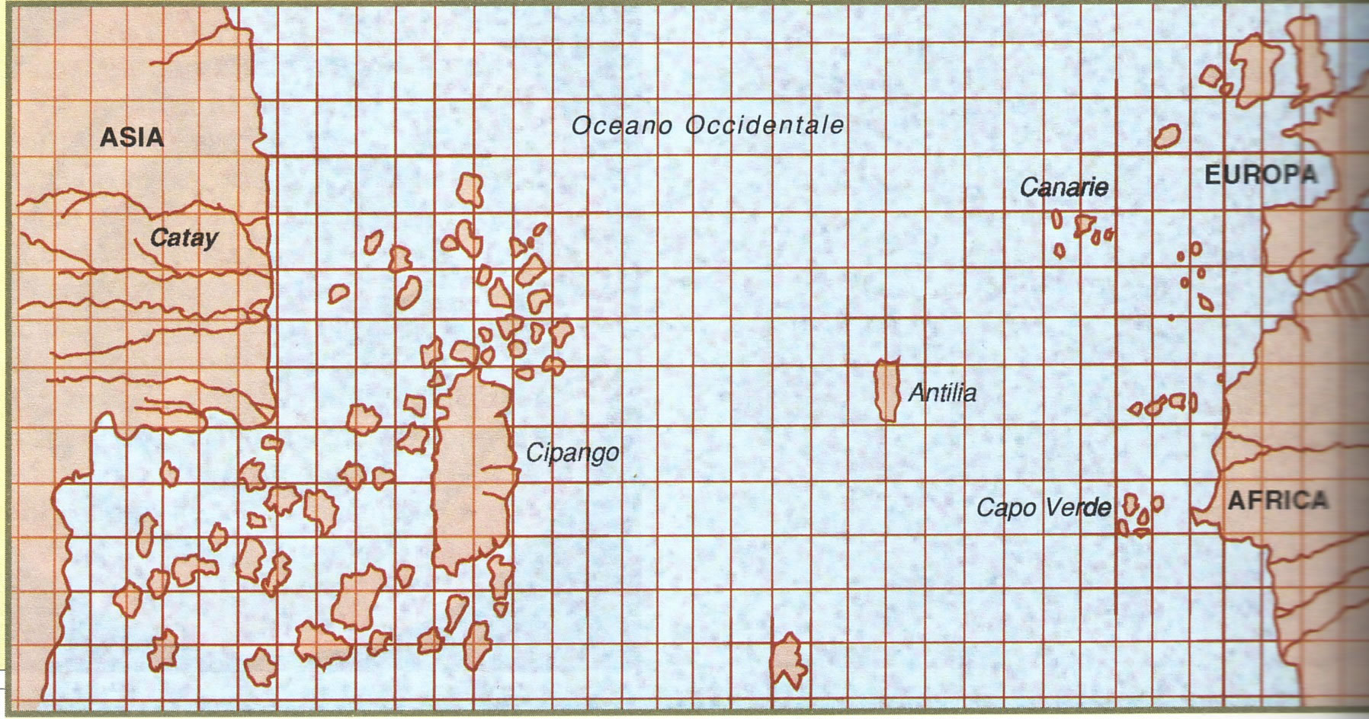
What Columbus thought
Why in your opinion, is that part of the map showing the west coast of Africa so detailed?
Mention two errors on the western side of the map
CATAY = CHINA
CIPANGO = JAPAN

Slide 19
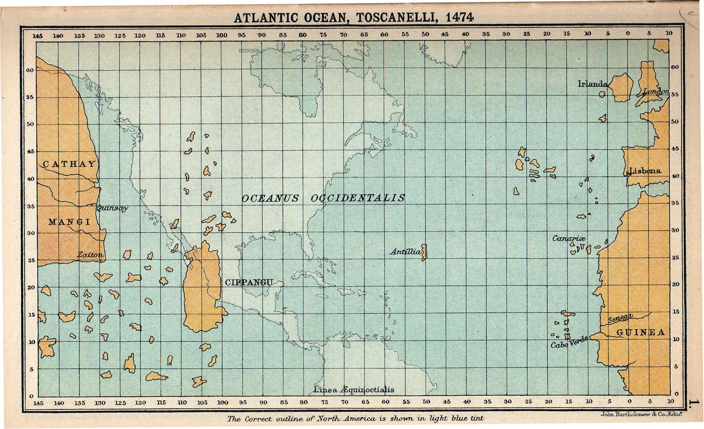
The same map with u.s.a.

Slide 20
Sponsorship?
What is sponsorship?
Why do you think that Columbus needed sponsorship?
What do you think he needed?

Slide 21
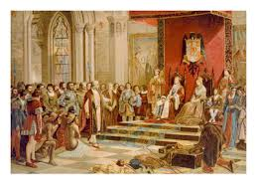
Sponsorship
Journeys of great exploration were very expensive and the people with money were the monarchs of Europe
Columbus sought sponsorship from Portugal to fund his journey
Portugal refused as they were happy with the African route
Columbus went to Spain where the King & Queen, Ferdinand and Isabella, agreed to sponsor him
Notes:
What is sponsorship? Why?

Slide 22
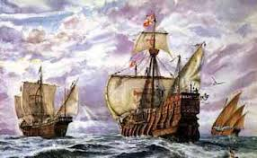
Voyage one
Columbus had three ships
The Nina, Pinta and the Santa Maria
The set sail in 1492
Stopped in the Canary Islands
Columbus thought the entire journey would take three weeks
Sailors began to get scurvy
Columbus kept two logs
One log was the true distance the other a false account so that the sailors wouldn’t panic
After over two months land was discovered (San Salvador).

Slide 23
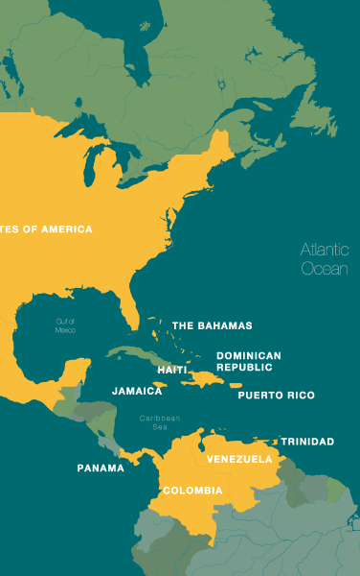
Where had Columbus landed?
Columbus was convinced that he had finally landed in Asia.
He had in fact landed in what is known today as the Caribbean Islands

Slide 24
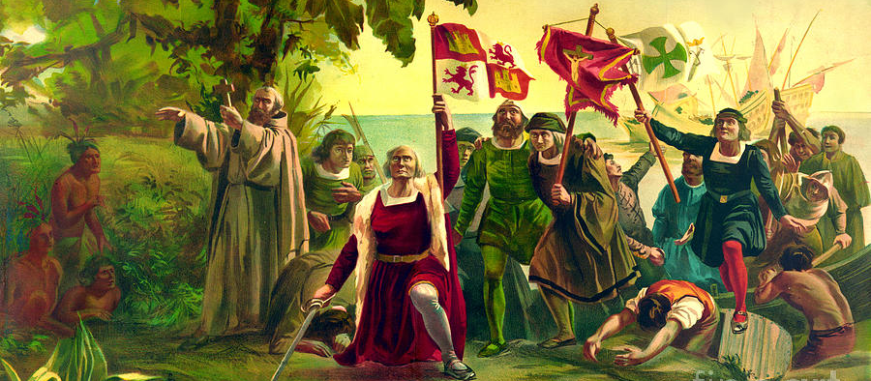
The landing
What do you notice about the picture?
Notes:
How are they dressed? Would you say this is realistic? Why draw like this?

Slide 25
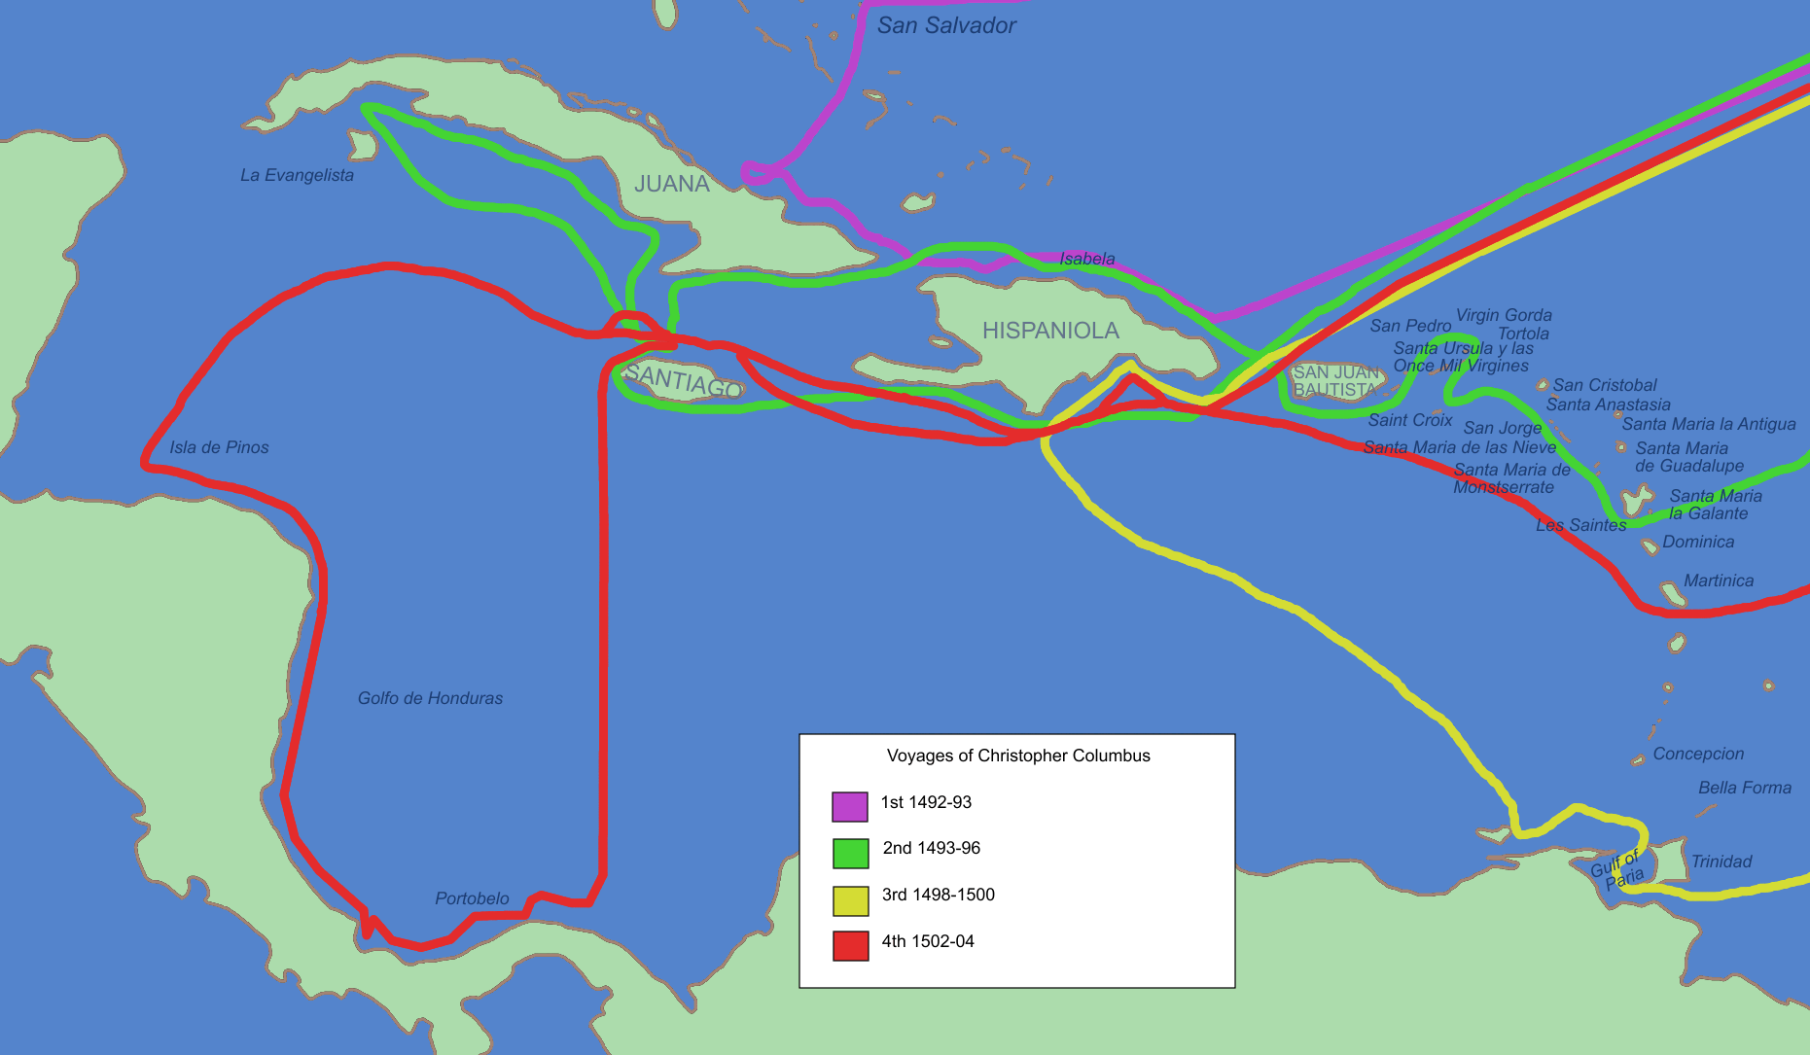
On the islands
Columbus spent the three months exploring the islands of the Caribbean.
He placed the Spanish flag and Christian cross on the island
He called the locals Indians
Discovered the islands of Cuba and Hispaniola

Slide 26
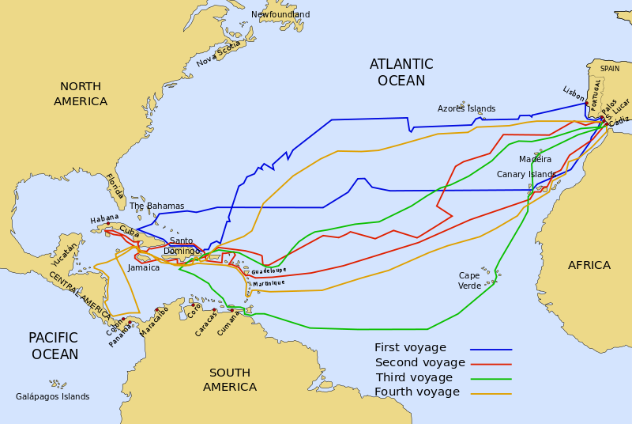
Columbus & the four journeys
Between 1492 and his death in 1506 Columbus undertook four more exploration trips to the new islands.

Slide 27
Final years
He was still convinced, up to his death, that he had discovered Asia.
Columbus was made governor of the new lands discovered
He could not understand why he couldn’t find the big Asian cities
Many more people followed the journey of Columbus
These people were extremely cruel to the locals, murdering and torturing them
Columbus was later charged with cruelty but proved his innocence
He died in 1506 a bitter and disappointed man

Slide 28
MORE ABOUT COLUMBUS
Watch this video for more information about Columbus:
https://www.bbc.co.uk/teach/class-clips-video/ks2-christopher-columbus/z7j3hbk
Notes:
Once a plan has been agreed essay can be type up.

Slide 29
activities
Complete the Christopher Columbus comprehension activity.
Create a story map about Christopher Columbus’ life and journeys.

