Slide 1


Science
Animals Including Humans
Year One
Science | Year 6 | Animals Including Humans | The Circulatory System: Parts | Lesson 1

Slide 2
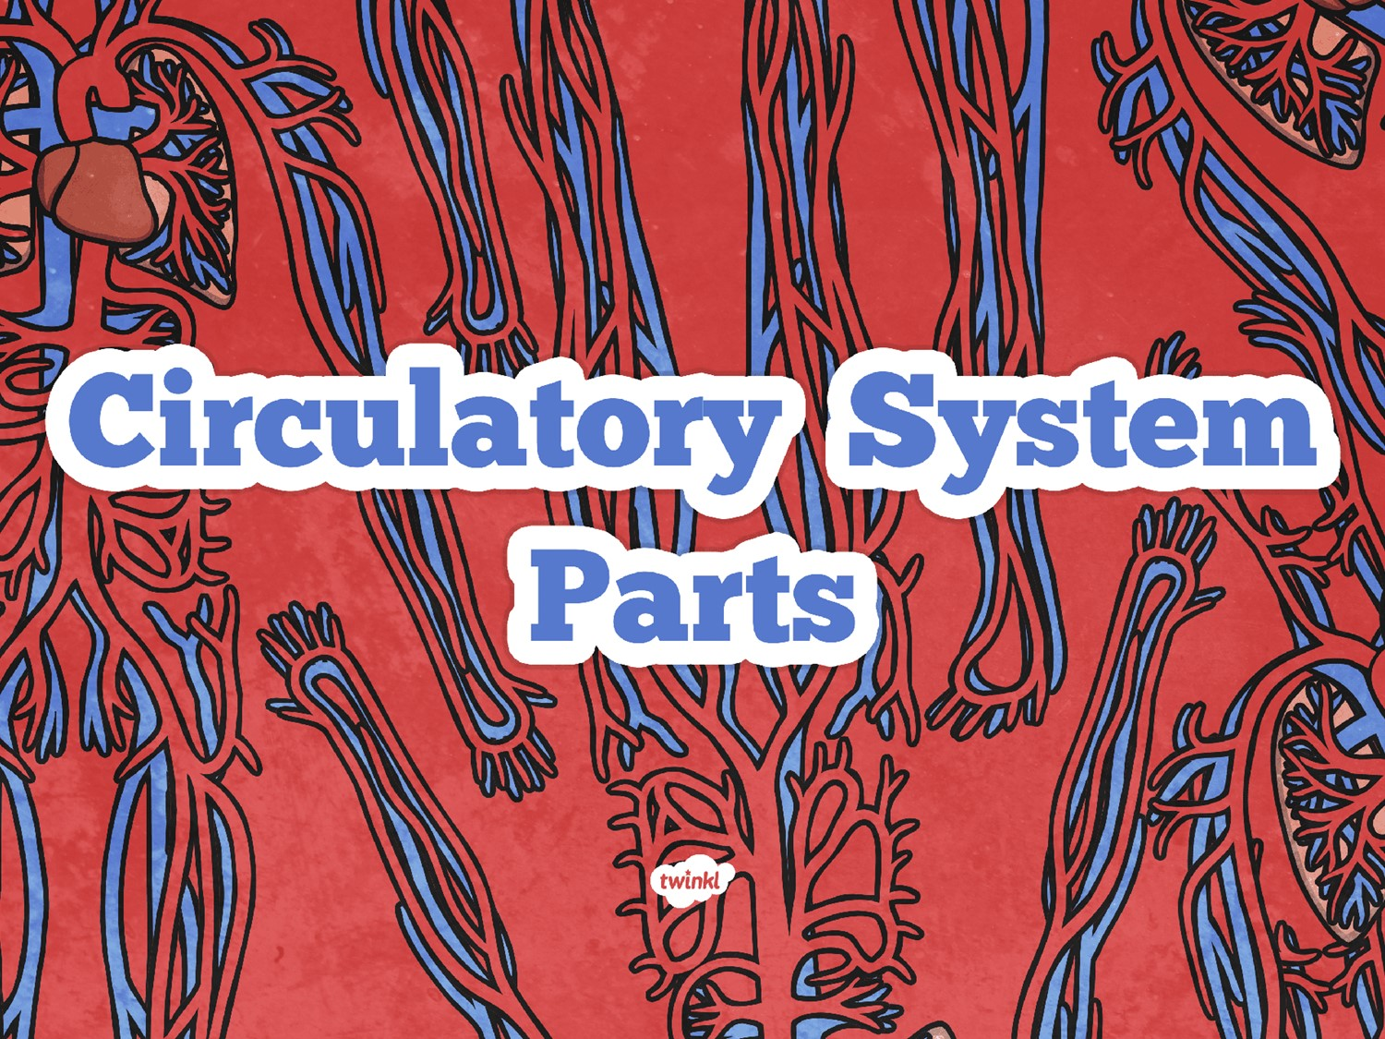

Slide 3
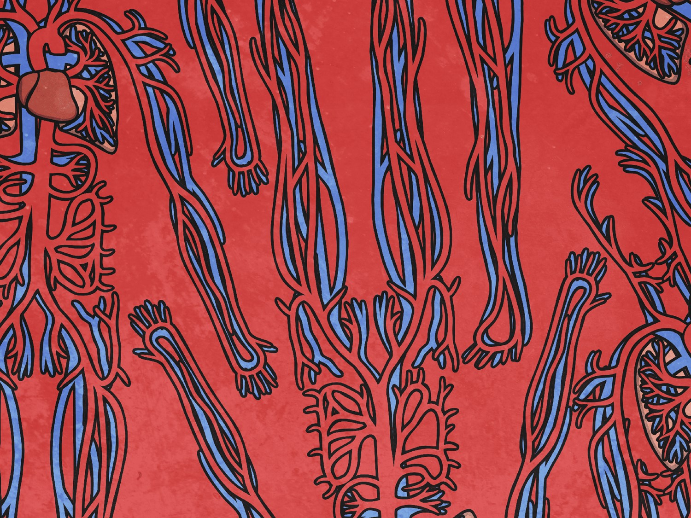
Aim
I can identify and name the parts of the human circulatory system.
Success Criteria
I can identify the parts of the circulatory system.
I can name the parts of the circulatory system.

Slide 4

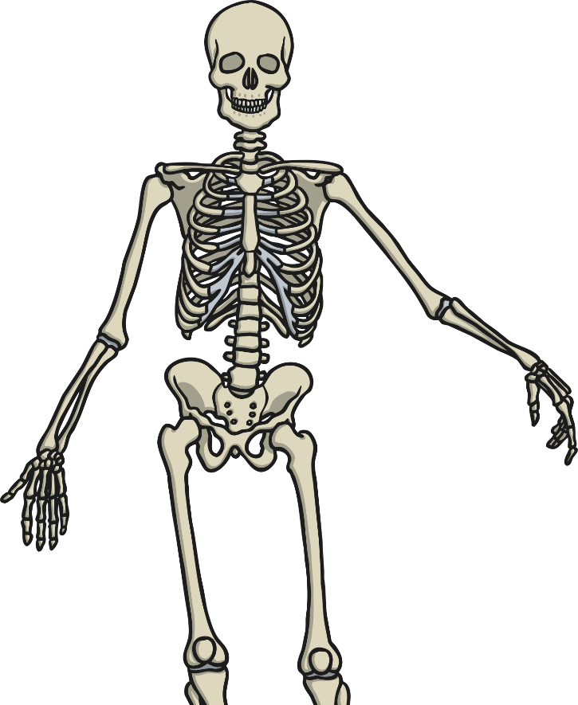
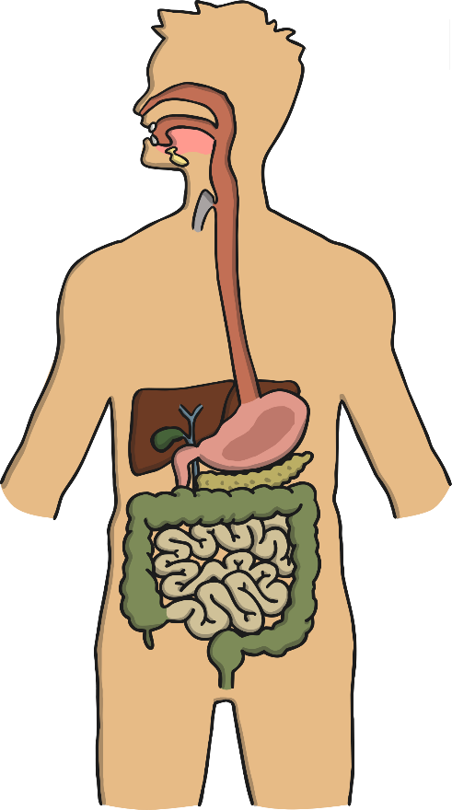
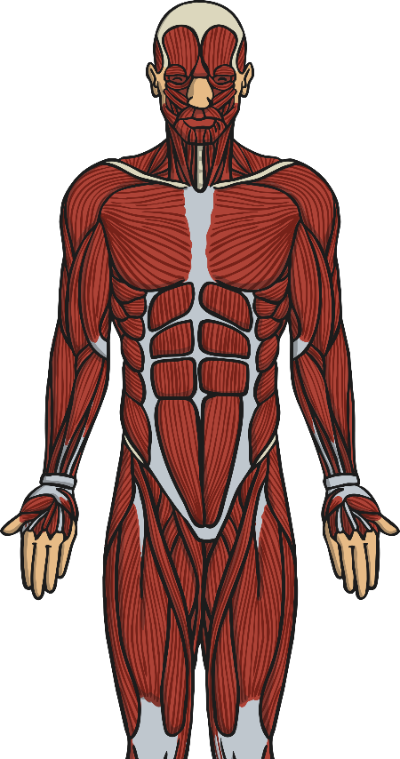
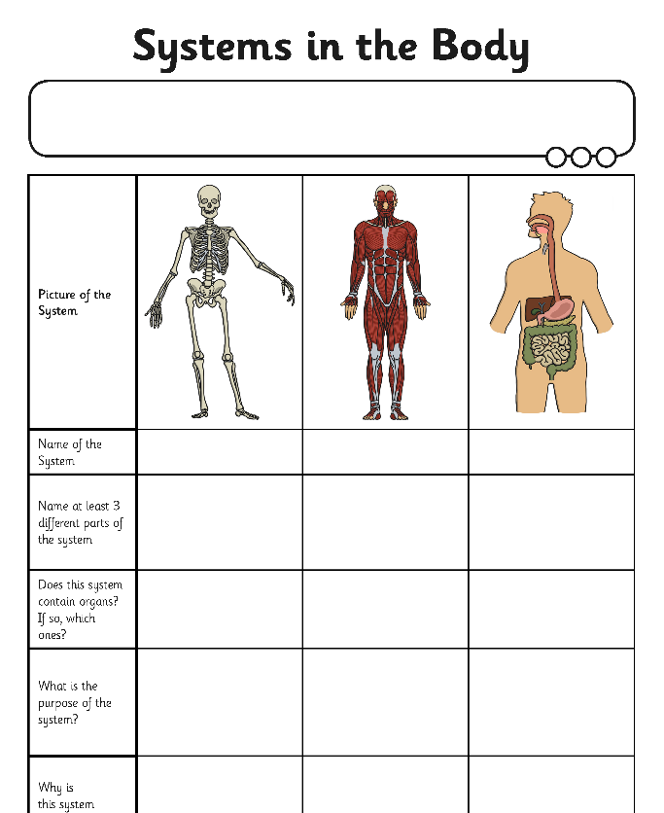
Systems in the Body: a Reminder
In Years 3 and 4, you may have learnt about a number of different systems in the body. We’re going to begin by seeing how much you remember!

Slide 5
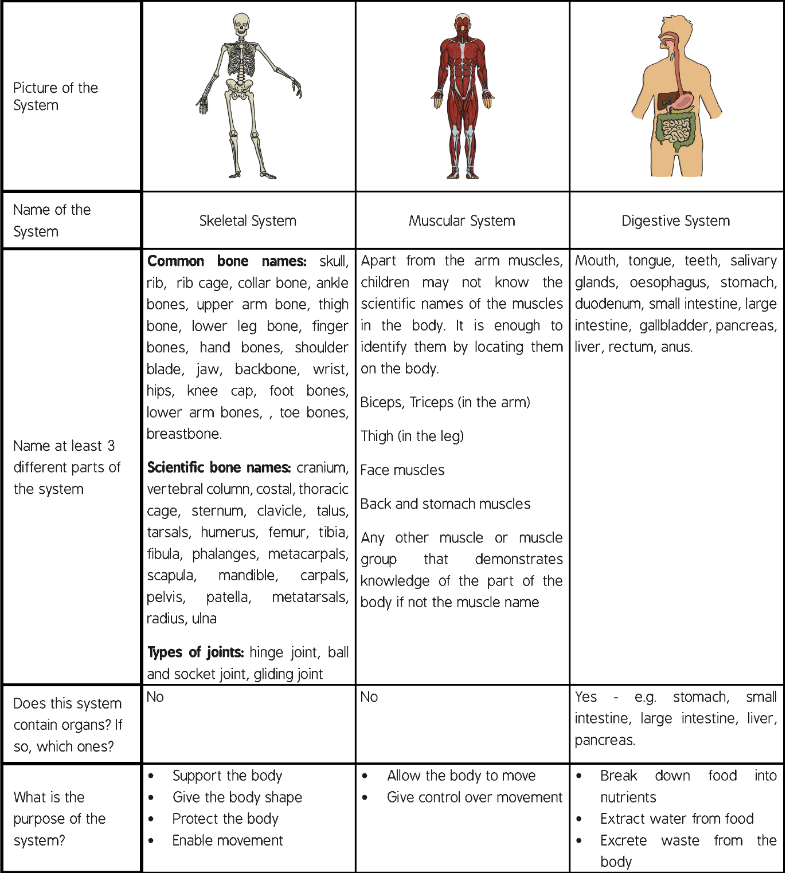
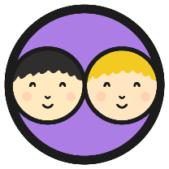

Systems in the Body:
Answers
Swap your Systems in the Body Activity Sheets with a partner and mark their work using the table below:
Click me for a larger version!
Click anywhere to hide.

Slide 6


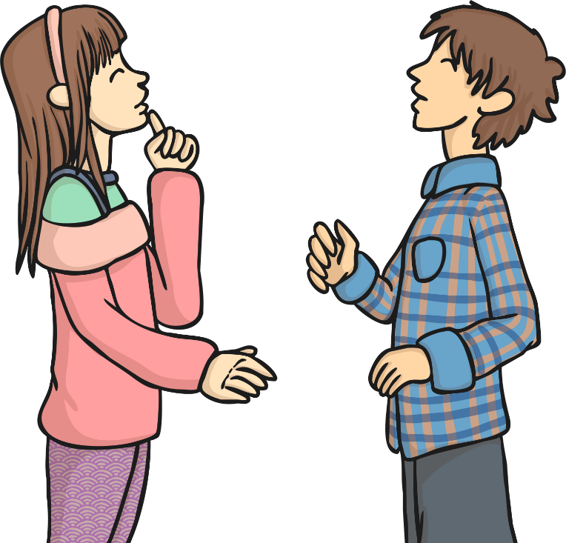
Systems in Your Body
We have just reminded ourselves about the skeletal, muscular and digestive systems in the body.
Do you know any other systems in the body? You have 2 minutes to discuss with your talk partner before feeding back to the class.

Slide 7
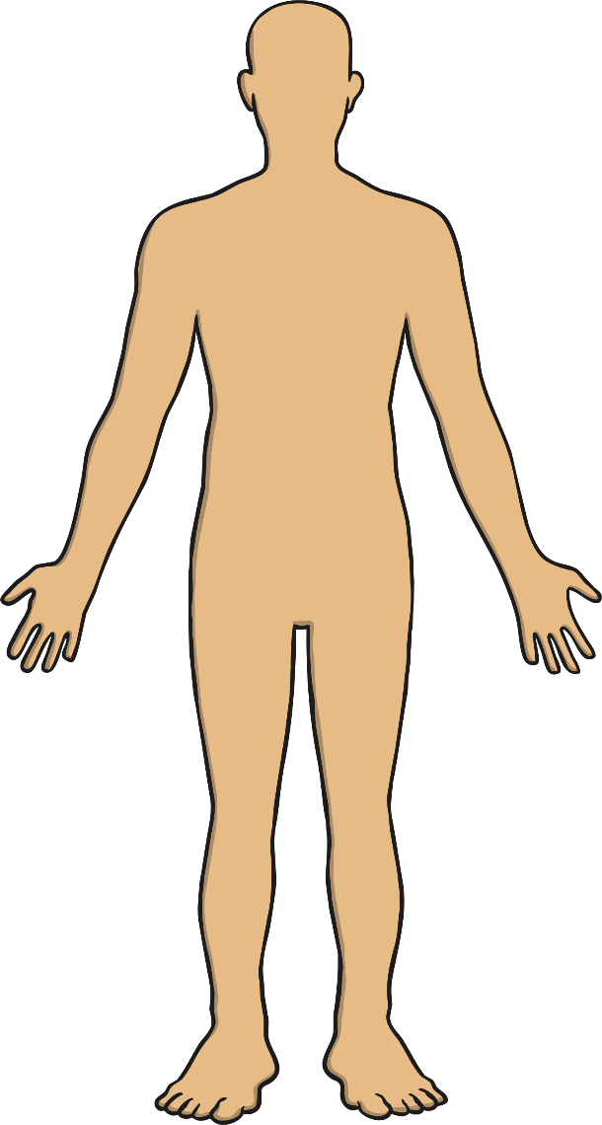
Systems in Your Body
The system we will look at for the rest of this lesson is called the:
‘Circulatory System’.
The word circulation means ‘the movement to, fro or around something’.
Discuss the following questions with your talk partner:
What does the system do?
What are the parts of the system?

Slide 8

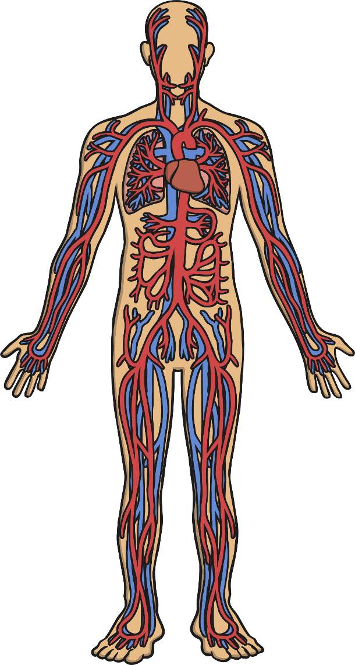
The Circulatory System
What can you see?
Is this what you expected?
Are there parts you did not expect to be in the circulatory system?

Slide 9
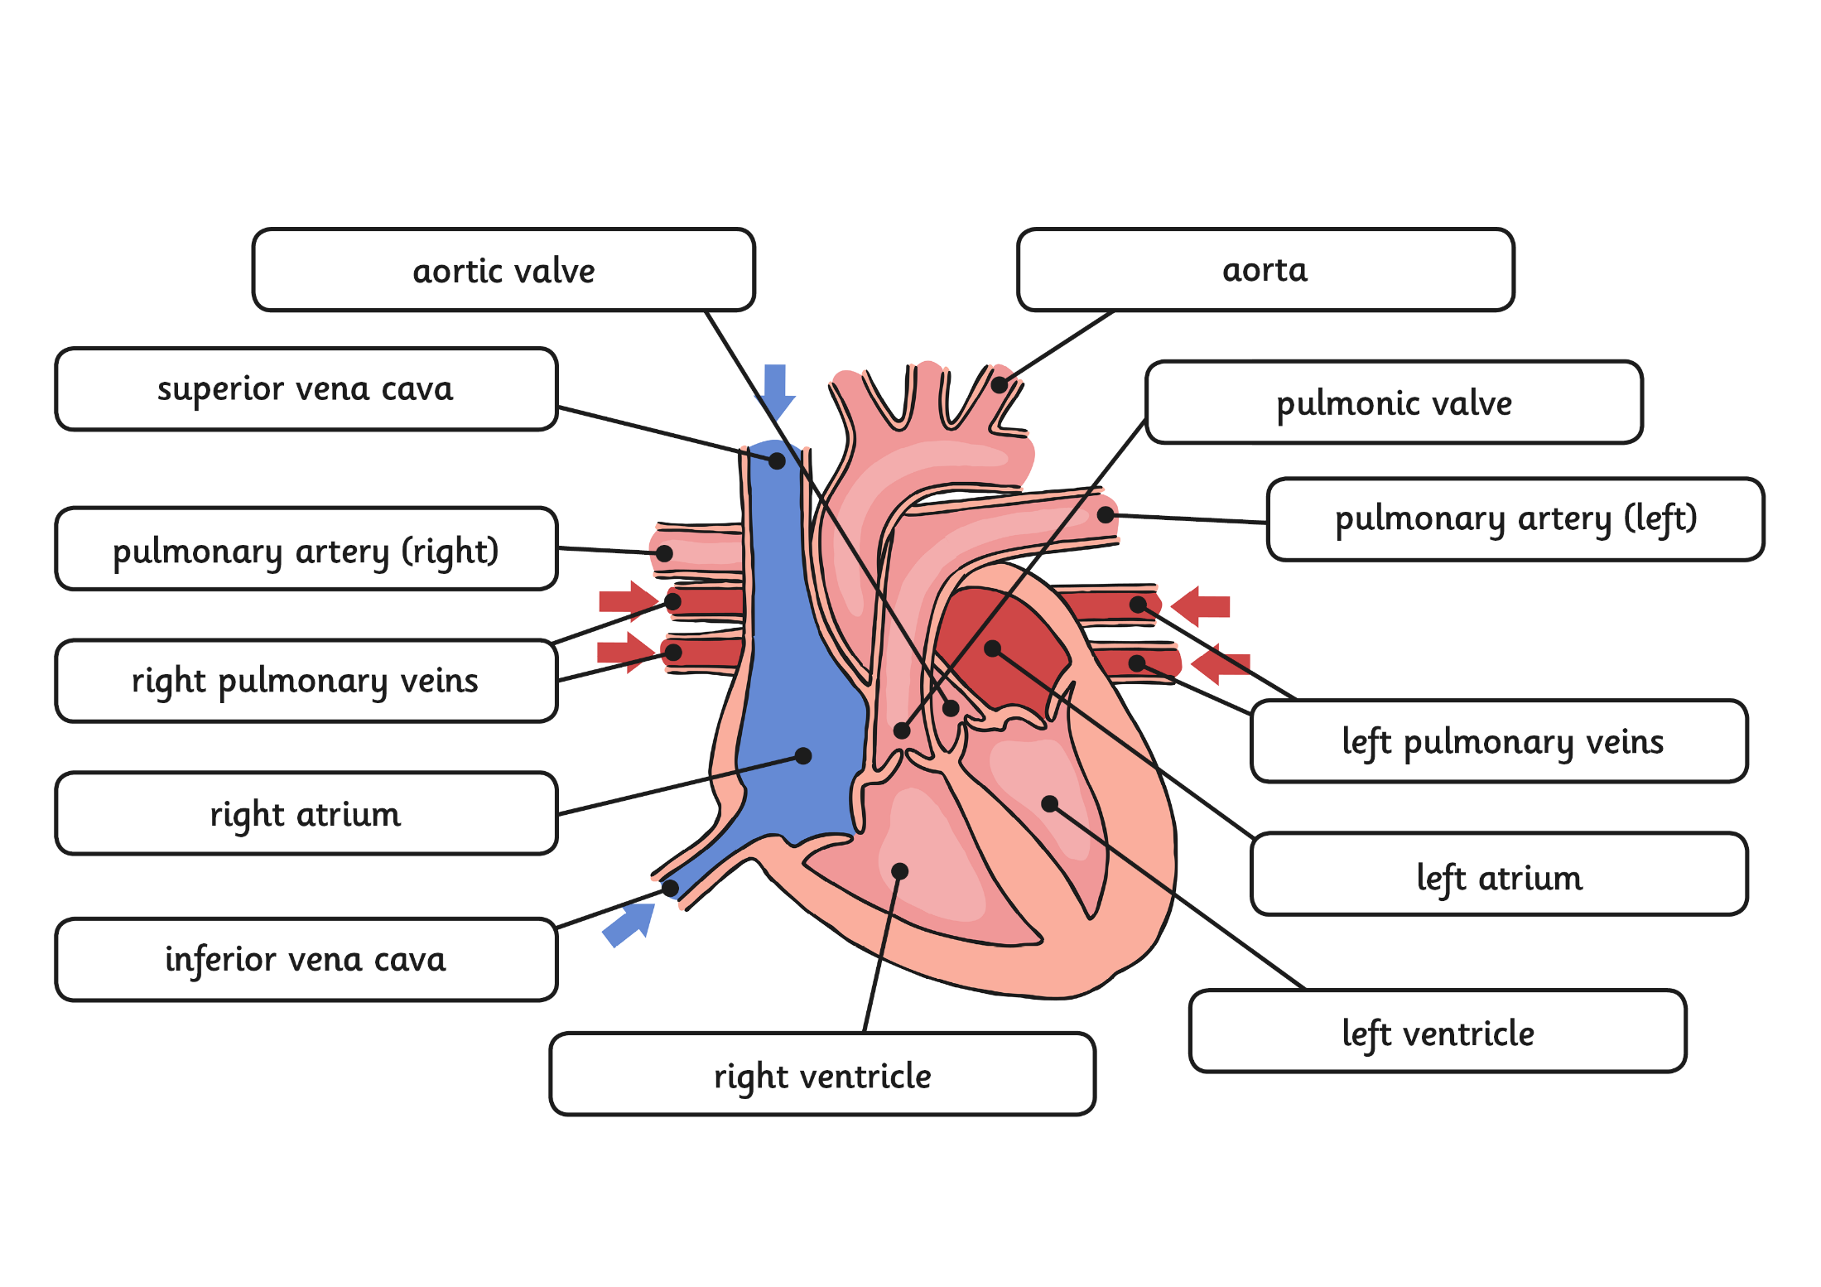
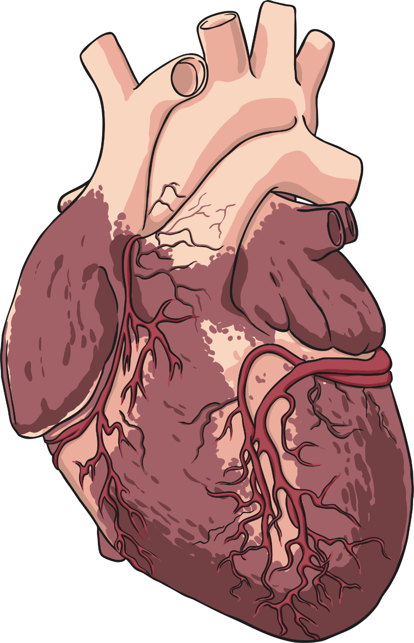


Parts of the Circulatory
System: Heart
The heart is a powerful organ that is situated between your lungs and protected by the ribcage.
The heart pumps blood to the lungs to get oxygen.
The heart then pumps this oxygenated blood around the body.
The heart is split between the left and right side.
As you can see, it consists of many parts!
Click me for a larger version!
Click anywhere to hide.
Click me for a larger version!
Click anywhere to hide.

Slide 10
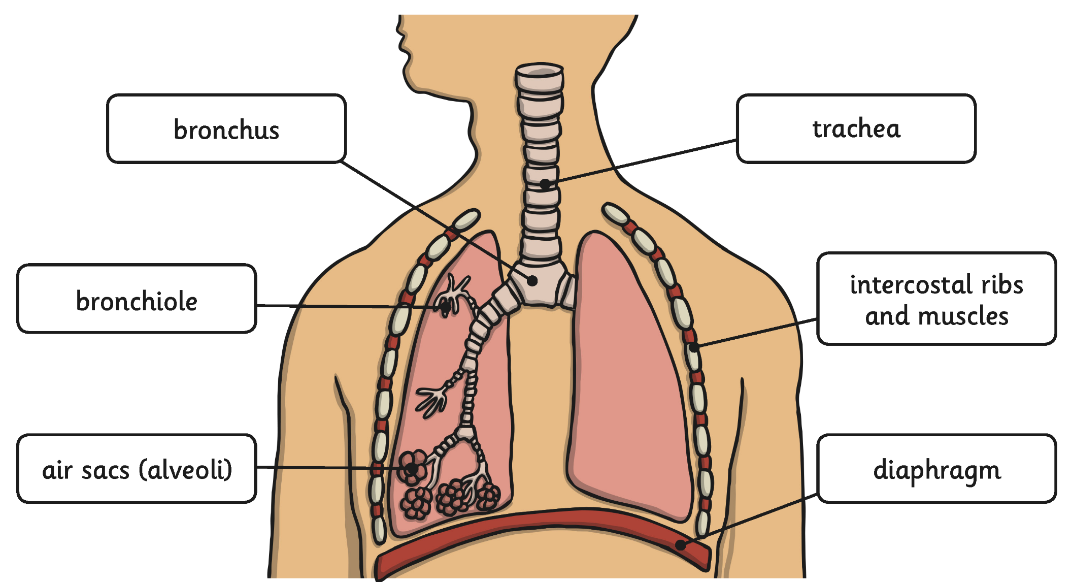

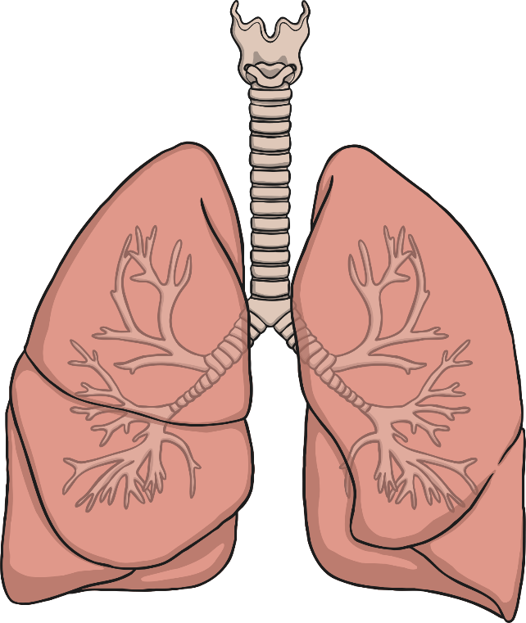
Parts of the Circulatory
System: Lungs
Click me for a larger version!
Air breathed in through the mouth or nose travels down the trachea, through the bronchi into one of the lungs. The air travels into the bronchioles and into the air sacs (alveoli).
Click anywhere to hide.

Slide 11
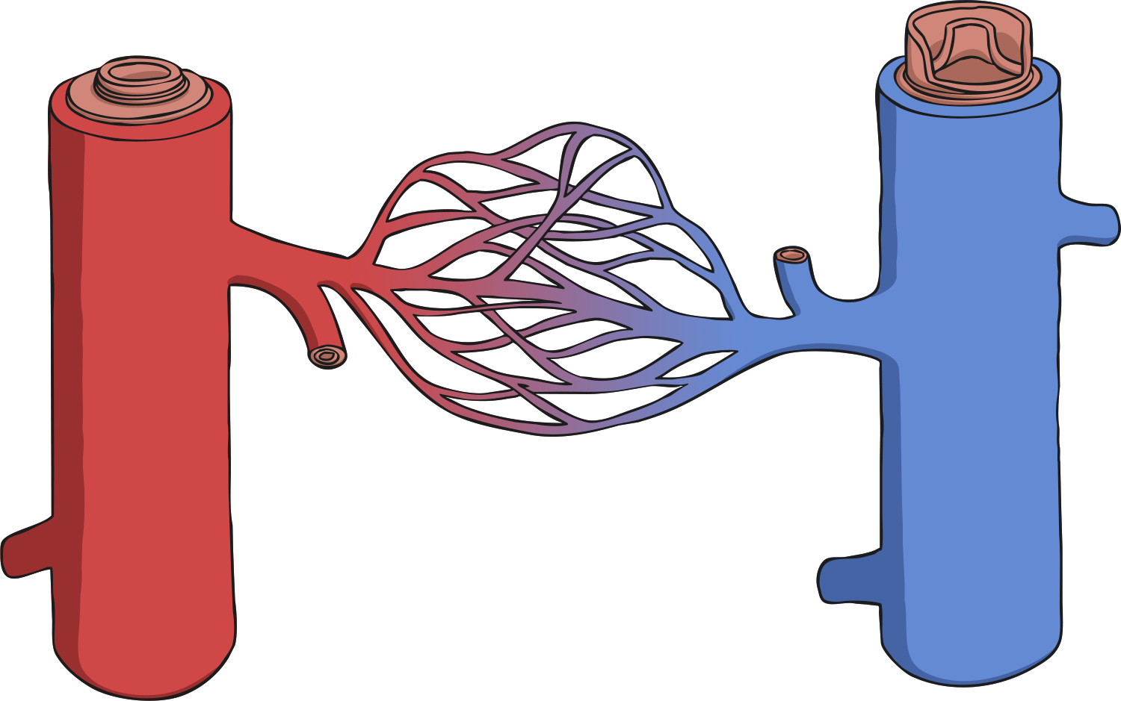
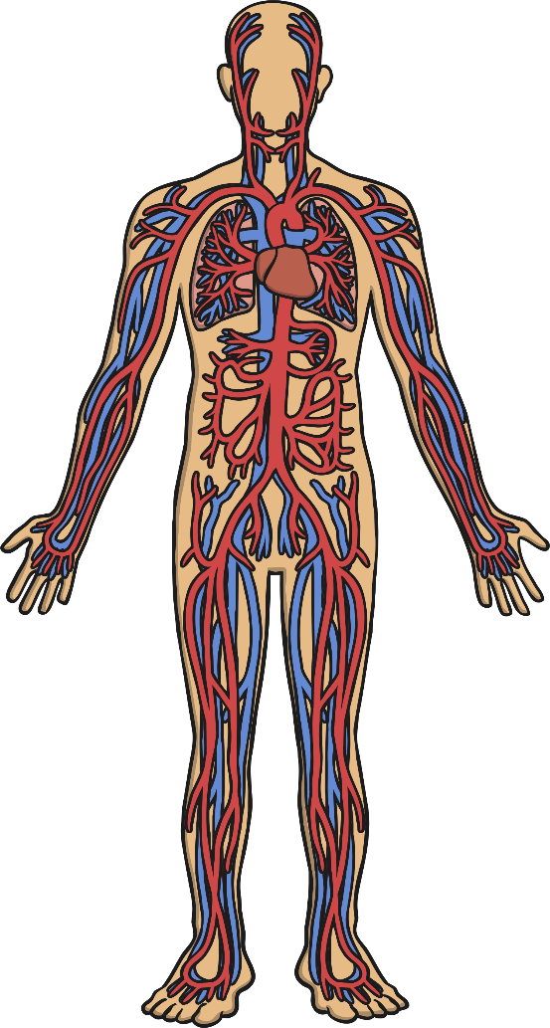
Parts of the Circulatory System:
Blood Vessels
vein
artery
capillaries
Blood vessels can be split into three types:
Arterial blood vessels - arteries:
Arteries are blood vessels that carry blood away from the heart.
Venous blood vessels - veins:
Veins are blood vessels that carry blood to the heart.
Capillaries:
These are the smallest blood vessels. Capillaries connect the arteries and the veins and are the place where water and chemicals exchange in the blood.
Click anywhere to hide.
Click here for a diagram that shows how the three blood vessels are linked.

Slide 12
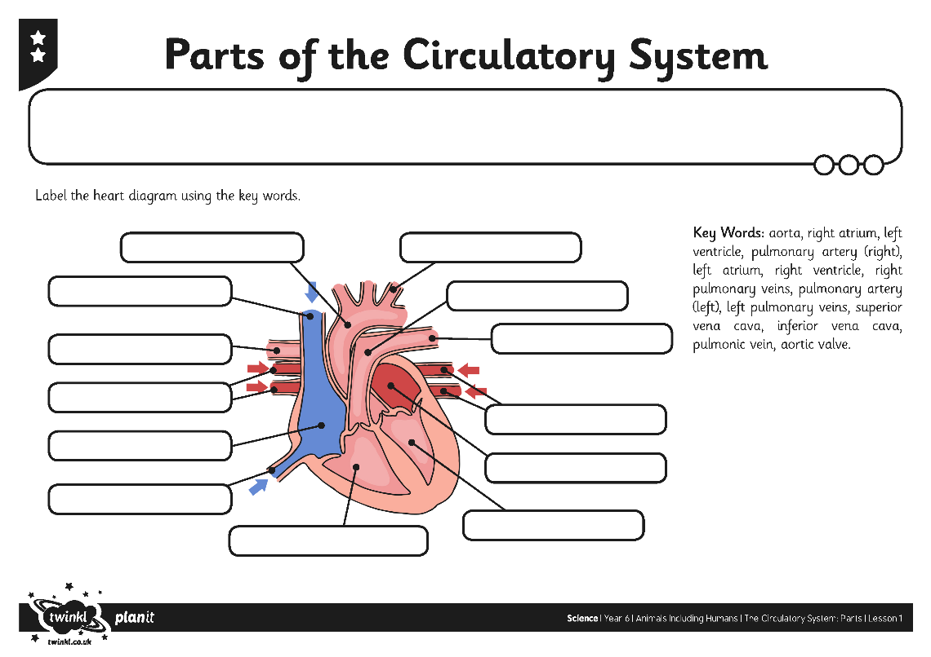
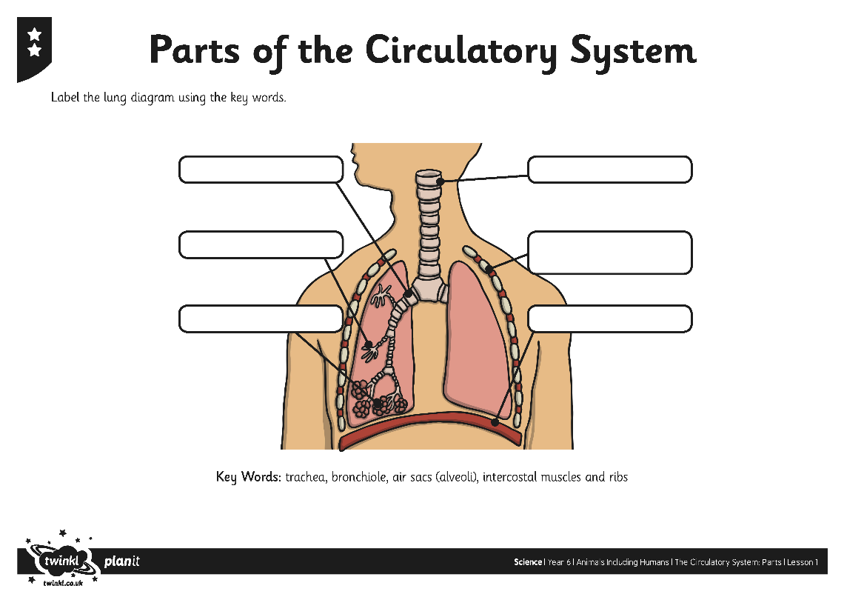
Parts of the Circulatory
System

Slide 13

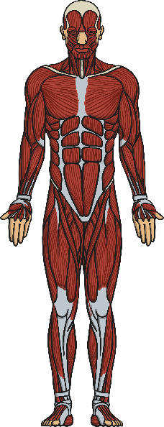

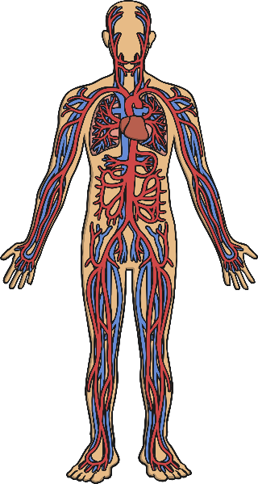
Systems In The Body:
Functions
Diagram of System
What are the functions of these parts of the system? | Bones: Joints: | Biceps: | Stomach: Salivary glands: | Heart: Lungs: Blood Vessels:

Slide 14

Aim
I can identify and name the parts of the human circulatory system.
Success Criteria
I can identify the parts of the circulatory system.
I can name the parts of the circulatory system.

