Slide 1
Change

Slide 2
Change is always negative.
Discuss this statement with a family member. Do you agree or disagree? Talk about why.

Slide 3
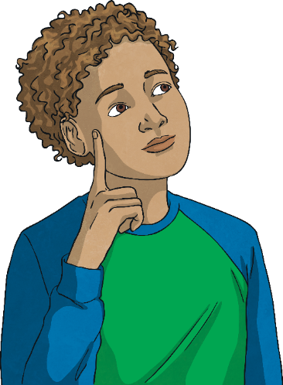
What changes can you think of?
1. Think of all the examples of changes that could take place for you and write these down.
3. Have a look at the list you created. Which of these changes are expected?
Which of these changes are unexpected?
2. Areas to think about: personal interests, relationships, home life, school life, homework, exams and society.
What did you come up with?
Do you think your classmates will have similar ideas to you?

Slide 4
What changes can you think of?
Have another look at the list of changes you came up with.
If/when that changed happened, how would you feel?
Draw an emoji next to each of the changes. Or, if you want, write the emotion you’d feel.

Slide 5
What changes can you think of?
Have a look at your list of changes again.
What challenges may these changes cause?
What opportunities might occur from them?

Slide 6
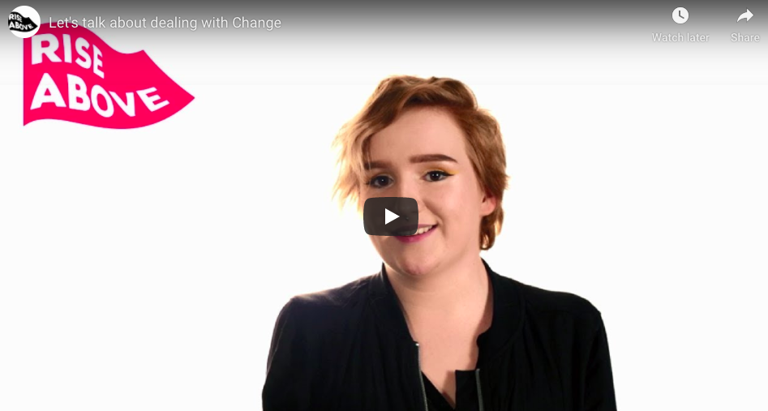
Let’s talk about dealing with change…
Watch this video about change.
Did you have any of the changes any your list?
https://riseabove.org.uk/article/lets-talk-about-change/

Slide 7
Dealing with change
There are lots of ways to deal with change. Some are positive, some are negative.
Make a list of the positive ways you can deal with change.

Slide 8
Dealing with change
Watch this video about dealing with change.
Do you have any of their suggestions on your list?
https://riseabove.org.uk/article/dealing-with-change/

Slide 9
Dealing with change: scenarios
Have a look at the scenarios below. For each scenario, what advice or ‘management strategies’ would you give to the person who is experiencing the change?
Someone has just moved to this country
Someone is going through physical changes (puberty)
Someone’s parents are separating
Someone has experienced a change in their friendship group

Slide 10
Dealing with change: scenarios
Talk to someone they trust
Make time for relaxing activities
Have realistic expectations
Eat and drink healthily
Create a daily routine
Reduce time on social media
Spend time doing activities they enjoy, such as, listening to music or playing sport
Set achievable goals
Give themselves time to adjust
Think positively and use self encouragement
Did you have any of these solutions?
Could any of these solutions fit with the scenarios you looked at?
Could any of these solutions be used to help someone who was experiencing the changes you came up with at the start of the lesson?

Slide 11
What if someone is struggling to cope with change?
Sometimes, people might find the change too overwhelming and difficult. They might find that they’re unable to put any strategies in place.
In this situation, the best thing to do is…
Speak to a trusted adult – don’t ever be scared to say that you’re finding something hard – talking is important.
Childline website/phone line
Kooth – an online service for young people.
If there’s time, have a look at the Childline or Kooth website to see what advice they offer.

Slide 12
What about now?
Talk to someone they trust
Make time for relaxing activities
Have realistic expectations
Eat and drink healthily
Create a daily routine
Reduce time on social media
Spend time doing activities they enjoy, such as, listening to music or playing sport
Set achievable goals
Give themselves time to adjust
Think positively and use self encouragement
We have all experienced a lot of change in the last couple of months due to coronavirus.
Has anybody done any of the things on this list to help them cope with the change?
Are there any positives or future opportunities that have come out of coronavirus? (These things may not be obvious yet, but are there any that, when things go back to normal, you think may exist?)

