Slide 1
Clue #1
Barry was found in his pot, on a windowsill. The curtains were open and sun was streaming into his apartment.

Slide 2
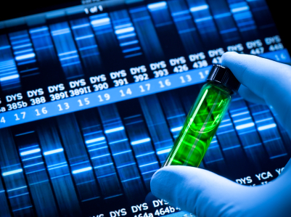
Clue #2
Our forensics team investigated the soil in Barry’s pot. The soil was damp, concluding that Barry had recently had a drink.

Slide 3
Clue #3
Barry’s neighbour, Fiona the flower, said that she saw Barry last week looking rather yellow.

Slide 4
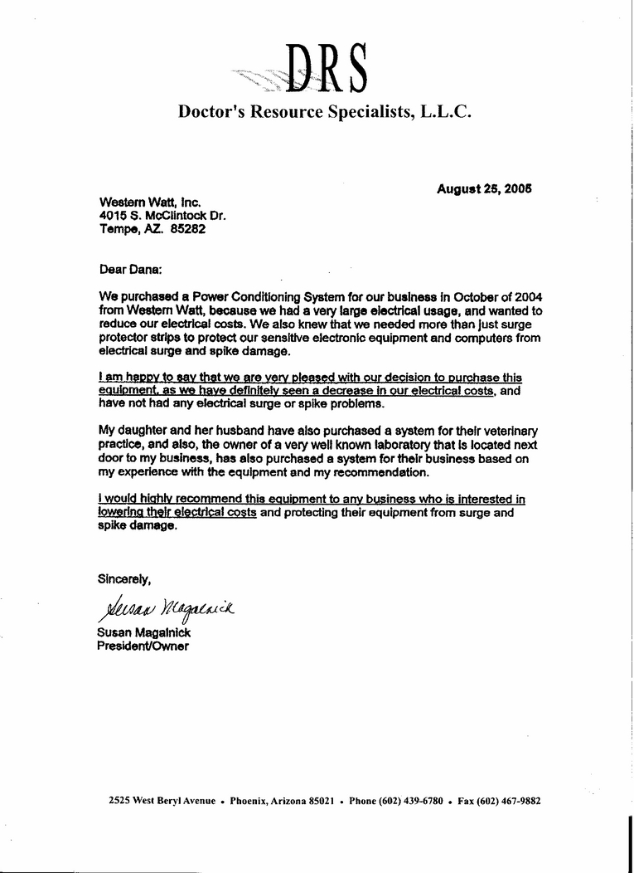
Clue #4
A recent letter from the doctor. It seems Barry had taken some time off work, due to feeling weak in his stems.

Slide 5
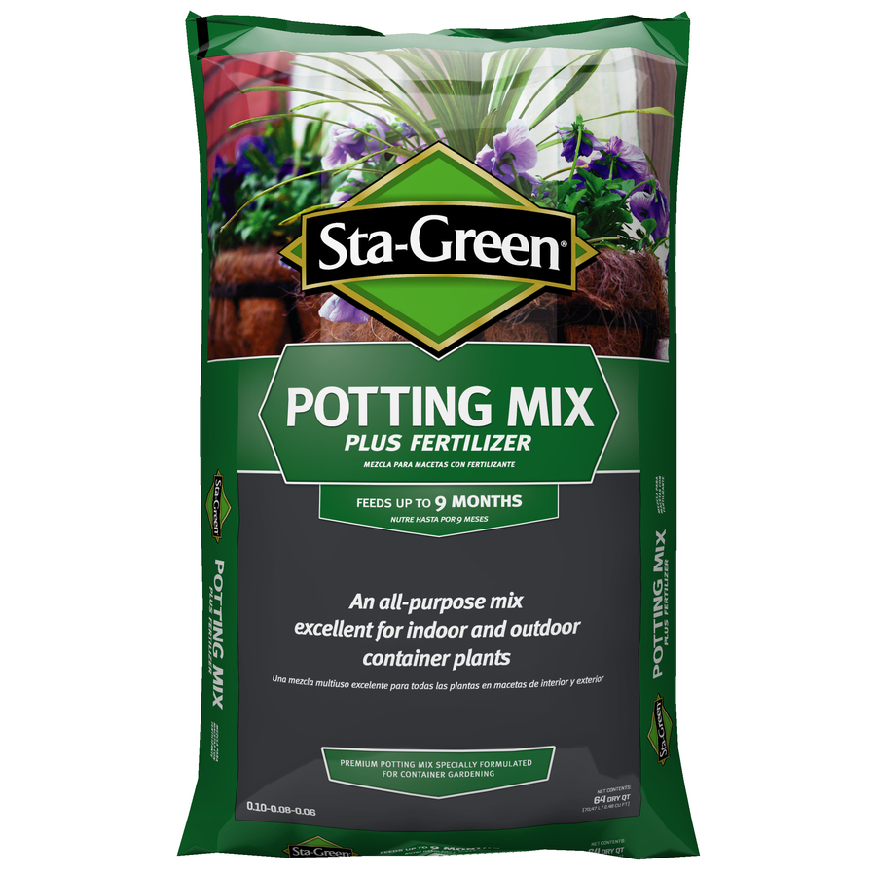
Clue #5
A bag of potting soil was found in Barry’s kitchen. It looks like it had been tampered with, as it had a fake label on the front.

Slide 6
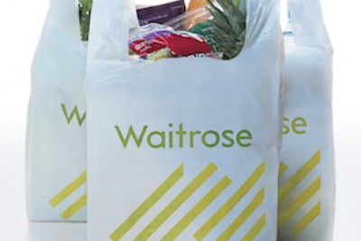
Clue #6
Barry worked at the local Wait-Rose. His boss said that he hadn’t been in for over a week, as Barry was feeling pale and weak.

Slide 7
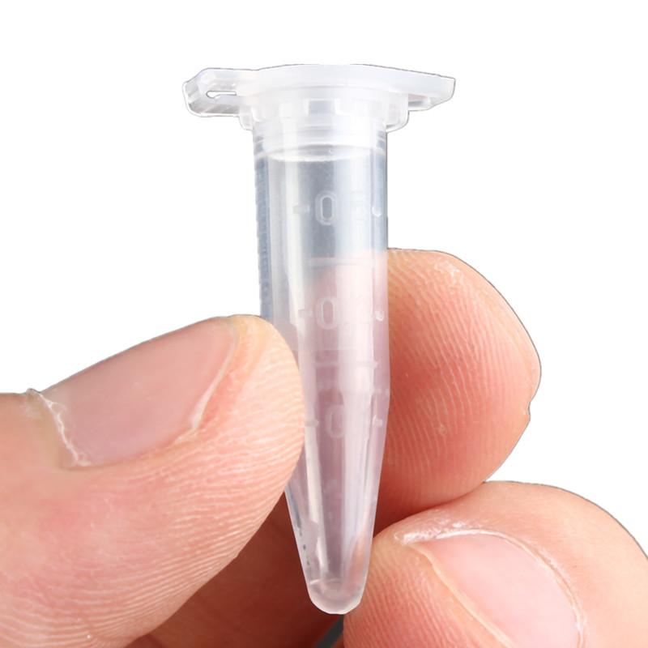
Clue #7
The forensics team took samples of the air, and found high levels of carbon dioxide in Barry’s apartment.

Slide 8
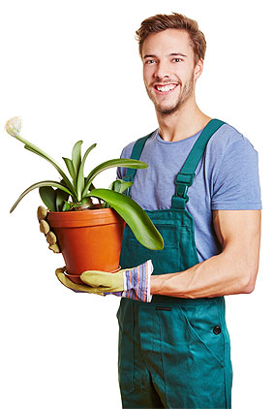
Clue #8
A statement from a plant expert:
“Plants need water, sunlight, carbon dioxide and minerals in order to stay healthy and alive.”

Slide 9
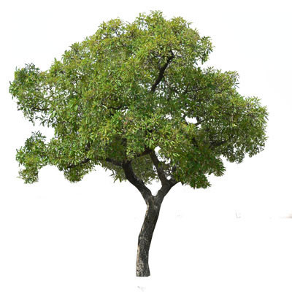
Clue #9
Barry’s neighbour, Terry the tree, said that he saw a different plant delivering Barry’s weekly soil. He thinks that the delivery plant was some kind of yellow flower, but he can’t remember for sure.

Slide 10
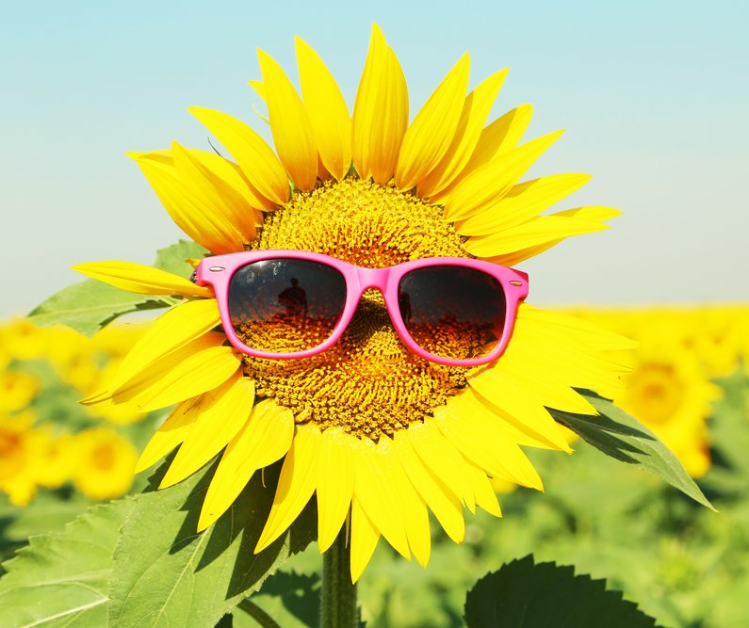
Clue #10
According to Barry’s friends, Barry had recently fallen out with a guy named Simon the Sunflower. Details of the fight are unclear – but apparently it was fierce.

Slide 11
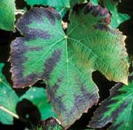
Clue #11
Plants that do not receive enough phosphorous have discoloured, purple leaves and small roots. They need phosphorous to make roots. If plants don’t have proper roots, they will not be able to absorb more minerals.

Slide 12
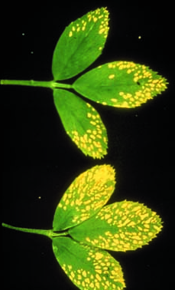
Clue #12
Potassium is used by to make flowers and fruit. If the plants don’t have enough potassium they have poor flower and fruit growth. The leaves will be yellow with dead spots.

Slide 13
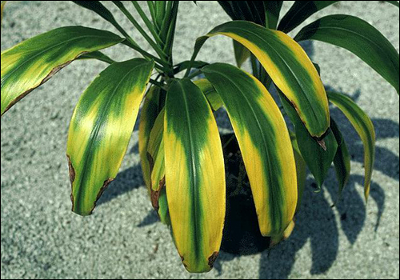
Clue #13
Magnesium is used to make chlorophyll which the plant needs for photosynthesis. If a plant does not have enough magnesium the lower leaves will start to turn yellow.

Slide 14
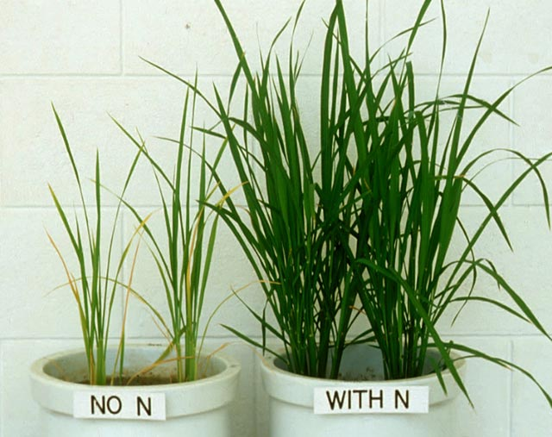
Clue #14
Nitrogen is used by plants to make proteins, including those to make leaves. Plants need larger amounts of nitrogen than any other mineral. Nitrogen-deficient plants have poor growth and weak stems. The leaves will turn yellow and eventually die.

Slide 15
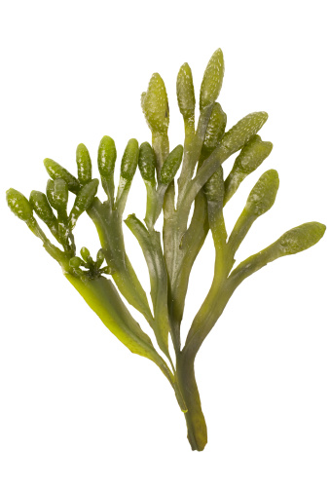
Clue #15
Barry’s friend, Sally the Seaweed, said that Barry was complaining that he was always feeling hungry. Sally said that she wanted to lend him some fresh soil – but as she is a seaweed she doesn’t have any at home!

