Slide 1
Houses and Homes – Odd One Out
VICTORIANS
NGfL CYMRU GCaD

Slide 2
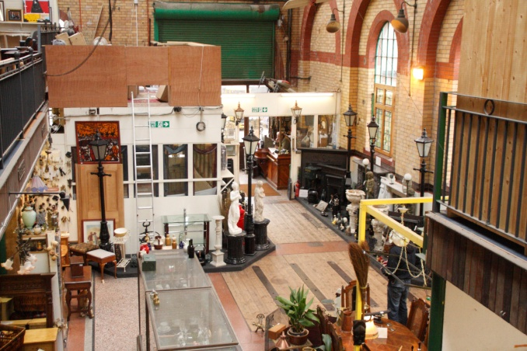
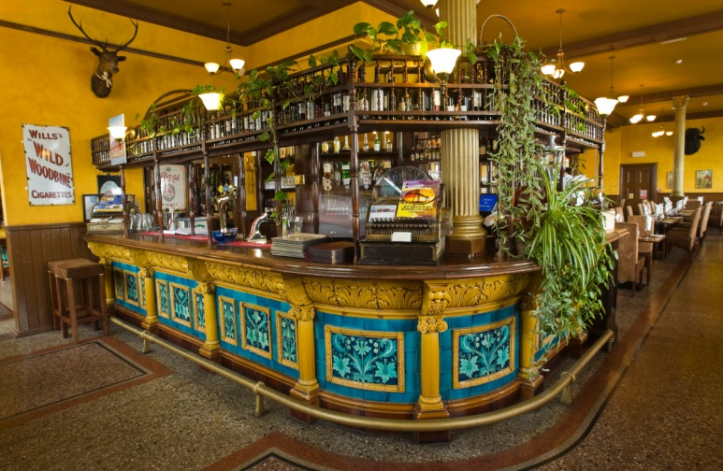
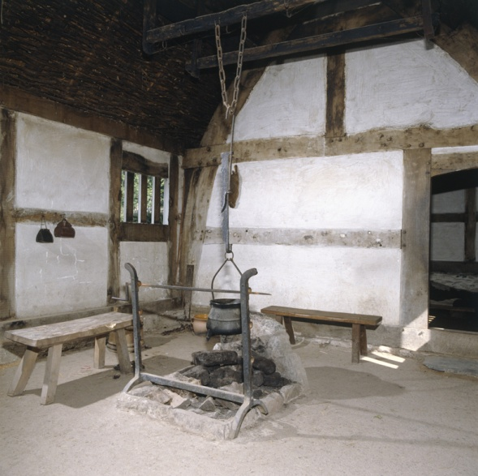
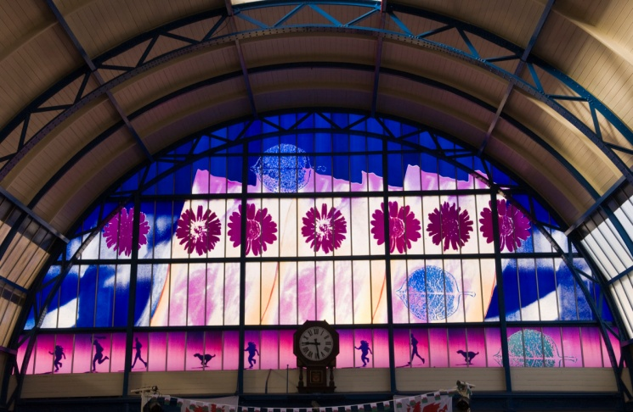
Houses and Homes – Odd One Out
Click the image you think is the odd one out?
Why do you think this?
VICTORIANS

Slide 3
TRY AGAIN!
CLICK TO TRY AGAIN

Slide 4
CORRECT!
The images from Victorian times all feature arches in their architecture. These images can be found at www.photolibrarywales.com
CLICK FOR NEXT CHALLENGE

Slide 5
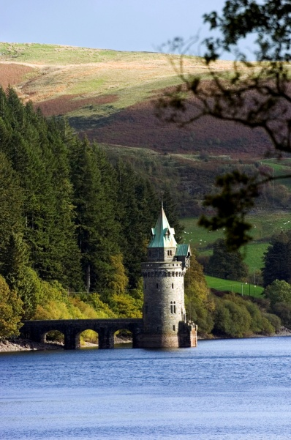
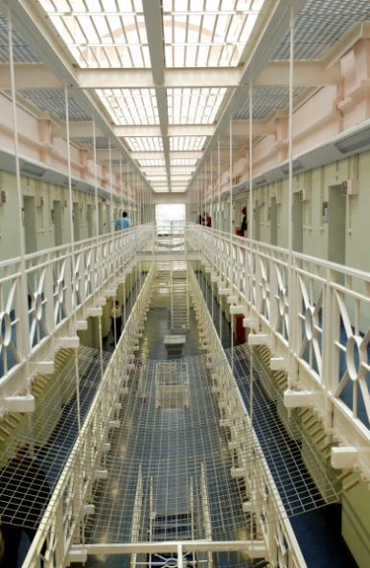
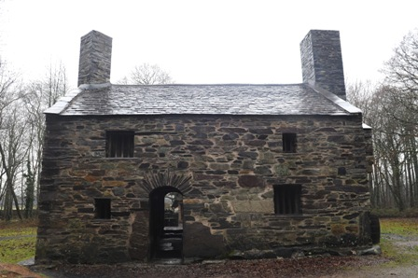
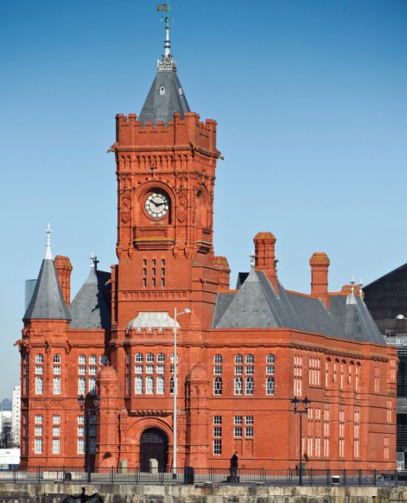
Houses and Homes – Odd One Out
Click the image you think is the odd one out?
Why do you think this?
VICTORIANS

Slide 6
TRY AGAIN!
CLICK TO TRY AGAIN

Slide 7
CORRECT!
All three images are examples of Victorian architecture. They are the Straining Tower on Lake Vyrnwy, the interior of Cardiff Prison and the old Pierhead building in Cardiff Bay.
CLICK FOR NEXT CHALLENGE

Slide 8
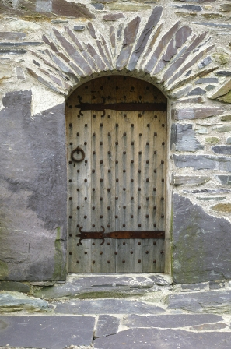
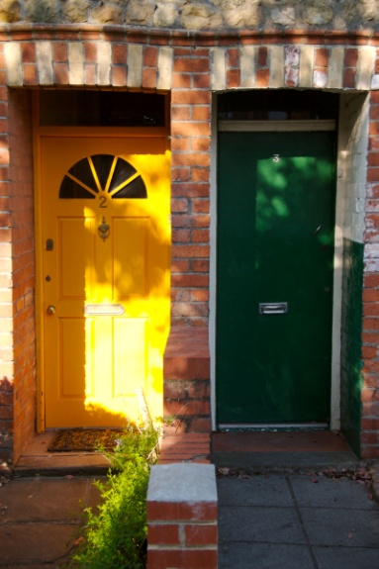
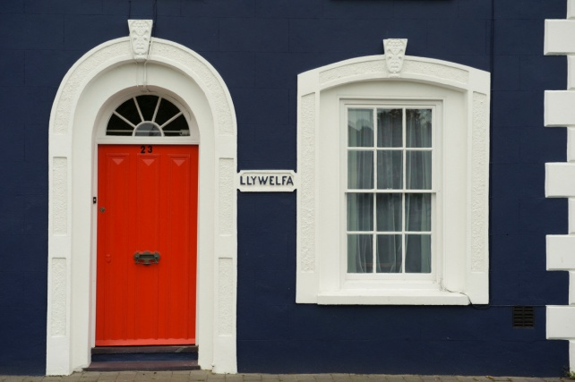
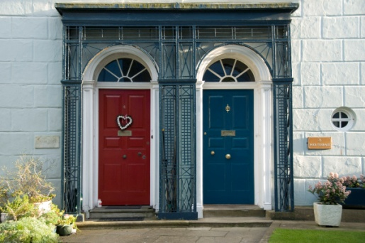
Houses and Homes – Odd One Out
Click the image you think is the odd one out?
Why do you think this?
VICTORIANS

Slide 9
TRY AGAIN!
CLICK TO TRY AGAIN

Slide 10
CORRECT!
The images shown are examples of Victorian doorways. You can see that they have similarities in their design.
CLICK FOR NEXT CHALLENGE

Slide 11
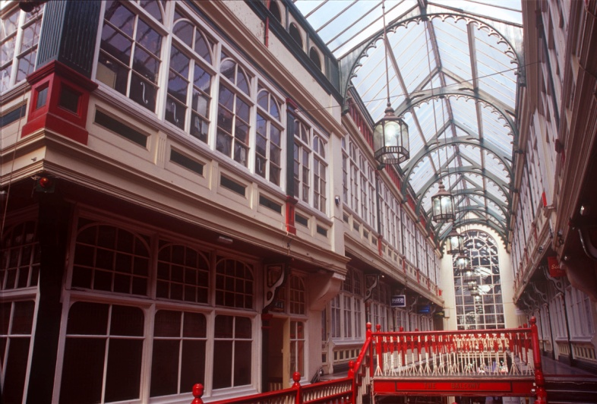
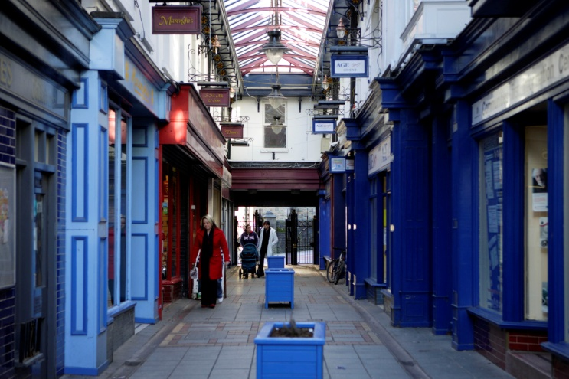
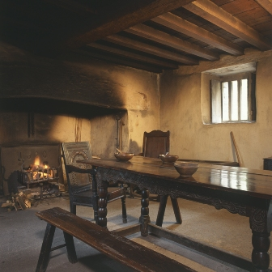
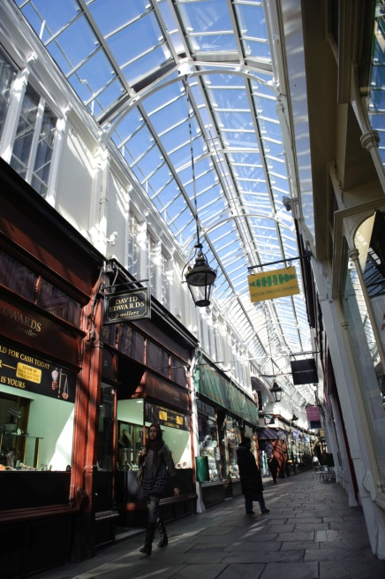
Houses and Homes – Odd One Out
Click the image you think is the odd one out?
Why do you think this?
VICTORIANS

Slide 12
TRY AGAIN!
CLICK TO TRY AGAIN

Slide 13
CORRECT!
The images are of Victorian interiors and the Victorian Arcades in Cardiff and Abertillery.
CLICK FOR NEXT CHALLENGE

Slide 14
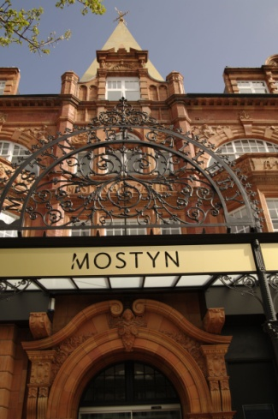
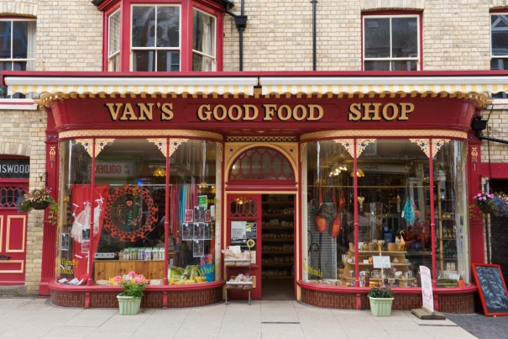
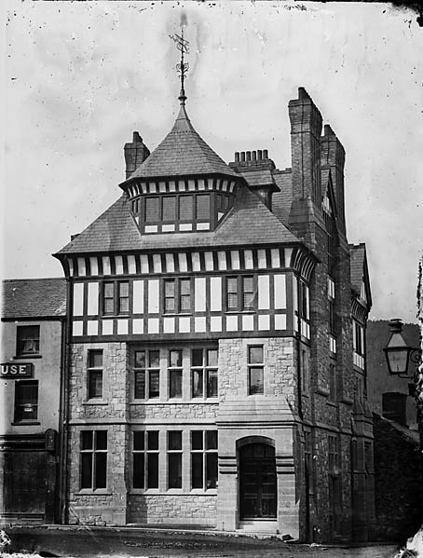
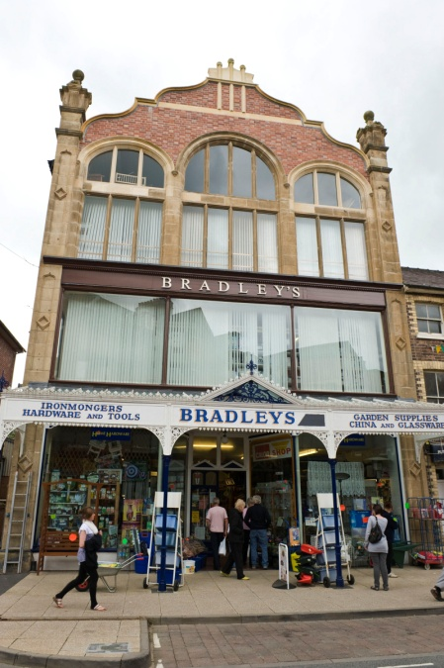
Houses and Homes – Odd One Out
Click the image you think is the odd one out?
Why do you think this?
VICTORIANS

Slide 15
TRY AGAIN!
CLICK TO TRY AGAIN

Slide 16
CORRECT!
The three correct images are of Victorian shop fronts in Llandudno and Llandrindod Wells. The odd image is from Tudor Times.
CLICK FOR NEXT CHALLENGE

Slide 17
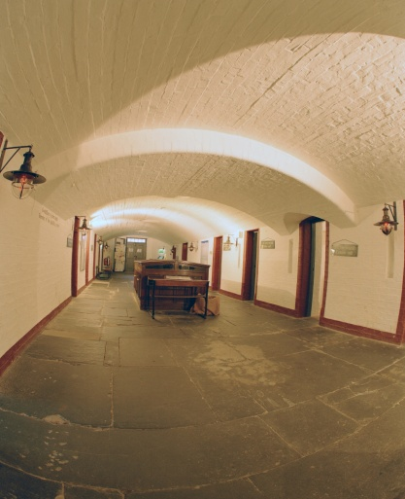
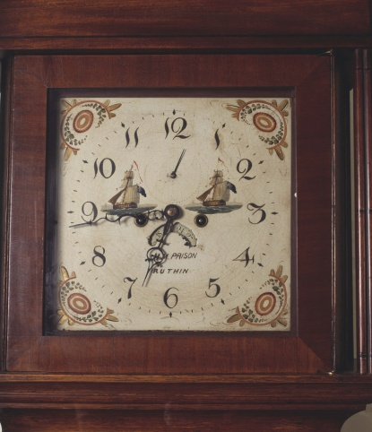
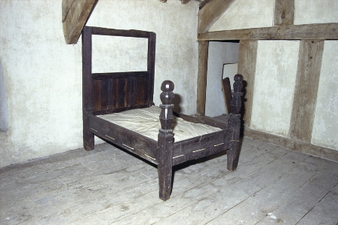
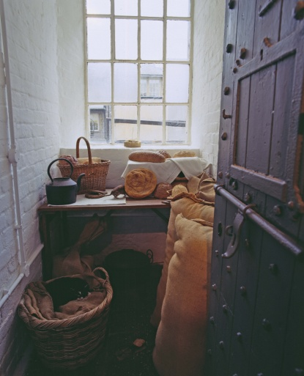
Houses and Homes – Odd One Out
Click the image you think is the odd one out?
Why do you think this?
VICTORIANS

Slide 18
TRY AGAIN!
CLICK TO TRY AGAIN

Slide 19
CORRECT!
The three correct images are from Rhuthin Gaol. It was built in 1775, but was used mainly during Victorian times and retains many Victorian fittings.
CLICK FOR NEXT CHALLENGE

Slide 20
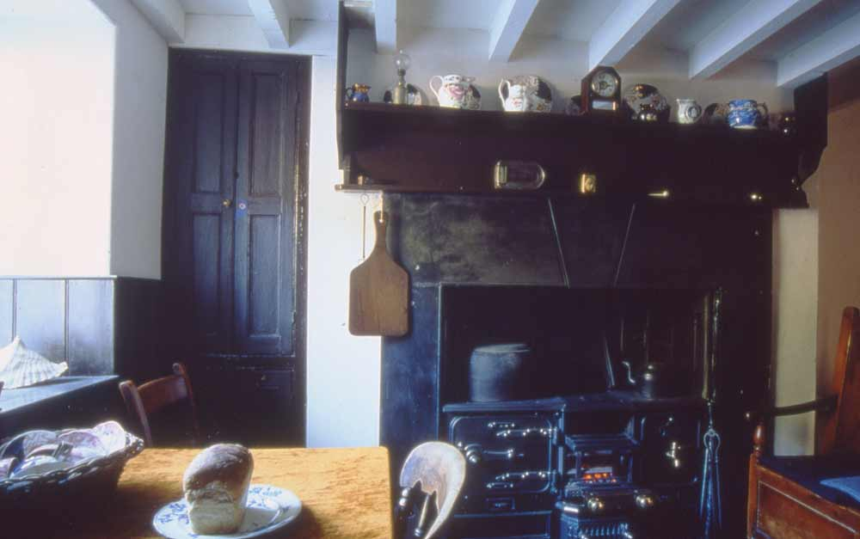
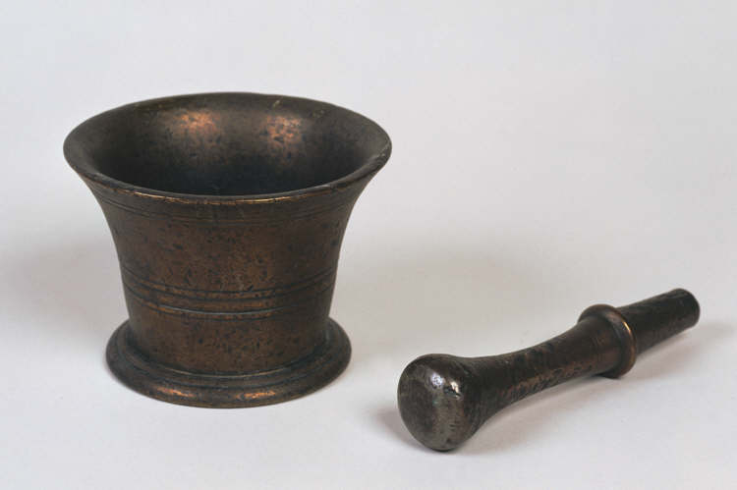
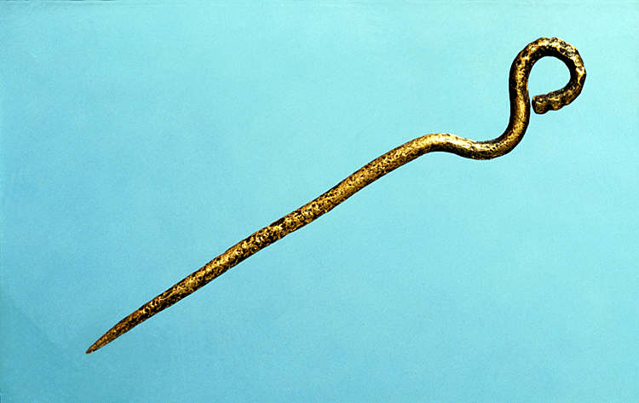
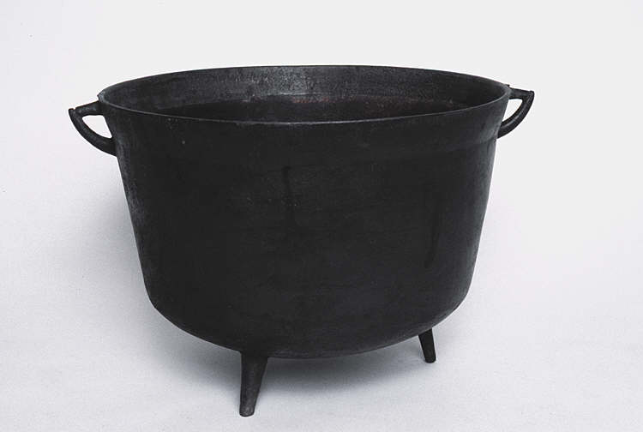
Houses and Homes – Odd One Out
Click the image you think is the odd one out?
Why do you think this?
VICTORIANS
Notes:
4 images – One is the odd one out.
Castell Henllys 3 images. http://www.coflein.gov.uk/en/site/94989/images/CASTELL+HENLLYS/?show=all
1950s living room - http://www.tournorfolk.co.uk/kingslynn/kingslynnlynnlife1950.jpg

Slide 21
TRY AGAIN!
CLICK TO TRY AGAIN

Slide 22
CORRECT!
The linked images are of items that you might find in Victorian kitchens. You can find more by searching at www.gtw.org.uk
CLICK FOR NEXT CHALLENGE

Slide 23
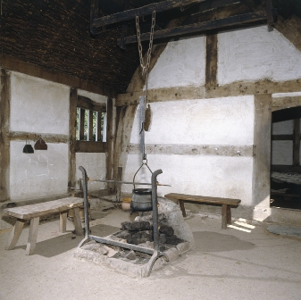
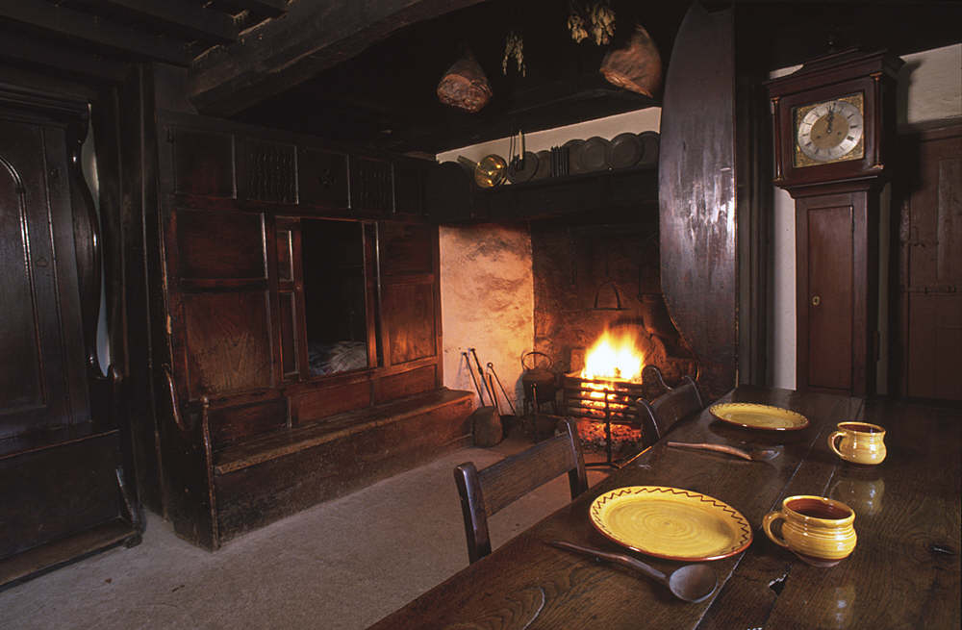
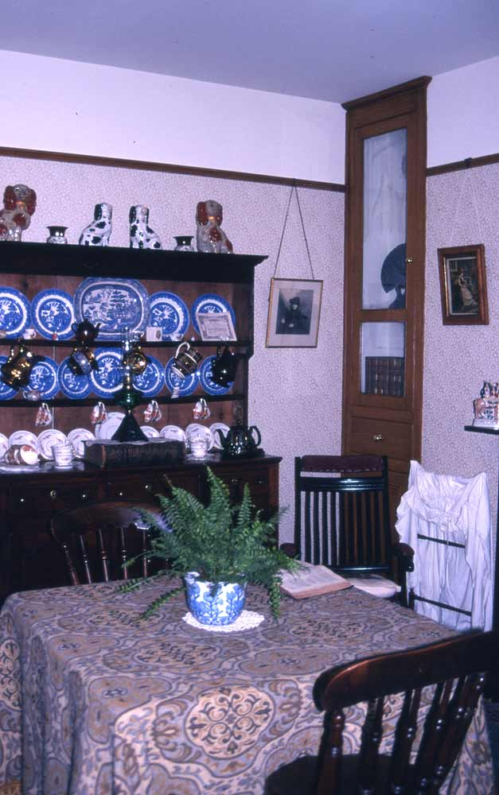
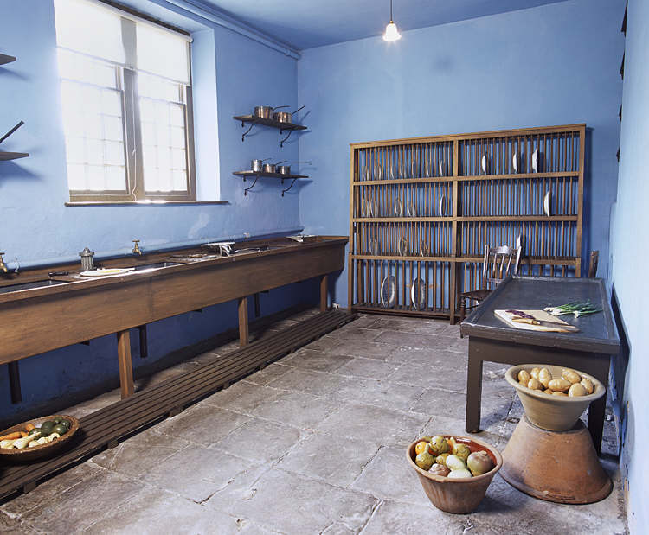
Houses and Homes – Odd One Out
Click the image you think is the odd one out?
Why do you think this?
VICTORIANS
Notes:
4 images – One is the odd one out.
Castell Henllys 3 images. http://www.coflein.gov.uk/en/site/94989/images/CASTELL+HENLLYS/?show=all
1950s living room - http://www.tournorfolk.co.uk/kingslynn/kingslynnlynnlife1950.jpg

Slide 24
TRY AGAIN!
CLICK TO TRY AGAIN

Slide 25
CORRECT!
The three images are of Victorian furnishings in their kitchens. Each image shows a different type of kitchen that would have existed for different purposes in Victorian times.
CLICK FOR NEXT CHALLENGE

Slide 26
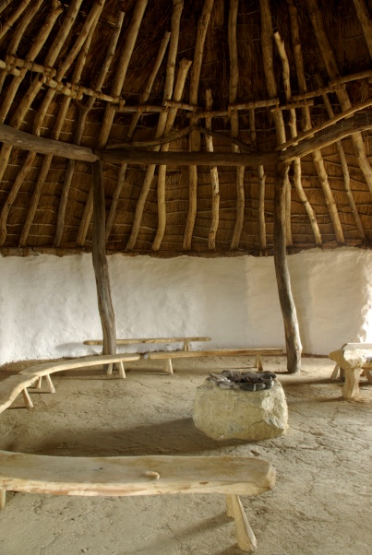
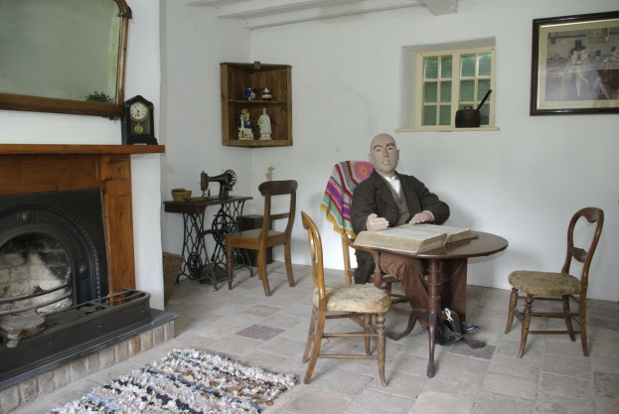
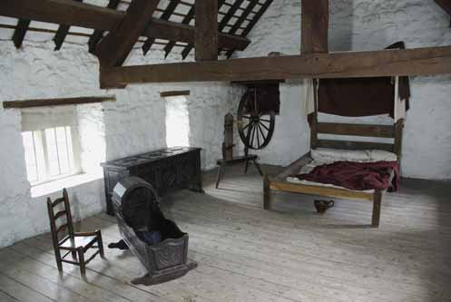
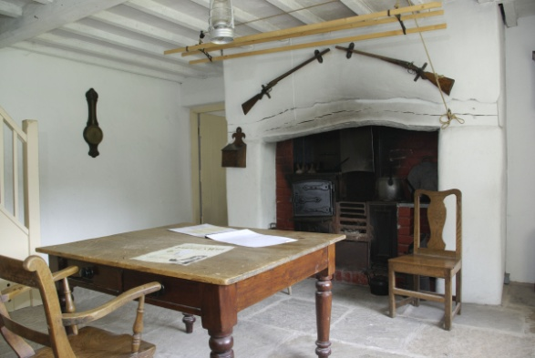
Houses and Homes – Odd One Out
Click the image you think is the odd one out?
Why do you think this?
VICTORIANS

Slide 27
TRY AGAIN!
CLICK TO TRY AGAIN

Slide 28
CORRECT!
These images are from Greenfield Valley Museum and show a farmhouse as it would have appeared in Victorian times.
CLICK FOR NEXT CHALLENGE

Slide 29
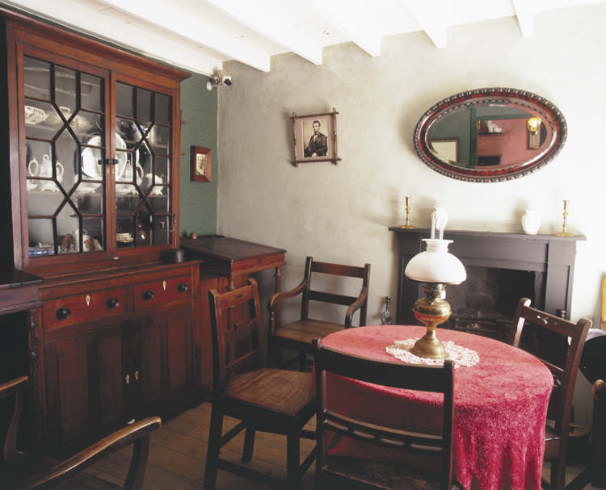
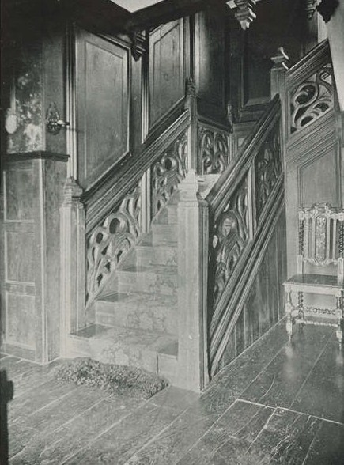
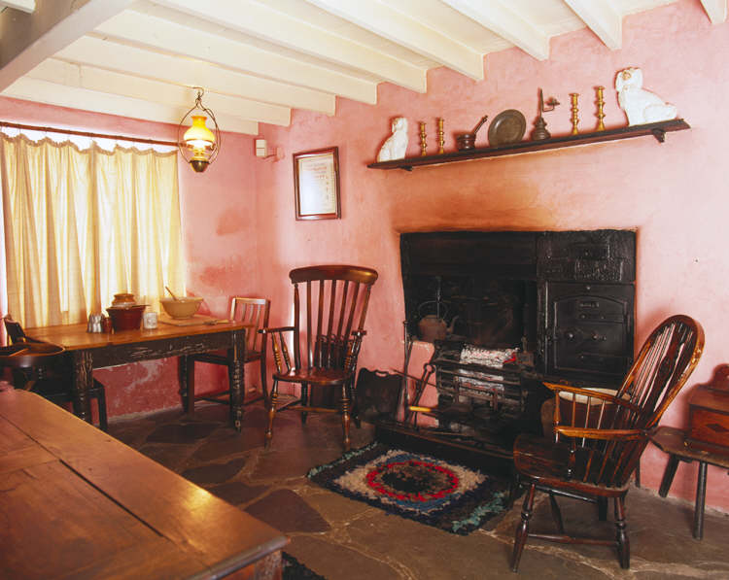
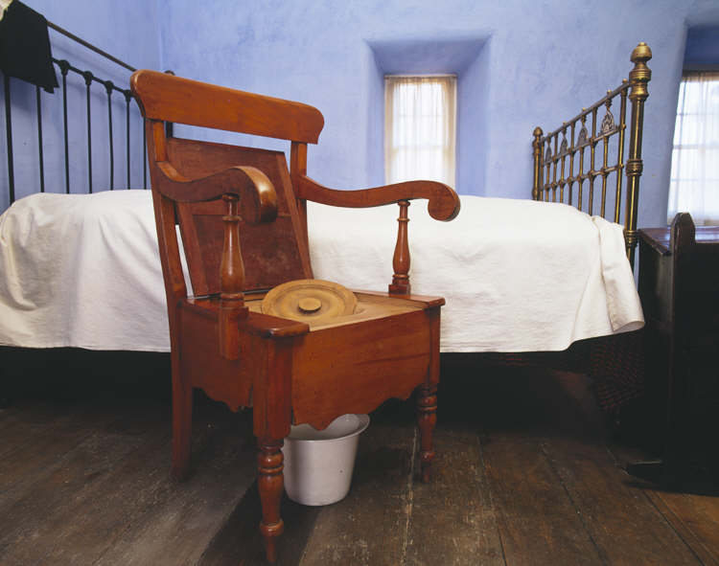
Houses and Homes – Odd One Out
Click the image you think is the odd one out?
Why do you think this?
VICTORIANS

Slide 30
TRY AGAIN!
CLICK TO TRY AGAIN

Slide 31
CORRECT!
The three similar images are from the David Lloyd George Museum. You can find more at www.gtj.org.uk
CLICK TO GO BACK TO THE START

