Slide 2
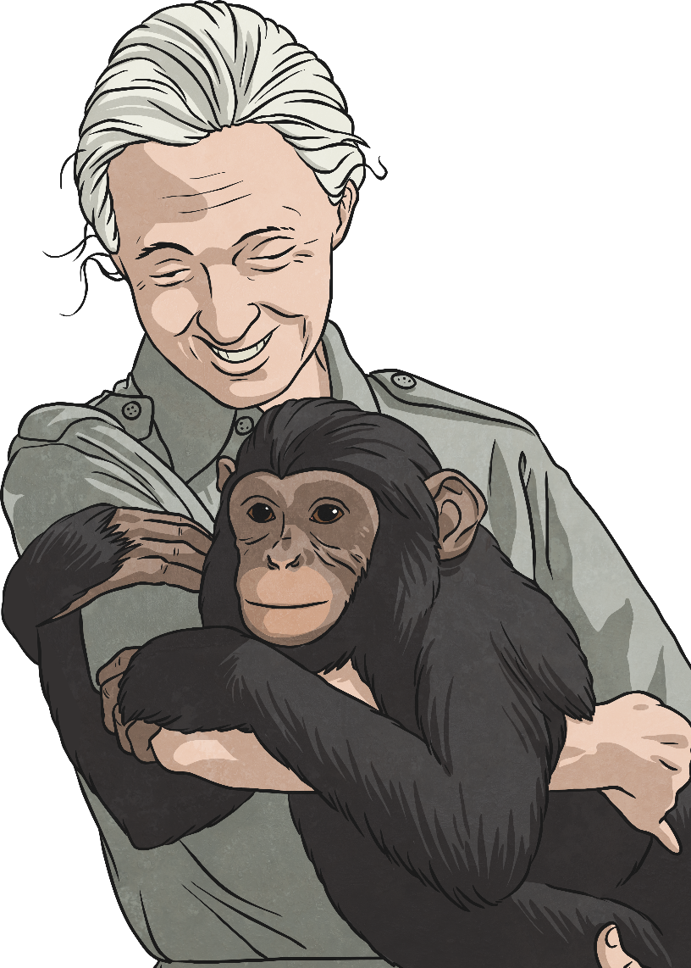
Who is Jane Goodall?
Jane Goodall is a British scientist who has studied chimpanzees for many years.
She is considered to be the world expert on chimpanzees and their behaviour.
Goodall was born in 1934 in London. When she was a child, her father gave her a chimpanzee toy, which began her lifelong love of animals.

Slide 3
Jane's Work With Chimpanzees
In 1960, Goodall was appointed as a chimpanzee researcher by a famous archaeologist called Louis Leakey. Leakey sent her to Gombe Stream National Park, in what is now called Tanzania in Africa, to observe the chimpanzee troop living there.
Tanzania was known as Tanganyika when Jane Goodall went to study the chimpanzees there.

Slide 4
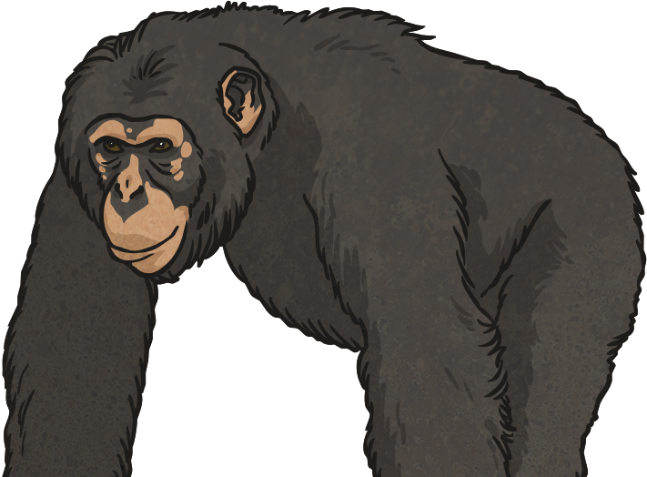
Jane's Work With Chimpanzees
Jane began to study the Kasakela chimpanzee community. She used unusual methods, such as giving the chimpanzees names. At that time, scientists working with animals would use numbers to identify the animals, so they didn't get too attached. Goodall's methods allowed her to observe the chimpanzees' personalities and emotions.
Observing patiently over a number of years, Goodall won the trust of the chimpanzees, and noticed new and interesting things about the chimpanzees' behaviour.

Slide 5
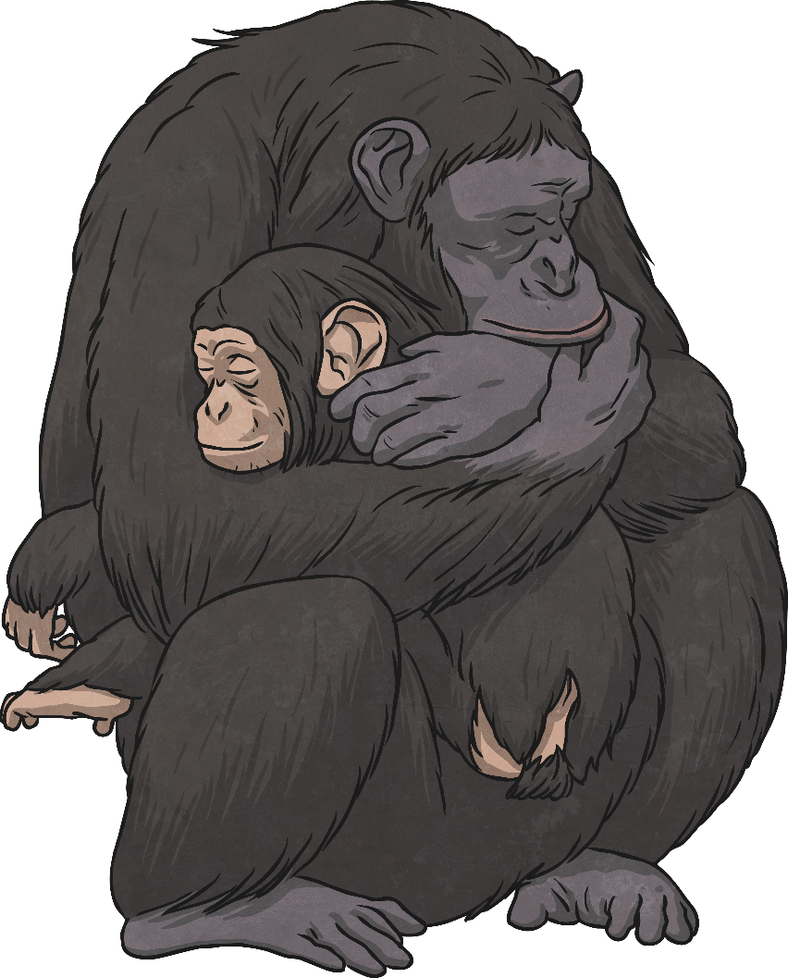
Jane's Work With Chimpanzees
She found that the chimpanzees had strong family bonds that would last for the whole of the chimpanzees' lives. She observed family members hugging, kissing, patting each other on the back, and even tickling each other!
Goodall became familiar with several families of chimpanzees, and watched new family members be born. She saw the life cycle of the chimpanzees in action.

Slide 6
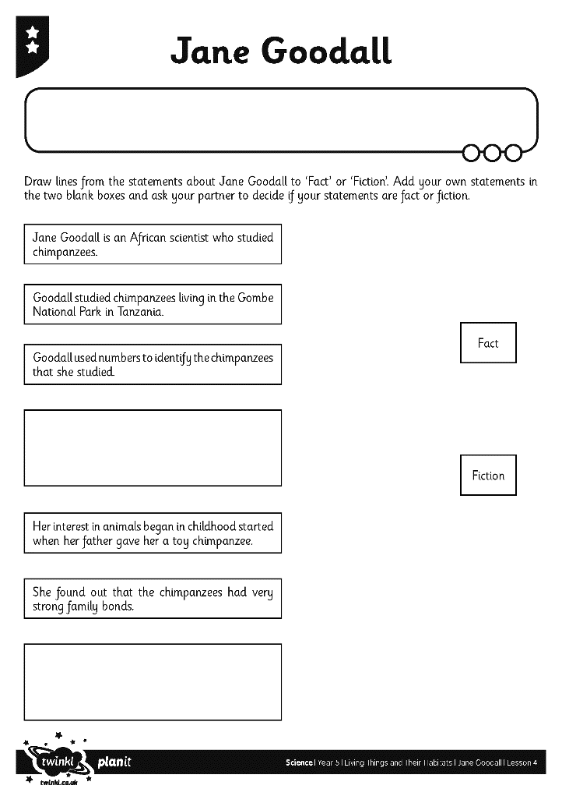
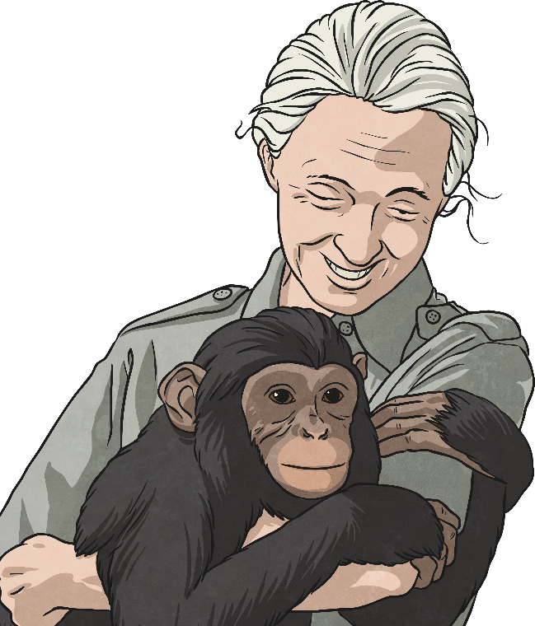
Fact or Fiction? - Activity One
Match the statements on your Jane Goodall Activity Sheet to show whether they are facts or fiction.

