Slide 2
Aim
I can explain what mindfulness is.
Success Criteria
I can recognise when my mind wanders.
I can describe what happens when I do not pay attention.
I can identify how mindfulness helps to settle my mind.

Slide 3
The Big Questions

Slide 4
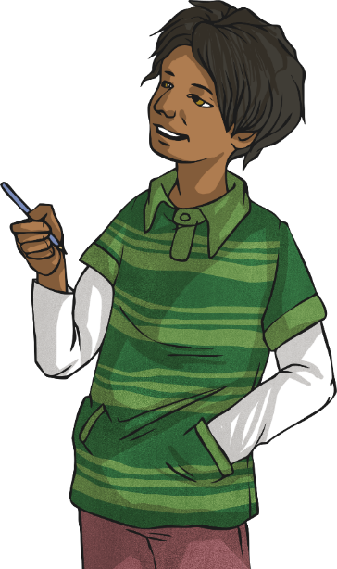

The Big Questions
What do you know
about mindfulness?
What do you think we mean by ‘the
scattered mind’?

Slide 5
Reconnecting

Slide 6

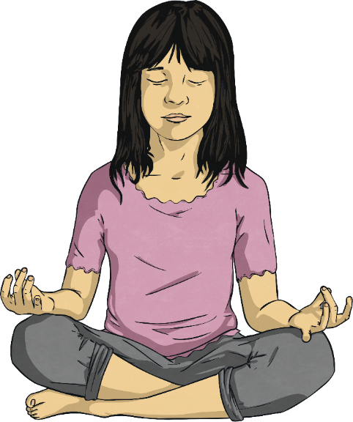
Mindful Scientists
How would you like to try a completely different subject and a new type of learning?
The subject is mindfulness.
In mindfulness, we learn not from books but from our direct experience.
This means we use our senses and experiences to learn.
We learn about focus, concentration and being calm.
We also learn how to manage difficult emotions.
We can become calmer!

Slide 7
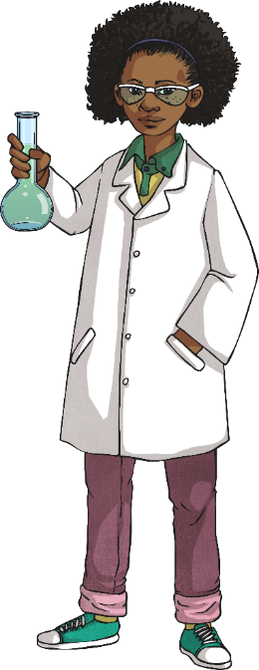
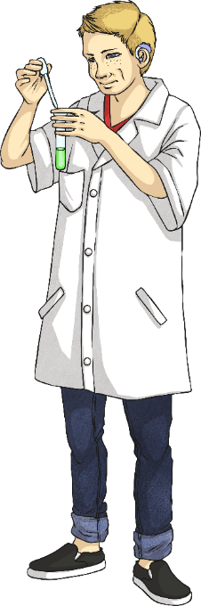
Mindful Scientists
Through mindfulness, we learn to observe and watch our
day-to-day experiences.
In our mindfulness lessons, we are going to be mindful scientists.
What does a scientist do?
A scientist:
explores what is happening;
does experiments in a laboratory;
tries to find answers to questions.
Today we are going to be mindful scientists. We will do experiments where we explore what is happening to us.

Slide 8
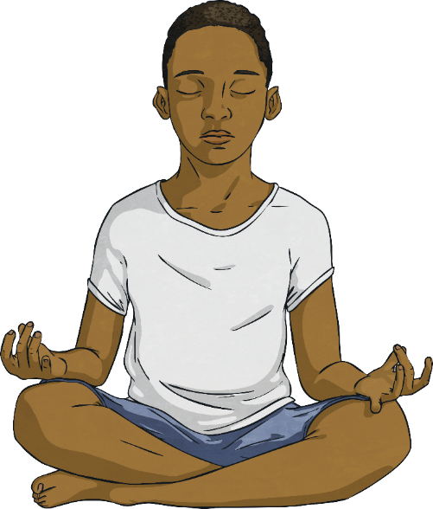

Mindful Scientists
Mindfulness is all about asking questions but not rushing for answers.
We just look closely and see what comes up.
Mindfulness is not about getting the right or wrong answers, we just want to see what we think and feel.
Another important part of mindfulness is learning to be OK with not knowing!

Slide 9
Exploring

Slide 10
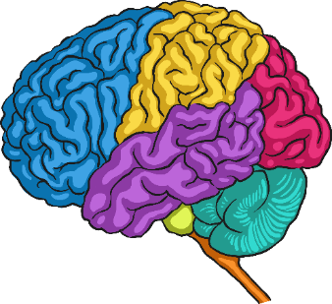
What Is Mindfulness?
Mindfulness is a practice that allows us to look at our experience.
Mindfulness helps us to understand ourselves, our behaviour and
our habits.
Mindfulness practices train us to be more focused, settled and calm.
Through mindfulness, we learn to pay attention to our:
thoughts;
emotions;
physical feelings.
We can then see how these affect our mood and behaviour.
Learning to pay attention also helps us notice when our mind has
become busy or scattered.

Slide 11

The Scattered Mind
Do you ever feel that the mind is unsettled and full of thoughts?
This is the mind being scattered.
It is quite normal to have a scattered mind but it can make it very difficult to concentrate. We can try a little activity to show this.
Sit down and just allow your mind to wander.

Slide 12
The Scattered Mind
Sit down and just allow your mind to wander.
How quickly did a thought pop into your head? Did you think about lots of things? Were your thoughts about the things you are worried about?
This lack of focus is often described in mindfulness as the scattered mind.

Slide 13

The Scattered Mind
Having a scattered mind is quite natural. However, a scattered mind affects more than our concentration. It can also affect how we are feeling.
Psychologists have discovered that when our minds are scattered, we are more likely to feel worried, sad and unsettled. This is because we are not focused on how things are but on the thoughts and worries in our minds.
These thoughts may not be real or true but they affect our mood, behaviour and how we feel because we focus on them and not on how things actually are.
Learning to recognise the scattered mind is a key part of learning to be calm and settled. It is a key part of mindfulness.

Slide 14


The Scattered Mind
This snow globe represents our busy, scattered minds. Imagine the snow gradually beginning to settle. This is just like our minds settling all
our thoughts.

Slide 15
Practising

Slide 16

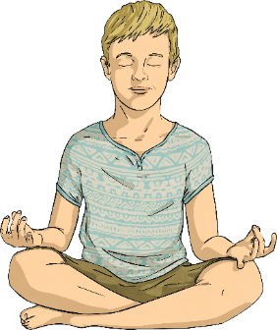
Guided Meditation
We are now going to practise focussing our scattered minds by taking part in a guided meditation. Remember, it’s natural for your mind to wander but
just try to bring it back to the meditation when you remember.
Consolidating
https://www.youtube.com/watch?v=W6rqDZnpCDw
Click on this link for a guided meditation.
Reflecting

Slide 17
Reflecting

Slide 18
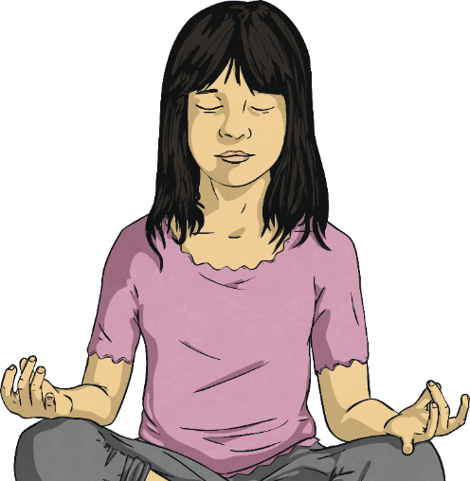
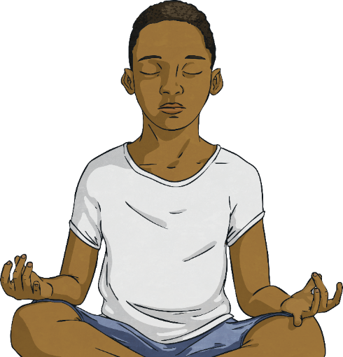
Discussion Time
Now, think about your experiences of the guided meditation.
What did you notice?
Did your mind wander?
Can you describe your experience?

Slide 19
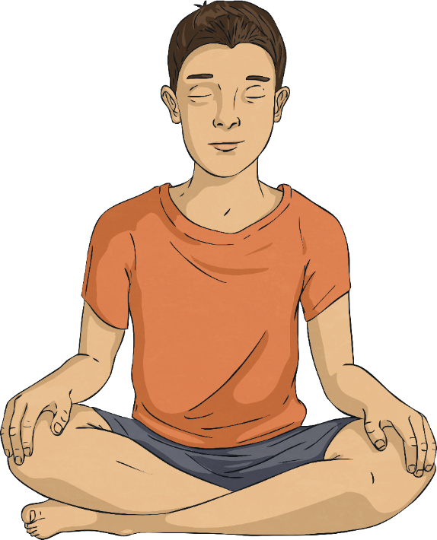
Discussion Time
Mindfulness helps settle the mind.
The mind is naturally scattered.
Learning to focus the mind can help us to settle and feel calm.
This can help us better understand our feelings and emotions.
It can help us not get so distracted by
our thoughts.
Practicing mindfulness can have a positive
impact on how we feel and on our
mental health.

Slide 20
Daily Mindfulness
Look at the document which says ‘Mindfulness Every Day. See if you can have a go at the different mindful activity - one each day and see if you can help your mind be more present and mindful.

