Slide 2
The Thirteen Colonies
The thirteen colonies were:
1. Connecticut
2. Delaware
3. Georgia
4. Maryland
5. Massachusetts (Boston)
6. New Hampshire
7. New Jersey
8. New York
9. North Carolina
10. Pennsylvania
11. Rhode Island
12. South Carolina
13. Virginia
In the 17th and 18th centuries, Britain colonised (took over and claimed of its own) many parts of the Atlantic coast (in America).
As time went on, the Thirteen Colonies started to govern themselves and worked together without involving Great Britain. This caused Great Britain to become annoyed and as this annoyance continued, the Americans formed the Continental Congress. This led to the American Revolution and The War of Independence where the Americans, with the help of France, fought Britain.

Slide 3

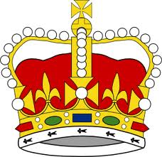

Why was the American Revolution fought?
+
+
HIGH TAXES NO REPRESENTATION WANT TO BE FREE
MONEY GOVERNMENT PHILOSOPHY

Slide 4
The Battle of Lexington and Concord
April 1775
The Battles of Lexington and Concord marked the beginning of the American War of Independence on 19th April 1775. The British Army had departed from Boston to capture rebel leaders Samuel Adams and John Hancock in Lexington. They also planned to destroy stored weapons and ammunition in Concord.
The colonists were warned that the British Army was approaching. Adams and Hancock were able to escape and the local militia was able to hide much of their weapons.
A large British army approached the town of Lexington. They were met by a small group of American militiamen. Neither side expected a fight. A British officer began calling for the militiamen to lay down their weapons. A gunshot was fired in all the confusions, forcing the British to attack. Some of the colonists were killed and the rest fled.
Militiamen were also known as minutemen for their ability to be ready on a moment’s notice.

Slide 5
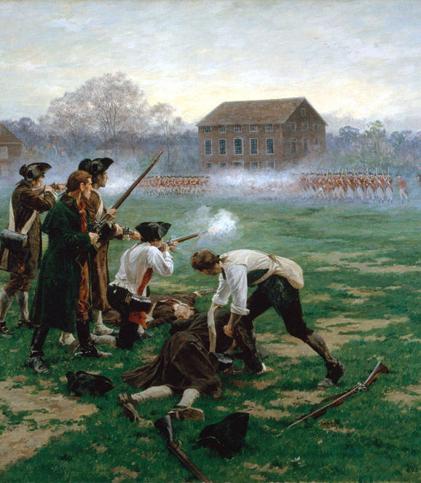
The Battle of Lexington and Concord
April 1775
The British marched towards Concord. They searched the town for hidden weapons. The colonists had been warned of the British Army’s approach and had hidden much of their weapons.
The Americans had retreated to the outskirts of the town and watched the British as they entered Concord. While the British were searching for weapons, more American militiamen arrived, making their forces stronger. The Americans decided to cross the North Bridge back into Concord. The militiamen began firing at the British from behind trees, stone walls and houses.
They overpowered the British Army and forced them to retreat to Boston.

Slide 6
The Second Continental Congress, April 1775
Following The Battle of Lexington and Concord, a meeting was called in Philadelphia on 10th May 1775 to assemble delegates to the Second Continental Congress.
Those present included Sam Adams, Patrick Henry, John Hancock, John Adams, Benjamin Franklin, and George Washington.
Some wanted to declare America independent immediately; some wanted to avoid war at all costs.
So Congress did both! They sent a document called the Olive Branch Petition to King George III to see if their differences could be settled once and for all, but also created an army and appointed George Washington as commander-in-chief (just in case!).
King George III refused to even read the document, and so Britain and America were officially at war.
The Congress acted like a government. They signed treaties, organised armies, and sent ambassadors to foreign countries in search of support.
On 22nd June 1775, Congress began printing their own currency in order to support the ongoing war.
On 4th July 1776, Congress issued the Declaration
of Independence.

Slide 7
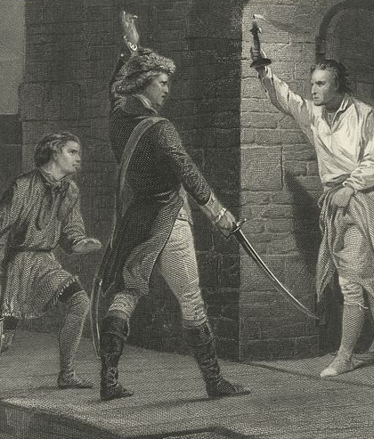
Capture of Fort Ticonderoga
May 1775
The capture of Fort Ticonderoga took place on 10th May 1775.
The Green Mountain Boys, a local militia group led by Ethan Allan, were tasked with taking over the fort for the Americans.
Colonel Benedict Arnold was also tasked with taking over the fort.
The Green Mountain Boys began to sneak across the river during the night. As dawn approached, Ethan Allan ordered his men
to attack.
The attack came as a surprise to the British, who were sleeping at the time.
The Americans took the fort without a single death. The Americans wanted to capture the fort to get control of its cannons. The cannons were moved to Boston where they were used to help end the Siege of Boston.

Slide 8
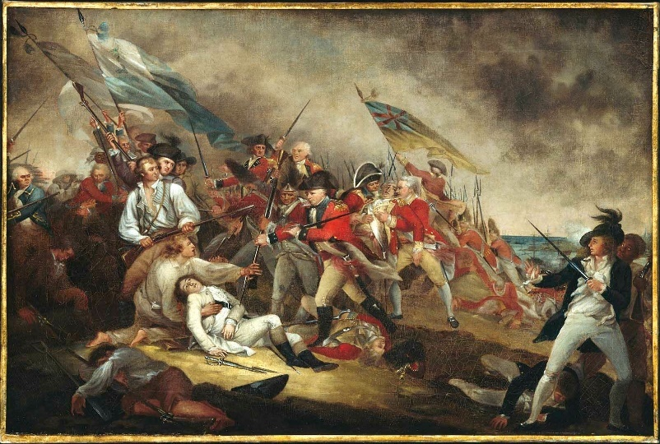
The Battle of Bunker Hill
June 1775
On 17th June 1775, the British troops defeated the Continental Army in the Battle of Bunker Hill in Massachusetts.
Boston had been under siege since April 1775. American minutemen had prevented the British Army from moving out of Boston by land. The British still had access to the sea port.
The British planned to take two hills, Bunker Hill and Breed’s Hill, in order to gain a tactical advantage. The American’s learned of this plan and secretly moved to the hills, built fortifications and prepared to defend their position.
The British realised what was happening and attacked.
The British led two charges up Breed’s Hill but the
American troops fought back. However, the Americans
Began to run out of ammunition, reducing the battle to
close combat. The militia had to retreat on the third
attack. The British took control of the hill, but suffered
hundreds of casualties.
Although it is known as the Battle of Bunker Hill most of the battle took place on Breed’s Hill.

Slide 9
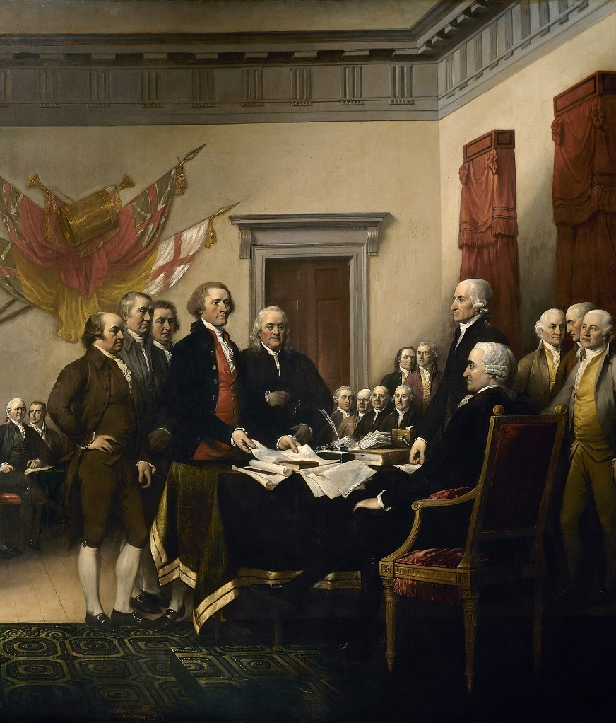
Writing the Declaration of Independence
June 1776
On 11th June 1776, the Continental Congress appointed five leaders to write a document explaining why the thirteen colonies were declaring their independence.
The five members were: Benjamin Franklin, John Adams, Robert Livingston, Roger Sherman and Thomas Jefferson. They were known as the Committee of Five.
Thomas Jefferson was tasked with drafting the Declaration of Independence.
Thomas Jefferson proclaimed that everyone is created equal and that everyone has a right to, “Life, Liberty and the pursuit of Happiness”.
The Declaration of Independence was presented to Congress on 28th June 1776, at Independence Hall in Philadelphia. It was officially adopted on 4th July 1776.

Slide 10
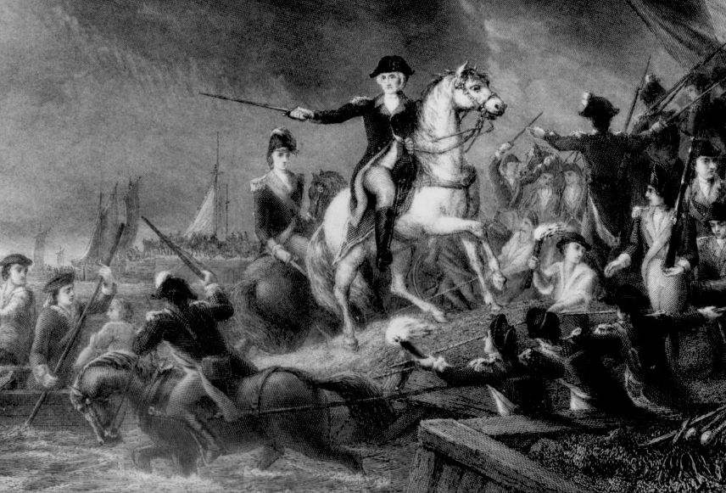
The Battle of Long Island
August 1776
The battle took place in the southwest of Long Island, New York on 27th August 1776.
This was the first major battle after the Declaration of Independence was signed.
The British had been forced out of Boston in March 1776; however, George Washington knew they would return.
The British intended to seize control of New York. Washington sent his army from Boston to defend New York. A British fleet arrived into the port in New York in July 1776. They set up on Staten Island. In August, the British attacked Long Island. A small British army attacked the
American defences, however the majority of the army flanked the Americans and attacked from the east.
Washington ordered his army to retreat.
Several hundred men fought the British army while the American army retreated. Washington and his army managed to escape to Manhattan.
The victory was important for the British Army and they remained in control of New York City for the rest of the war.
This area is called Brooklyn today and
the battle is often referred to as the Battle of Brooklyn.

Slide 11
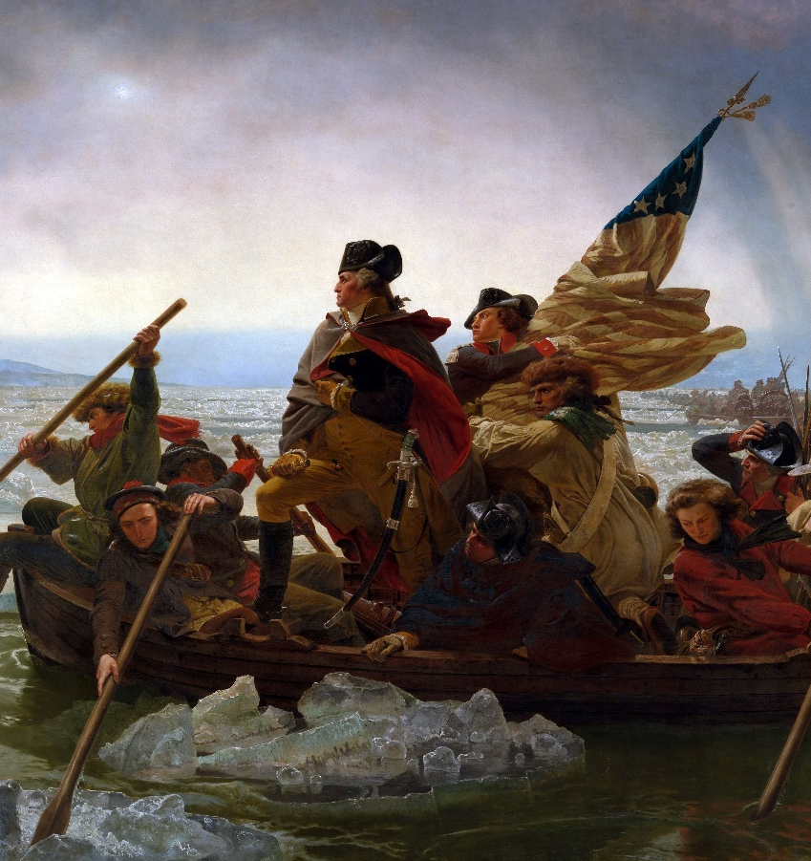
The Crossing of Delaware and the Battle of Trenton
December 1776
In the winter of 1776, George Washington and the Continental Army were camped on one side of the Delaware River. Stationed in Trenton on the side of the river was a regiment of Hessian soldiers.
Washington planned a daring assault on the Hessian soldiers. On 25th December 1776, George Washington and the Continental Army stealthily crossed the icy Delaware River. The following morning they attacked the Hessian soldiers, who did not expect an assault by the Americans.
The Hessian soldiers failed to set up a defensive position and their commander was killed in battle. The Hessians quickly surrendered. Washington realised his men could not hold Trenton from British reinforcements and decided to cross the Delaware back to their camp.

Slide 12
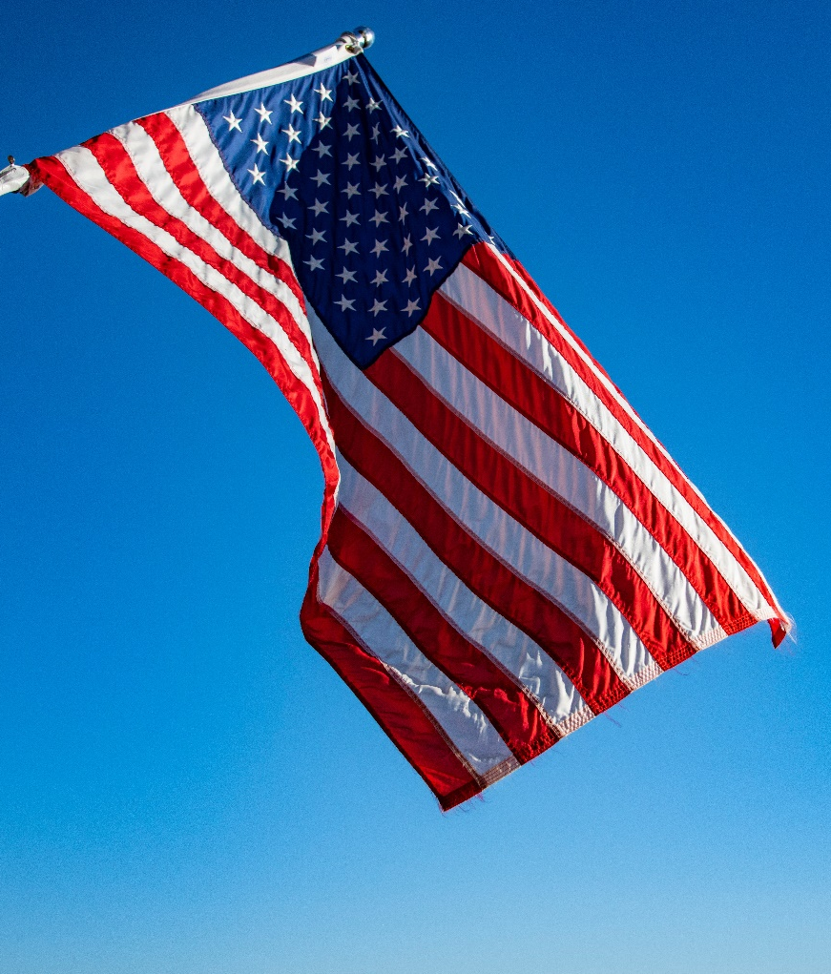
The United States Flag
1777
During the war, the Congress decided that the country needed a flag to represent the united colonies. The flag would later become a symbol of freedom.
On 14th June 1777, the Second Continental Congress passed the Flag Resolution for an official United States flag.
The flag was composed of 13 stars representing the 13 colonies, and alternating red and white stripes. The blue part in the upper left containing the stars became known as the Union.
According to legend, seamstress Betsy Ross sewed the first American Flag from a sketch that George Washington gave her. The first official United States flag flown during the battle was on 3rd August 1777.

Slide 13
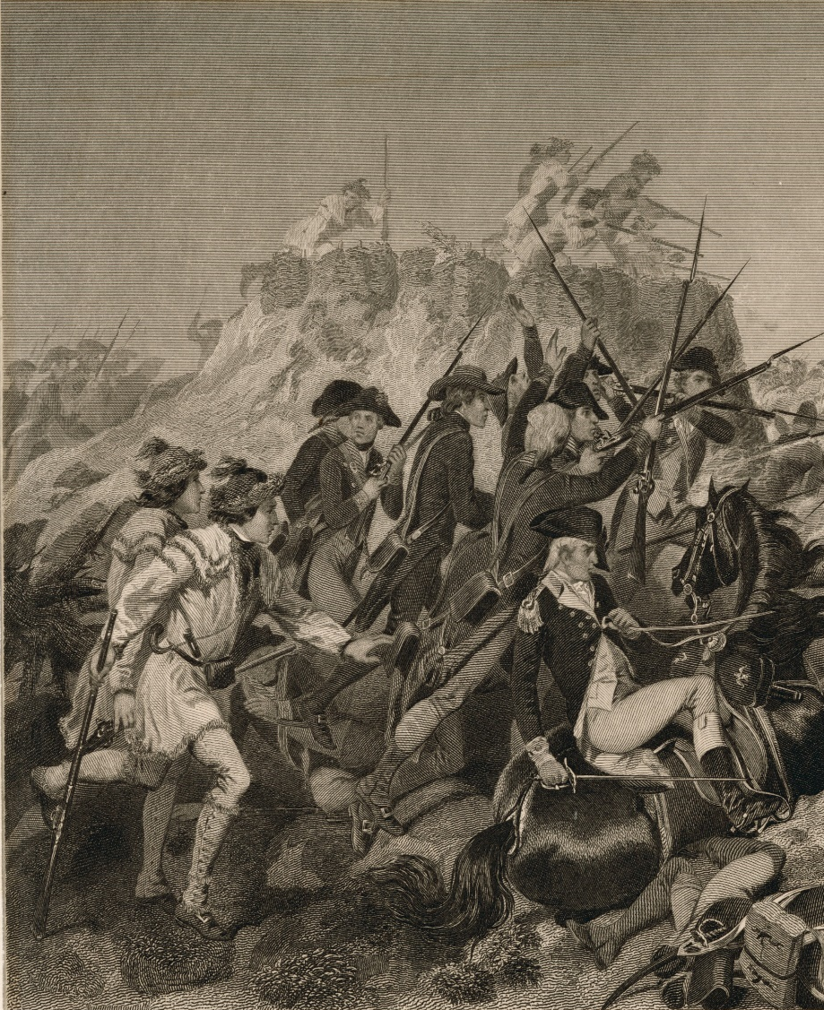
The Saratoga Campaign
The British, led by General John Burgoyne, had taken Fort Ticonderoga back with ease in July 1777.
General John Burgoyne, planned to move south, believing he would join with two other British regiments. He hoped separating New England from the southern colonies would make it easier to end the war. However, one of the British regiments, under the command of General Howe, headed east to Philadelphia.
Burgoyne marched south, but his slow progress allows the Americans to gather forces. Burgoyne, low on food and horses, sent troops to Bennington for supplies. However, Bennington was guarded by 2000 American soldiers, who easily dispatched the British soldiers. This weakened Burgoyne’s forces and gave Americans increased confidence.
New England included the colonies of New Hampshire, Massachusetts, Rhode Island
and Connecticut.

Slide 14
The Declaration of Independence
Watch this YouTube video to hear a simplified version of The Declaration of Independence.
This was a document that was written 2nd August 1776.
https://www.youtube.com/watch?v=hhqzGy8EguI

Slide 15
British Defeat, 1781
In October 1781, the war came to an end when General Cornwallis (British General) was surrounded and forced to surrender the British position at Yorktown, Virginia.
Two years later, the Treaty of Paris made it official: America was independent.

Slide 16
How did Britain lose?
DISTANCE
America was a long way from Britain
It took a long time to ship troops and supplies to America
This also had other effects
TIME
Reports to London were about 2 months out of date by the time they arrived
Orders to America usually arrived after the situation had changed
Generals in America had to do the best they could
TERRAIN
America was huge and the British couldn’t control the area by force – not enough manpower.
Troops needed to be stationed in a town or revolutionaries would take control again – limited the number of troops in the field.
Hard to operate away from a port – due to supplies.

Slide 17
How did Britain lose?
TACTICS
The Revolutionaries often used guerrilla warfare tactics.
Hit and run attacks.
If you do not fight a traditional battle – then you can not be defeated.
ALLIES
Spain, France and the Netherlands joined on the side of the colonists.
Their new allies gave them more man power, money and supplies.

Slide 18
Revolution Rap
The thirteen colonies in America
Were ruled by England’s king.
The colonists were so happy
The king’s praises they did sing.
Then he began to change things
That were not one bit funny.
He started to tax them
Which means they paid extra money.
As King George made new laws
New taxes he began to shout.
Many colonists became upset
And some even spoke out.
And that is when it happened
The king taxed the tea.
But it wasn’t quite a tea party
This you will plainly see.
Some colonists boarded ships
On a cold day in December.
They dumped 250 chests of tea
This you must remember.
The Redcoats came from Britain
It was order they wanted to keep.
Colonists formed the minutemen
And kept watch to hear one peep.
Paul Revere was paying attention
To see how many lights shone.
When he saw the lights he leapt on his horse
And rode out all alone.
“The Redcoats are coming. The Redcoats are coming.”
He began to warn.
Paul Revere was right
For the Redcoats arrived the next morn.
The shot heard round the world
Was not extremely loud.
It began a war that led
To a new nation that would be proud.
In 1776, American leaders met to sign
The Declaration of Independence
That gained freedom, yours and mine!

Slide 19
TASK
There were many battles in the American War of Independence. Newspapers were a common way of informing citizens about the events of the war. Write a newspaper report about one of the battles in the American War of Independence.
Pick one of the battles mentioned on the previous slides.
You may need to research a little bit more about the battle to help you.

