Slide 1
Narrative
Fairy Tales Adventure Legends
Fables Historical Fiction
Spooky stories Funny stories
Myths Animal stories
Fantasy Science Fiction
Detective

Slide 2



A Narrative needs:
Plot
Characters
Setting
4. Tension: problem and resolution

Slide 3
Plot
Problem in the middle
Tension – what’s going to happen?
Clues connected to the problem
Build up
Resolution
The main character will have ‘learnt’ something.
Setting & Characters
Ending
Beginning

Slide 4
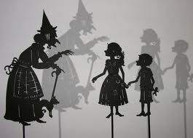
Characters
Think about WHO your characters are. Think about the details.
Name of your character. Make the name fit the character:
A happy character can have a happy sounding name: Milly/Molly/Toby/Mrs Sweet
A mean character can have a mean sounding name: Zik/Cranola/Mrs Shocker
Does your main character have friends?
How old is your character?
Describe the family of this character?
5. Where does this character live? Where was this character born? ( It can change.) Tom Money Banks was born in the biggest mansion on the rich side of town. It was strange then, that at 9 years old, here he was living in a shabby, run-down orphanage on the poor side of town.

Slide 5
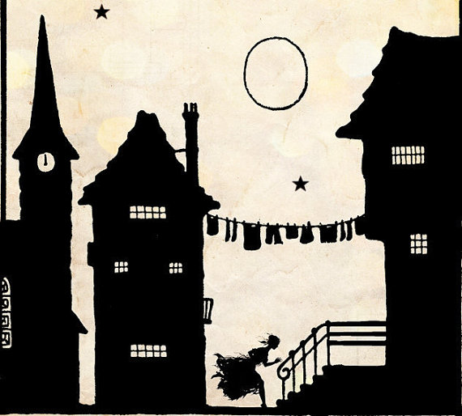
Setting
Make sure the setting fits with you story:
Mystery stories:
Old houses with hidden doors
Animals stories:
Zoos forests woods
Other settings – BIG space:
Mountain Beach Lost island Jungle Forest Ocean
Other settings – DETAILED space:
Old twisted tree shabby hut crooked house dark cave cold, dark lake
Settings can tell us something about the character:
Tom’s room was so messy that even his pet rat could not find its way back to its cage.

Slide 6
Tension: problem and resolution
Problem:
has to be difficult to solve
If the character chooses this way it will result in (B)
If the character chooses this way – it will result in (A).

Slide 7
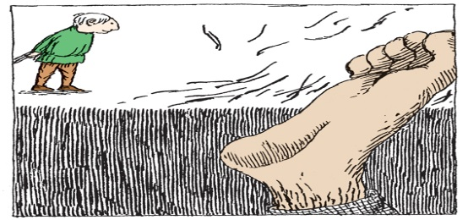
Catchy start
Short, sharp and dramatic leaves the reader wondering – why? What’s happened? The reader wants more……
Ben could not get up. His lips were bleeding, and his legs were wobbly.
Jane looked around. She had no idea where she had landed.

Slide 8
Openers for Beginning Middle and End
Beginning:
Once Upon A Time
One day
Let me tell you about
A long time ago
Yesterday
Jack ( character) had no idea where he was.

Slide 9
Openers for Beginning Middle and End
Middle:
All of a sudden
Suddenly
Unfortunately
Out of the blue
Without warning…..
They (characters) could not believe it: they found….

Slide 10
Openers for Beginning Middle and End
Beginning:
Finally
Eventually
Later on
A few days later
Sadly…
Happily…./ Luckily…./ Fortunately…/

