Slide 1
Monday: adding fractions

Slide 2
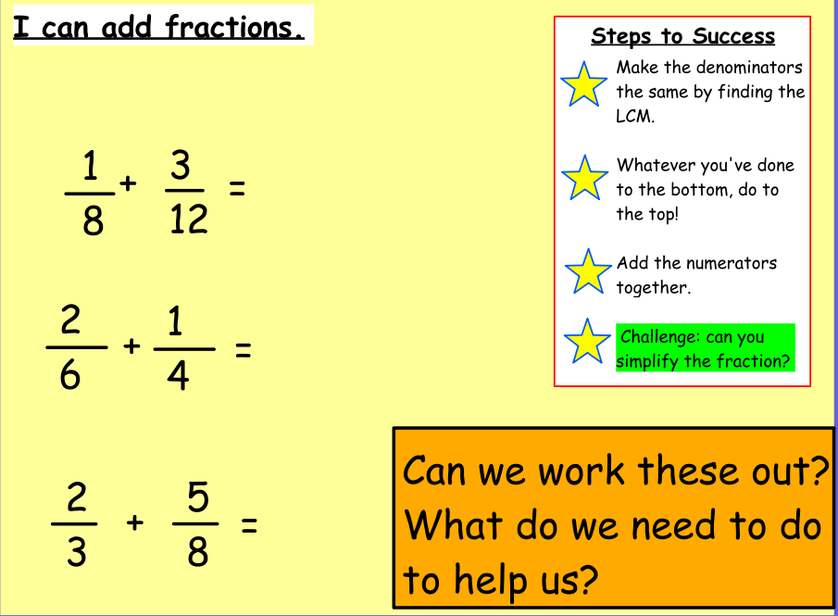
Adding Fractions

Slide 3
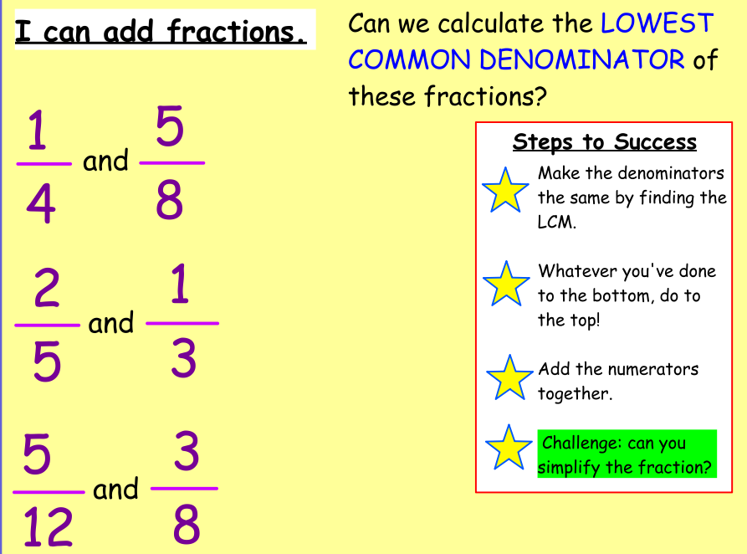

Slide 4
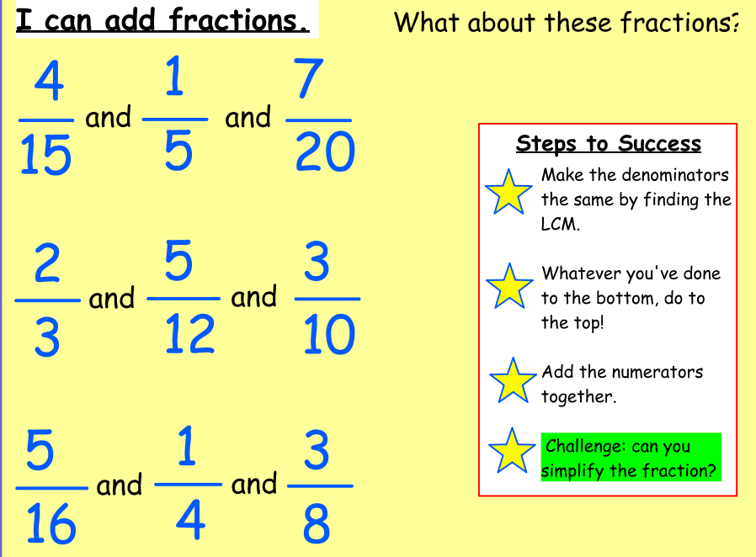

Slide 5
Adding fractions challenges

Slide 6
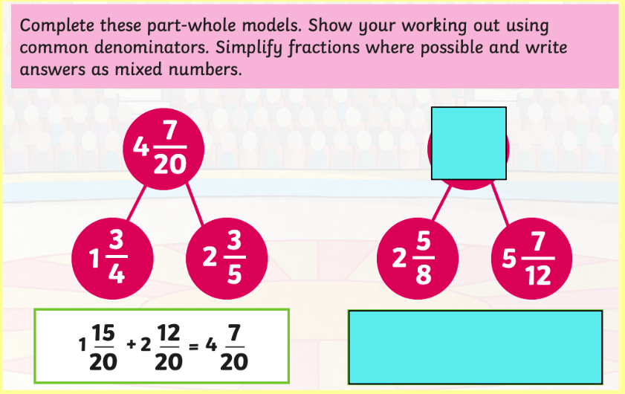
Adding fractions challenges
The first one is done for you.

Slide 7
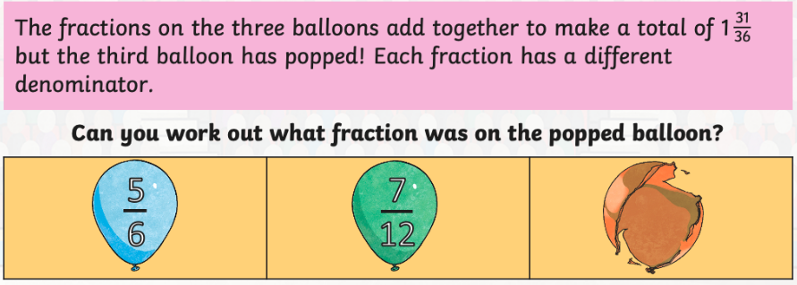
Adding fractions challenges

Slide 8
Tuesday: subtracting fractions

Slide 9
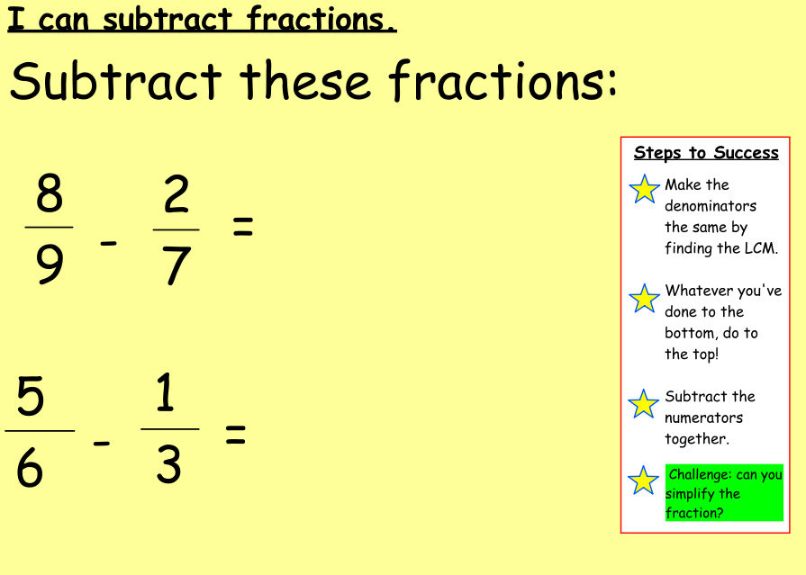

Slide 10
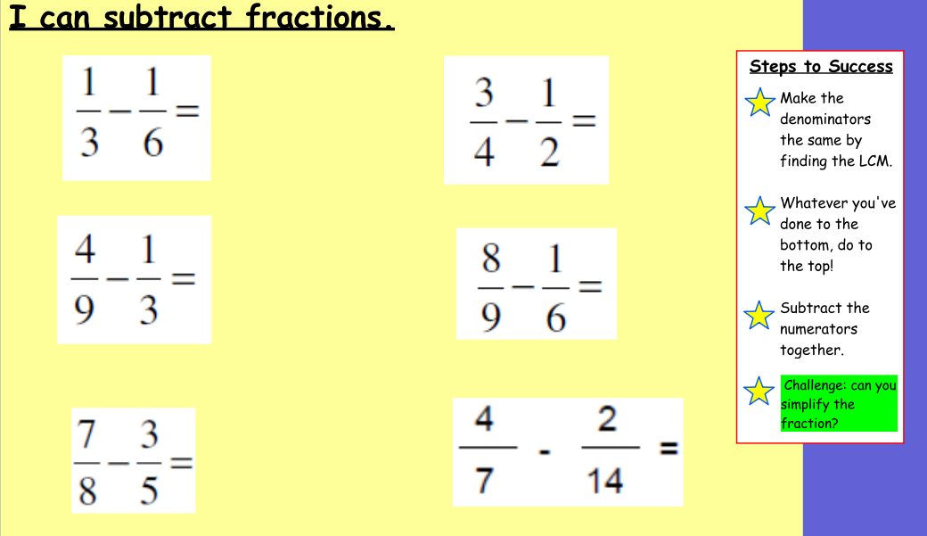

Slide 11
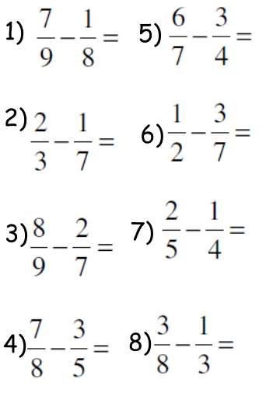
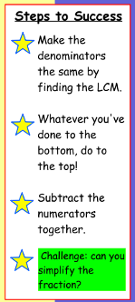
Try these questions…

Slide 12
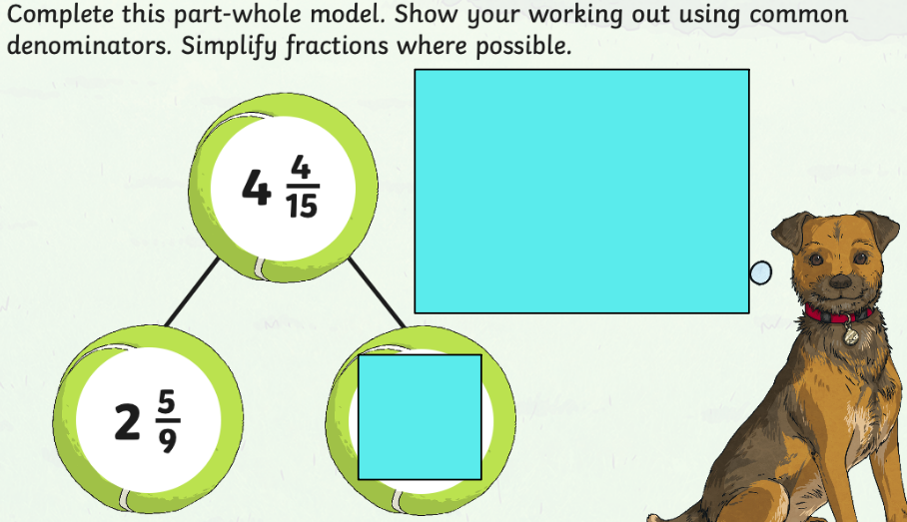
Subtracting fractions challenges

Slide 13
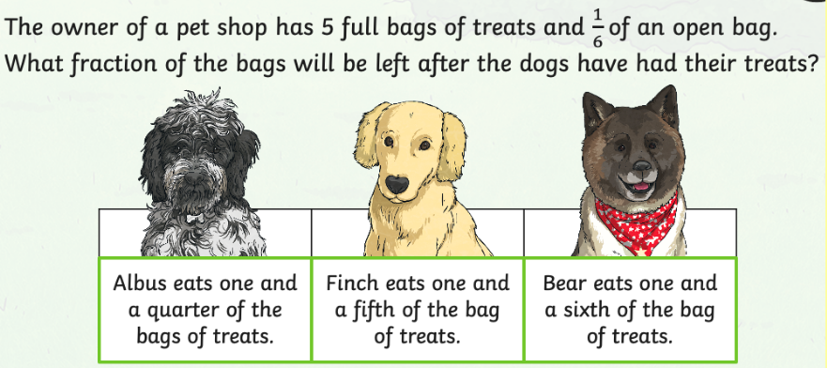
Subtracting fractions challenges

Slide 14
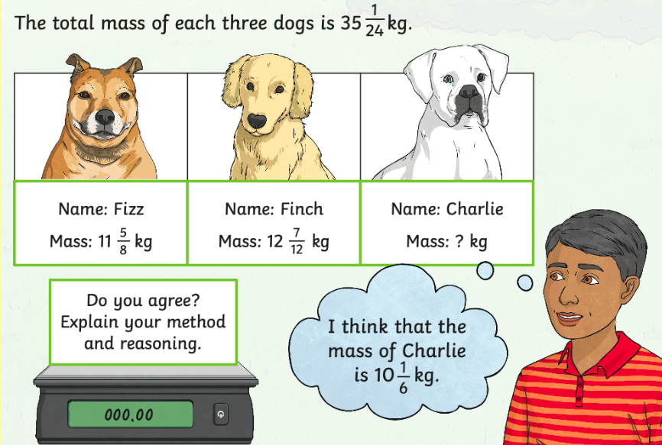
Subtracting fractions challenges

Slide 15
Wednesday: multiplying fractions

Slide 16
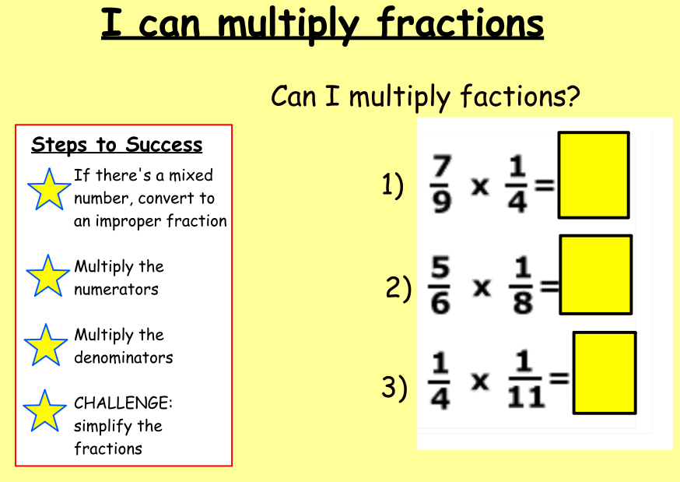

Slide 17
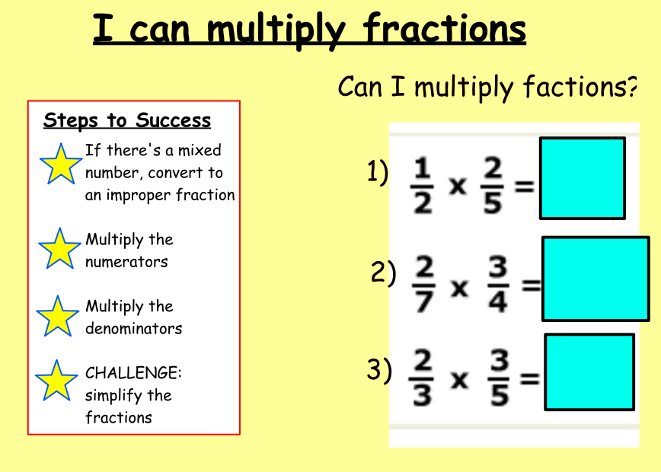

Slide 18
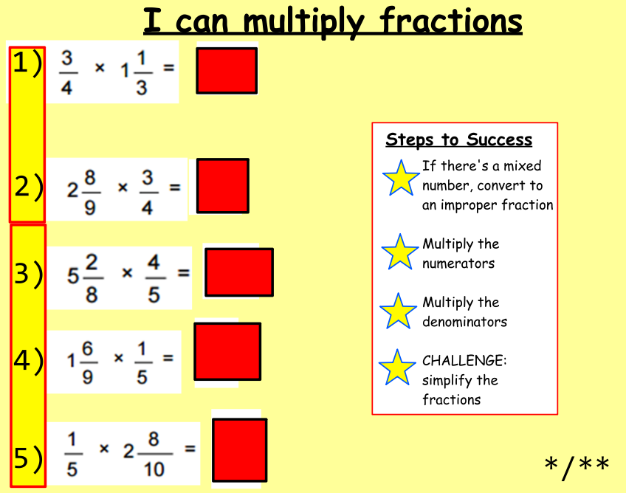

Slide 19
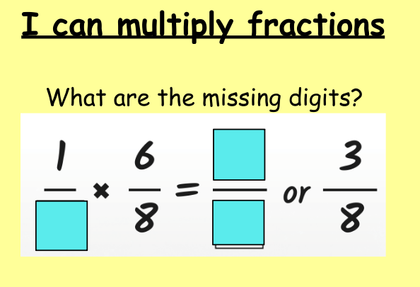
Multiplying fractions challenges

Slide 20
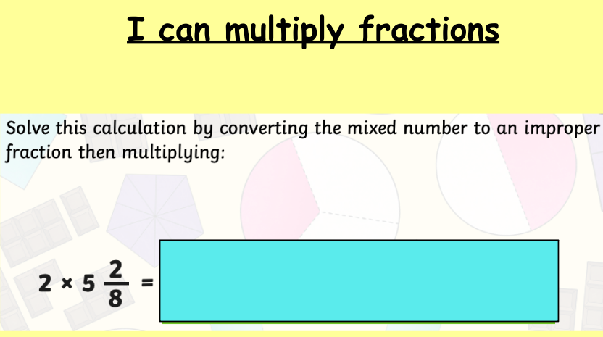
Multiplying fractions challenges

Slide 21
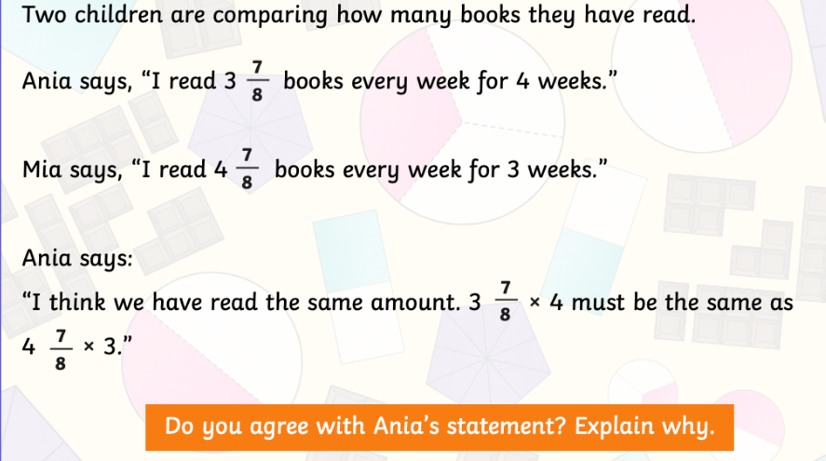
Multiplying fractions challenges

Slide 22
Multiplying fractions challenges

Slide 23
Thursday: dividing fractions

Slide 24
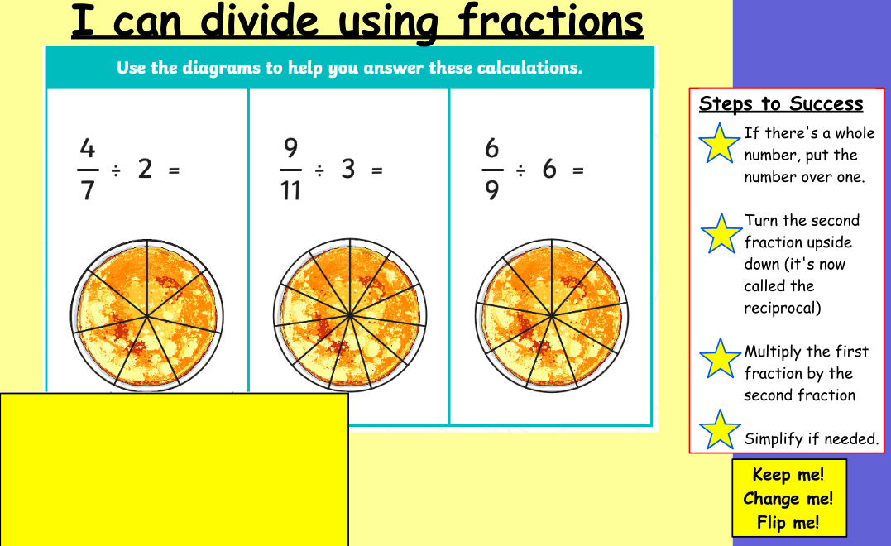

Slide 25
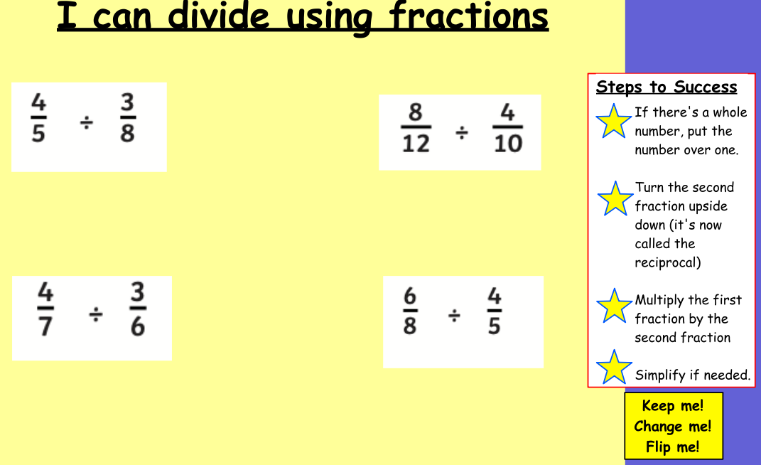

Slide 27
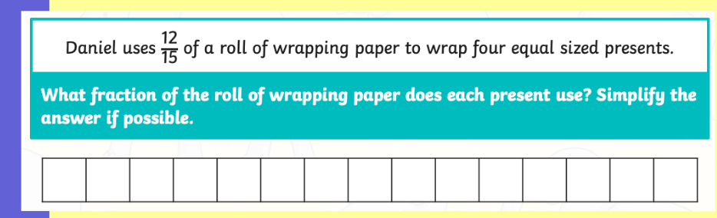
Dividing fractions challenges

Slide 28
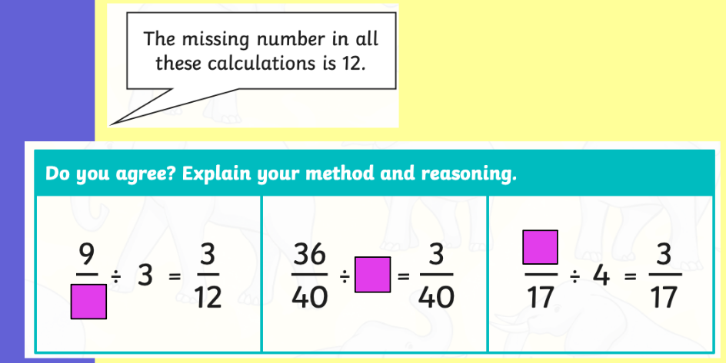
Dividing fractions challenges

Slide 29
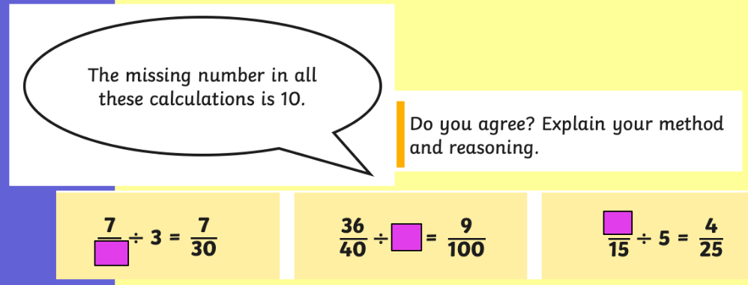
Dividing fractions challenges

Slide 30
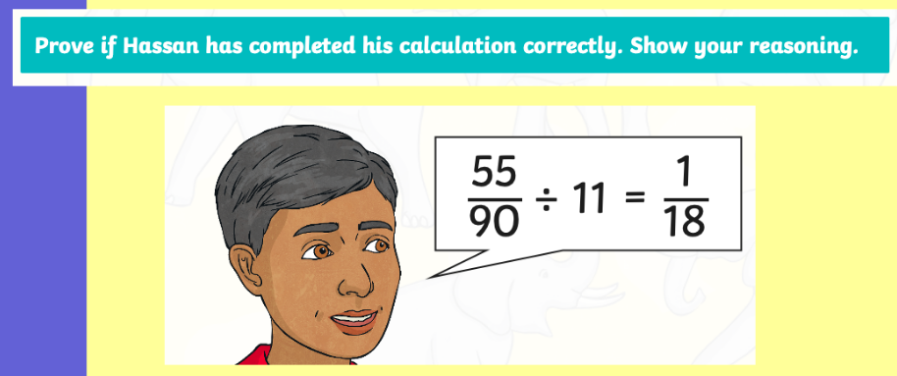
Dividing fractions challenges

Slide 31
Friday: all four operations

Slide 32
Design a Game
This week you’ve recapped your knowledge on all four operations in relation to fractions.
Similar to last week, we’d like you to design/create a game which encourages children to revise their fraction knowledge.
For example, you could create a game of snap where the cards are questions. If two cards with the same answer are placed on top of each other, a person can shout ”snap”. You would have to create the questions yourself, making sure that you have two question cards with the same answer.
This is just an example – you can design/create other games if you wish! If you do make them, please send pictures to uks2@northbeckton.ttlt.academy so we can see!

