Slide 1
Monday: Picture Perfect
Monday: Image introduction

Slide 2
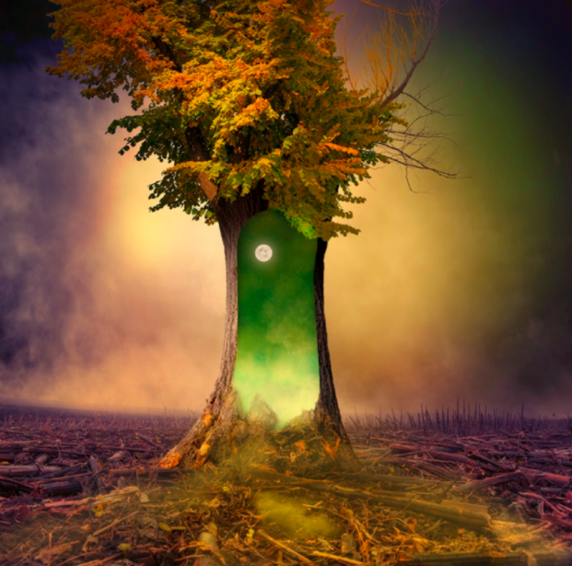
Think about:
What you can see.
What you wonder.
What you can infer.

Slide 3
Are there any parts of this image that remind you of Pocahontas?
How is the tree like Grandmother Willow?

Slide 4
Discuss and answer these questions:
What do you think has caused the destruction all around the tree?
Why has this one tree survived?
If you walked through the portal, what would happen to you? What would you see?
If this portal to another world, would you go through it or stay on Earth, even if you had no idea what could happen?
Is it good to take risks? Are some risks riskier than others?
Challenge: write your answers using PEE

Slide 5
Monday: Picture Perfect
Tuesday: Picture Perfect

Slide 6
Perfect picture!
Imagine you have just walked through the open portal and into the world inside the tree. Draw and describe what you can see.
Before you start, let’s recap last week’s learning on figurative language…

Slide 7
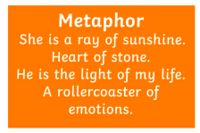
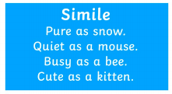
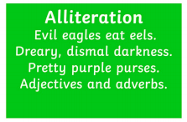
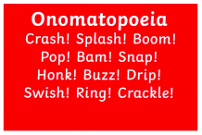
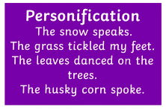
What is figurative language?
Remember, we use figurative language to create wonderful descriptions and to help the reader picture characters, settings and events.
MAPSO – these are the most common types of figurative language that we use. We’ve learnt about them a lot this year.
Things to remember:
Similes: use ’as’ or ‘like’
Metaphors: say something is something else
Personification: give something human characteristics

Slide 8
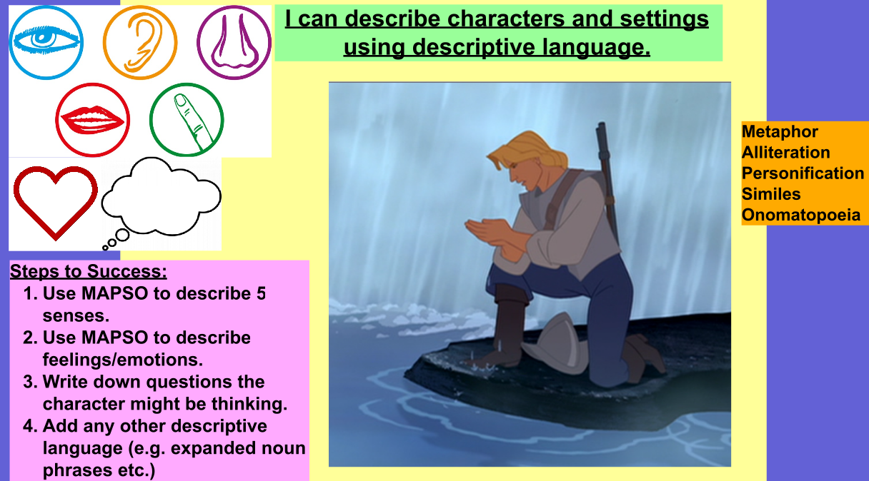
Examples:
Behind John, the waterfall gushed down, sending sparkling water droplets back into the air.
John knelt on the damp, slippery rock in order to scoop up some of the refreshing water.
John’s hand were rough like sandpaper due to the hard work involved in the journey.
The water of the waterfall bounced gleefully into the river.
RECAP:
Last week you looked at pictures from the Pocahontas film and wrote descriptive sentences about them.

Slide 9
Perfect picture!
Imagine you have just walked through the open portal and into the world inside the tree.
Draw and describe what you can see.
Use pictures of Grandmother Willow to help you.
Challenge: write a descriptive paragraph rather than descriptive sentences. Don’t just use figurative language, use varied sentence lengths to create suspense and tension.

Slide 10
Monday: Picture Perfect
Wednesday: Sentence Challenges

Slide 11
Warm up: prepositions
A preposition is a word that shows the relationship between one thing and another.
It may tell you where a thing is in relation to something else.
E.g. The green, shining door appeared inside the tree.
It may tell you when something is in relation to another event.
E.g. The portal would not close until the electrical storm had ended.
Can you find any prepositions in your writing from yesterday? Can you write 3 sentences that contain prepositions?
Challenge: can you write three sentences that include prepositional phrases?

Slide 12
Now we’re in Year 6, we’re expected to use some advanced vocabulary. This year, we’ve worked a lot on using synonyms and improving our writing to do this.
Have a look at the model writing on the next couple of slides.
Write a definition for the words in bold. If you don’t know the meaning, use a dictionary or dictionary.com to find out.

Slide 13
John Smith knelt on the damp rock by the river's edge and took in a deep breath of fresh, clean air: soothing his restless soul. Being away from the camaraderie of the other sailors was refreshing. Was needed.
John scooped up a handful of the crystal-clear water in front of him and splashed it over his tired face. Like a powerful potion he felt it rejuvenate him, removing the last of the treacherous journey's woes. Eager for more of the wonderful feeling, he grabbed another handful... only this time he noticed something odd. Rippling in the delicate mirror that sat calmly in his palms was a figure. A figure that was watching him. A figure that looked to be one of the natives. A savage!
Pocahontas looked down upon the Englishman, curious as to his actions. He didn't appear to behave savagely like she'd been warned he would. Suddenly he started to stand, and worried that he may see her, she dived back behind the cliff edge to conceal herself. From where Pocahontas was positioned, Tsenacommacah looked phenomenal: the waterfall gushed proudly into the river, droplets sparkling in the moonlight as they bounced off its surface. Trees stood proud, keeping a watchful gaze on what was unfolding in front of them, commanded to by the serene Grandmother Willow.

Slide 14
Cautiously, Pocahontas peered round the cliff edge - he was gone! Without thinking, heart, not head, leading the way, she scaled the cliff face as skilfully as any predatorial animal. As soon as she reached the river bank, Pocahontas took a nimble and gracious leap, landing elegantly (like the most prestigious ballerina), on to the first stepping stone. Little did she know, whilst she was doing all this - whilst she was acting like the predator scoping out its prey - there was someone watching her every move. Someone with an extremely powerful weapon. Someone with the power to end her life.
John, who had watched this mesmerising figure almost dance with the mountain she climbed down, was armed and ready to pounce. Focused on nothing but his own safety, he leapt, soaring through the waterfall and landing on a stone not far from where Pocahontas stood. Pocahontas started to rise from her crouched position, and as she did so held the gaze of John. At their eyes locking, John lowered his gun, a feeling of awe and wonder spreading through his veins. "Who are you?" he asked, desperate to know the bewitching woman in front of him. There was no response but the eyes he was looking into were calling to him, pulling him closer. He took a gentle, timid step forward... but Pocahontas turned and ran.

Slide 15
Challenge
Use the new words you’ve learnt to write some descriptive sentences that either:
Are about the story of Pocahontas (similar to those in the model)
Or
About what you imagined it would be like if you stepped through the portal in the tree
Remember to also include figurative language in your sentences!

Slide 16
Monday: Picture Perfect
Thursday: Story Starter

Slide 17
So far this week you have:
Asked questions about this image
Drawn and described where you imagined this tree to lead
Practised using higher level vocabulary in your descriptive writing
Today, you’re going to be given the beginning of a story about the tree and use what you’ve learnt this week (and last week!) to help you complete it.

Slide 18
The tree was all that remained. A solitary figure, it stood there in defiance of the destruction surrounding it. The bark had begun to peel away, one piece at a time, joining the wreckage of other trees that lay scattered across the scorched earth.
This tree was different to the other trees. It contained magic. It contained hope…
Can you continue the story?
What is so different about this tree?
What has happened to the other trees around it?

Slide 19
The tree was all that remained. A solitary figure, it stood there in defiance of the destruction surrounding it. The bark had begun to peel away, one piece at a time, joining the wreckage of other trees that lay scattered across the scorched earth.
This tree was different to the other trees. It contained magic. It contained hope…
Make sure you apply what you’ve learnt! This means your writing should:
Use a variety of cohesive devices
Use higher-level vocabulary
Use figurative language (MAPSO)
Include speech that is punctuated correctly (inverted commas and all the rules)!
And, of course, punctuation!
Challenge: include some of the words you learnt the other day in your work. Use a variety of different sentence lengths to create tension and suspense.

Slide 20
Monday: Picture Perfect
Friday: Sick Sentences

Slide 21
Remind yourself of your story from yesterday.

Slide 22
Sick sentences warm-up:
These sentences are ‘sick’ and need help to get better. Can you help?
The big tree had bark and leaves. Inside the tree were stars and the moon.
Pocahontas started to rise from her crowched position, and as she did she helded the gaze of John.
As soon as she reach the river bank, pocahontas took a leaped, landed elegantly (like the fattest elephant), on to the first stepping stone.

Slide 23
Editing your own sick sentences
Today, re-read the story you wrote yesterday. As you re-read it, make improvements to the sick sentences you come across.
You will need to look for:
Spelling errors
Tense errors
Missing punctuation and punctuation mistakes
Things that can be up-levelled and improved
Cohesion – make sure you’re not repeating words

