Slide 1
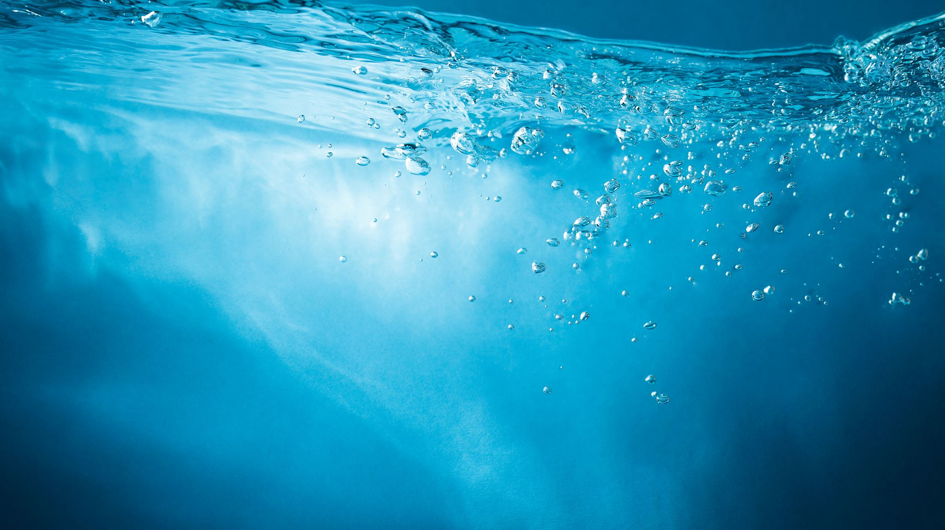
Water
How to write a poem based on rivers.

Slide 2
Monday

Slide 3
Vocabulary Challenge
______ : The process of water collecting in rivers, lakes, streams, oceans and other bodies of water. ______ : Particles of H20 in a cooling gas slow down and come together to form droplets of water. ______ : The fastest moving water molecules escape and form a gas. ______ : The release of water from clouds in the form of rain, sleet, snow, or hail. ______ : The movement of water out of a plant to the atmosphere in the form of a gas. ______ : A cycle that involves the processes of evaporation, condensation and precipitation. ______ : When water changes from a solid to liquid. ______ : When water changes liquid from solid.
Melting
Precipitation
Condensation
Water cycle
Freezing
Evaporation
Transpiration
Accumulation
Absorption
Estuary

Slide 4
Vocabulary Answers
Accumulation : The process of water collecting in rivers, lakes, streams, oceans and other bodies of water.
Condensation: Particles of H20 in a cooling gas slow down and come together to form droplets of water.
Evaporation: The fastest moving water molecules escape and form a gas.
Precipitation : The release of water from clouds in the form of rain, sleet, snow, or hail.
Transpiration : The movement of water out of a plant to the atmosphere in the form of a gas.
Water cycle : A cycle that involves the processes of evaporation, condensation and precipitation.
Melting : When water changes from a solid to liquid.
Freezing : When water changes liquid from solid.
Absorption : Taking liquid into a root system for plants from soil.
Estuary : An area where fresh water mixes with salt water.

Slide 5
Vocabulary Challenge
Now use the vocabulary from the previous slide to write a paragraph or two explaining how the water cycle works. You can use the link below to help you remember how the water cycle works.
https://www.youtube.com/watch?v=TWb4KlM2vts

