Slide 1
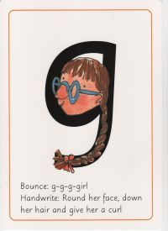
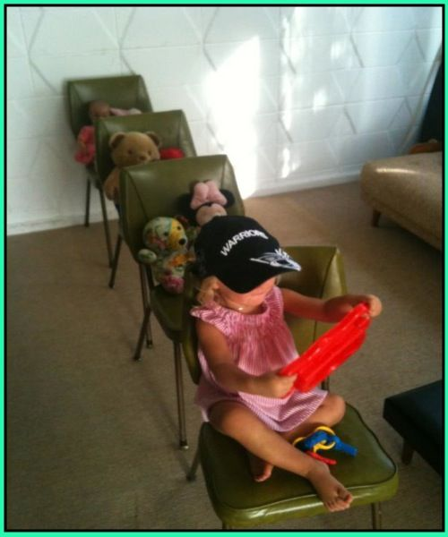
LEARNING FROM HOME
Nursery– Week Beginning 8.6.2020
This week’s book focus is ‘Naughty Bus’
https://www.youtube.com/watch?v=sqQ1BAEj1oE
Click on the above link to listen to the story on YouTube.
Who was the author?
Advised Timetable:
Read a story every day.
Practise writing your name every day or other familiar sounds.
Complete a phonics and numeracy activity every day.
Complete at least 1 activity from other areas each day.
Take part in rhyme time every day.
Literacy:
Read the story together.
Can you act it out using props at home?
Can you talk about a time when you have been on a bus?
What did you see on your bus ride?
Phonics Sound ‘g’
The rhyme for letter formation:
Round the face, down her hair and give her a curl!
Can you look around your house and find things beginning with that sound?
Can you practise writing ‘g’?
Numeracy activity:
Do you know your numbers 1 -10
Do you have any transport or lego toys you can count?
Can you draw a picture of 10 people waiting for the bus?
Expressive art and design:
Can you draw and colour a bus?
What other transport do you know?
Can you make your own bus station using Lego bricks or any other construction toys you may have?
Physical development
Can you pretend to be a bus driver and go over under, over, through and under a bridge/tower you have made with household items e.g cushions, chairs etc.

