Slide 1
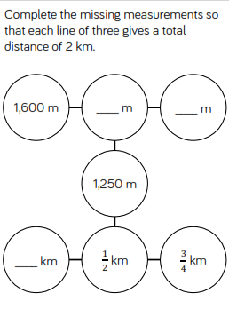
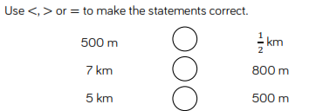
Starter
Hot
Mild
Spicy

Slide 2
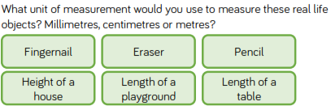
What would be the best equipment to measure km, m, cm,mm with? (e.g. tape measure, ruler, metre stick) What do we have to remember when using a ruler to measure? Which unit of measurement are we going to use to measure kilometres, centimetres or millimetres? What unit of measure would be best to measure weight?
RECAP

Slide 3
Perimeter
What is perimeter? https://www.youtube.com/watch?v=6mopAgqjkVM After watching the video answer following questions:
Which shape do you predict will have the longest perimeter?
Does it matter where you start when you measure the length of the perimeter?
Can you mark the place where you start and finish measuring?
Do you need to measure all the sides of a rectangle to find the perimeter? Explain why.
What do you think rectilinear means? Which part of the word sounds familiar?
( Recti=straight Linear= Line A rectilinear polygon is a polygon all of whose edges meet at right angles. The interior angle at each vertex is either 90° or 270°)
6. If I know the length and width of a rectangle, how can I calculate the perimeter? Can you tell me 2 different ways? Which way do you find the most efficient?

Slide 4
Choose the images where you can find the perimeter
a
b
c
d
e
f
Explain why you can’t find the perimeter of some of the images.
I wonder….
If a rectangle has a perimeter of 16 cm, could one of the sides measure 14 cm? 8 cm? 7 cm?
Convince me!

Slide 5
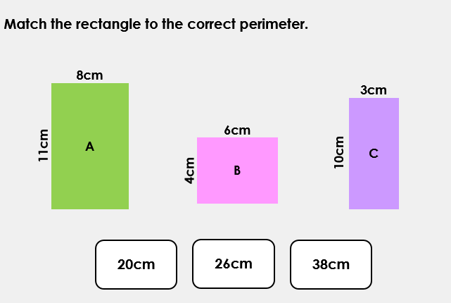

Slide 6
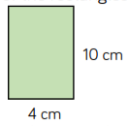
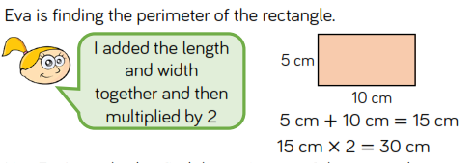
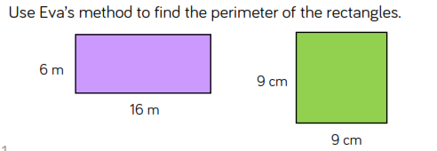
Calculate the perimeter of the rectangles:
Activity 1 in your book

Slide 7
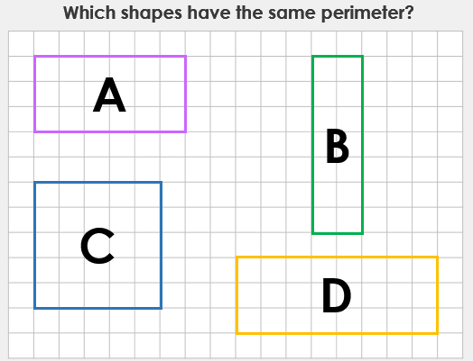
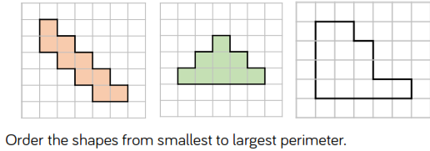
Activity 2 in your book a) Draw a shape with a perimeter of 10 cm b) Using squared paper, draw two rectilinear shapes, each with a perimeter of 28 cm. What the longest side in each shape? What is the shortest side in each shape?
Now try these:
a
b
c
Challenge:
Can a rectangle where the length and width are integers, ever have an odd perimeter? Why?

Slide 9
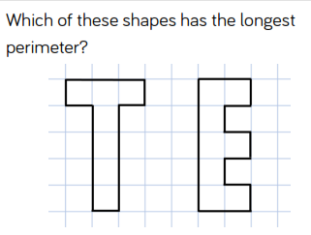
Challenge:
Explore other letters which could be drawn as rectilinear shapes.
Put them in order of shortest to longest perimeter.
Can you make a word?

Slide 10
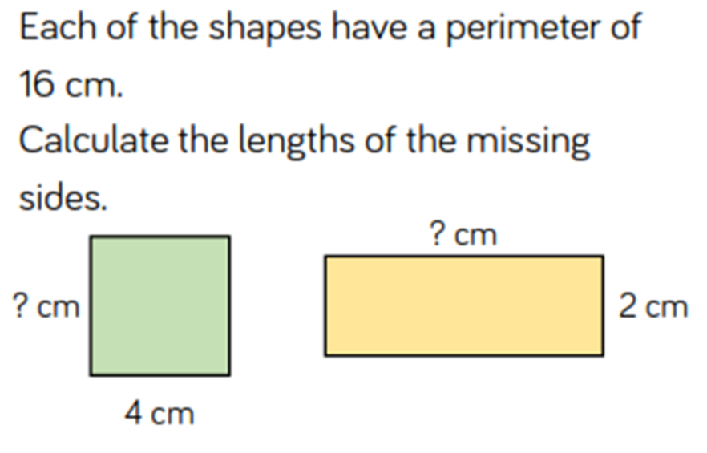

Slide 11
Activity 3 in your book
The width of a rectangle is 2 metres less than the length. The perimeter of the rectangle is between 20 m and 30 m.
What could the dimensions of the rectangle be?
Draw all the rectangles that fit these rules. Use 1 square side =1 m
Challenge:
Always, Sometimes, Never
When all the sides of a rectangle are odd numbers, the perimeter is even.
Prove it in your book!

Slide 12
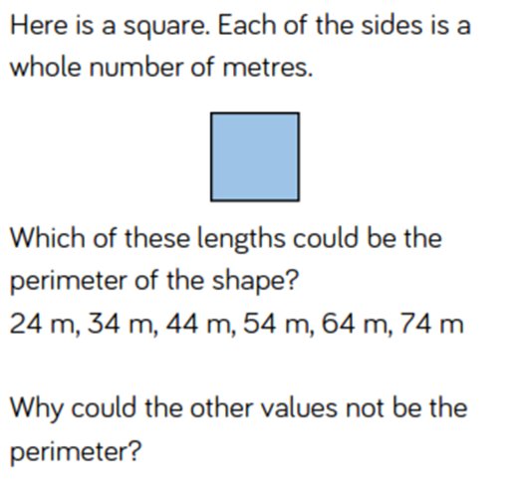
Challenge:

