Slide 2
Aim
I can compare the life cycles of amphibians and insects.
Success Criteria
I can explain metamorphosis and give examples.
I can describe the life cycles of amphibians and insects.
I can describe the similarities and differences between the life cycles of amphibians and insects.

Slide 3
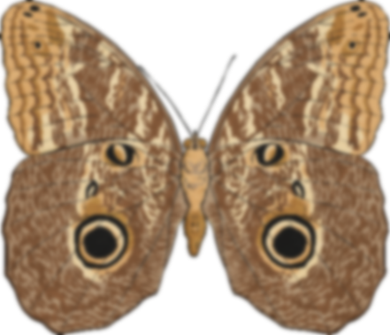
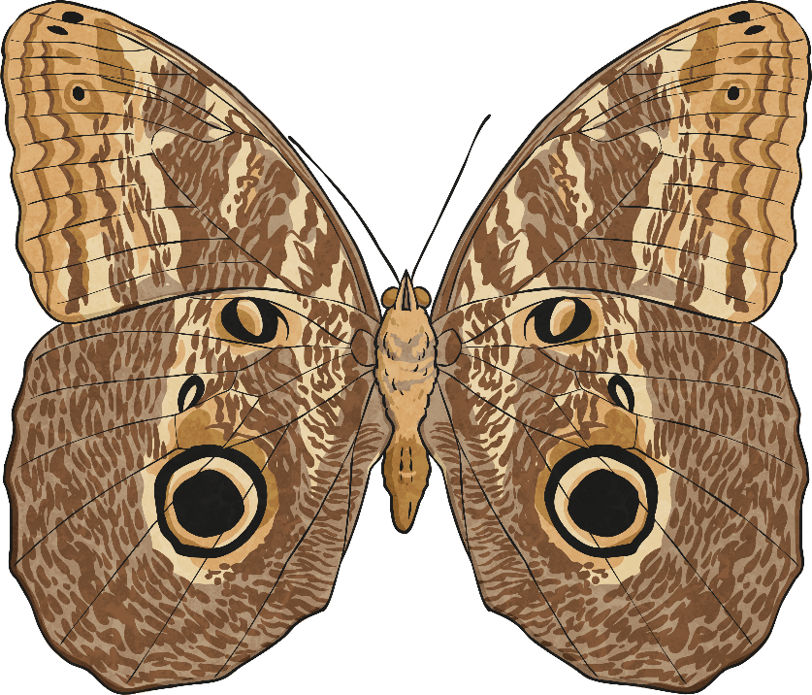
Metamorphosis
Metamorphosis is a process by which animals undergo an abrupt and obvious change in the structure of their body and their behaviour.
Some animals undergo complete metamorphosis, in which they completely transform. Other animals experience incomplete metamorphosis, where they go through several different stages, with each stage getting bigger than the last.

Slide 4
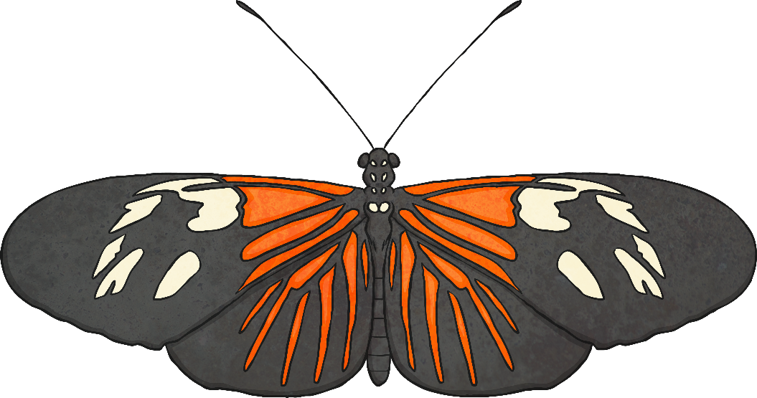
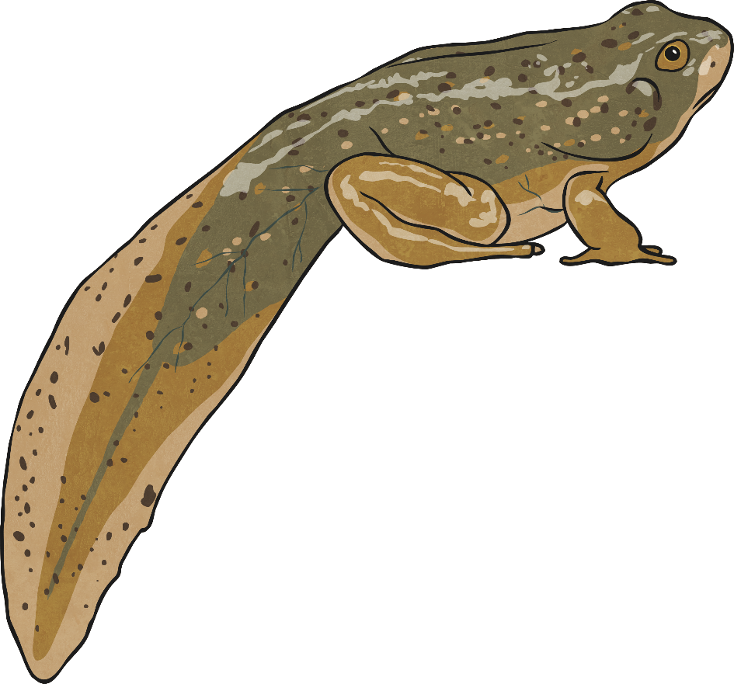
Animals That Change
Try to think of some animals that undergo metamorphosis. How do they change and transform? Use these pictures to help you get started!

Slide 5
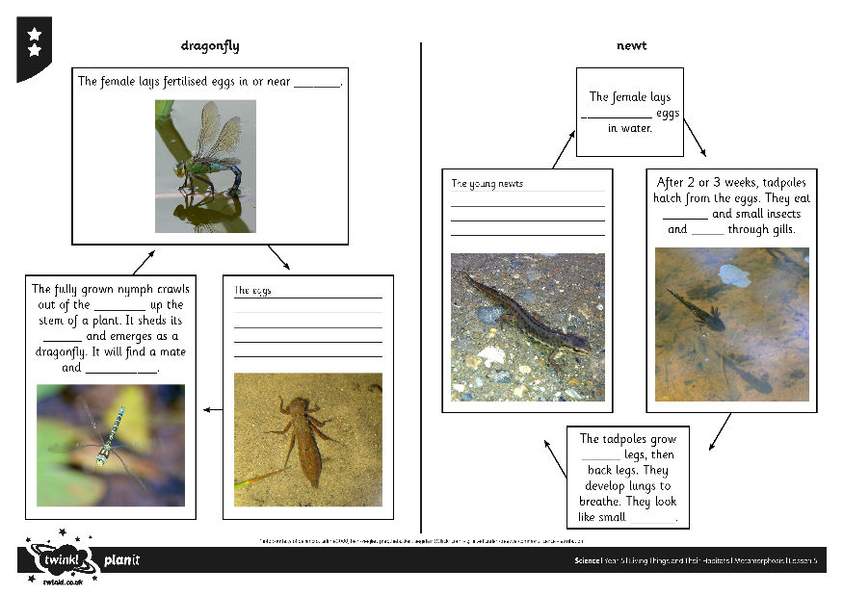
Amphibians and Insects - Activity One
Amphibians and insects are examples of animals that undergo metamorphosis. Their life cycles show the stages of their transformations.
Use the clue information pack to complete the life cycles on the Amphibians and Insects Activity Sheet. You can do these in your home learning book for each creature or on a Google document.

Slide 6
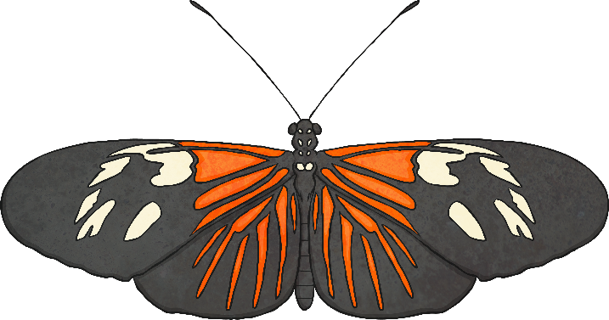
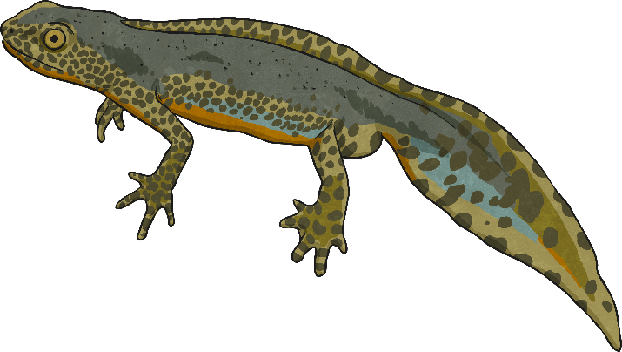
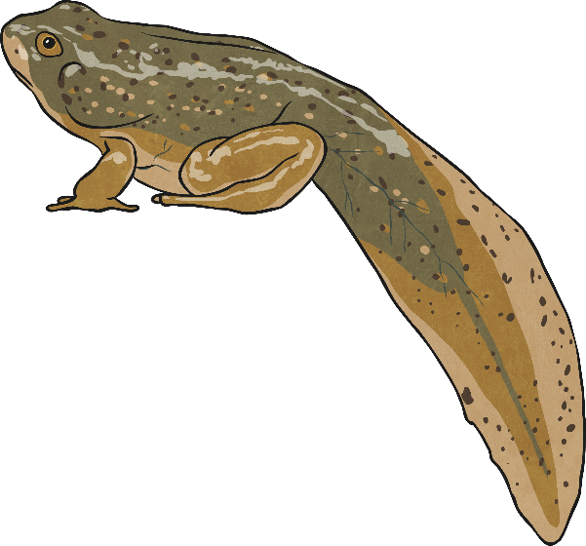
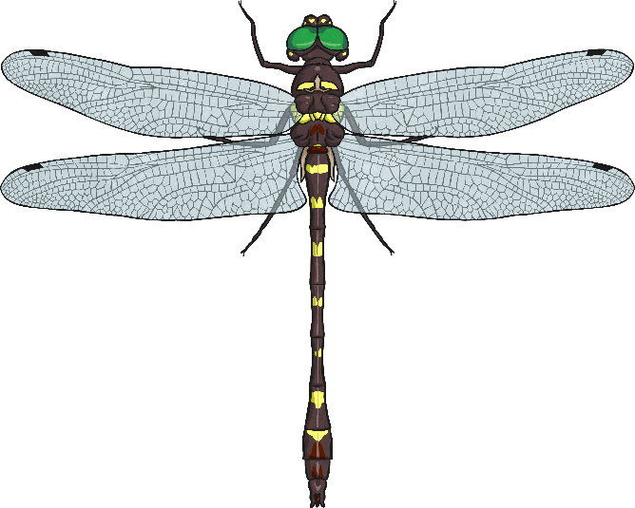
Comparing Life Cycles
Look at the life cycles you have described on your Amphibians and Insects Activity Sheet.
Can you find 3 similarities between the life cycles of the 4 animals?
Now identify 3 differences between the life cycles.

Slide 7
Aim
I can compare the life cycles of amphibians and insects.
Success Criteria
I can explain metamorphosis and give examples.
I can describe the life cycles of amphibians and insects.
I can describe the similarities and differences between the life cycles of amphibians and insects.

Slide 8
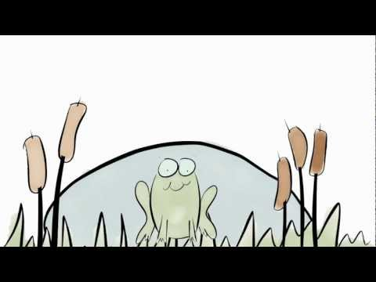
https://www.youtube.com/watch?v=Ka3q7bj45x0

Slide 9
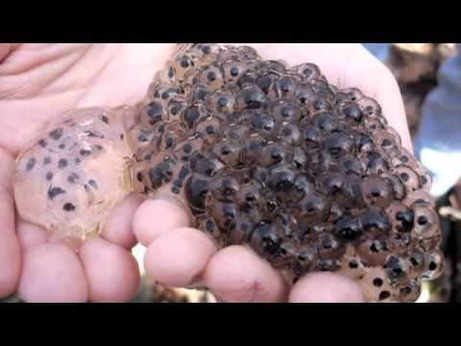

Slide 10
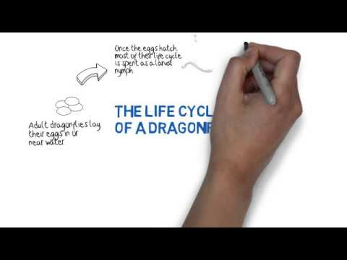
https://www.youtube.com/watch?v=9ZmZAMvHkOk

