Slide 1
Religious Education
Research a religion or culture of your choice (key focus – community)

Slide 2
Similarity and Difference
In every aspect of life you will find similarity and difference.
Talk to someone for just one minute. What similarities and differences can you find?
You both have a body, a head, hair, a face, a nose, two eyes and a mouth, two legs, two arms, all these things are similarities….
But if you look more closely you will start to see the differences - the height of your body, the colour of your hair, skin and eyes, the shape of your nose and mouth…. These are just a few.
People are complicated. Not only do they have outer features such as their body, they also have inner qualities, their likes and dislikes, their thoughts and experiences.

Slide 3
Similarity and Difference in Religion
The great world religions are communities of millions of people.
If people are complicated, then religions are likely to be even more complicated.
Is there any way we can explore something a bit less complex and then relate our observations of that topic to people and religions?
Think of leaves (William Morris link).
What features can you think about that leaves share, which makes all or most leaves similar?

Slide 4
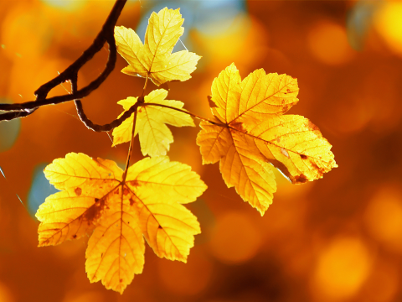
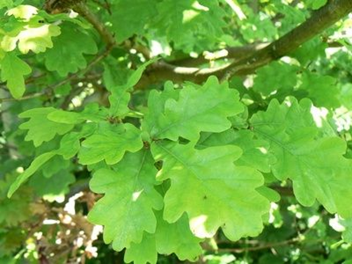
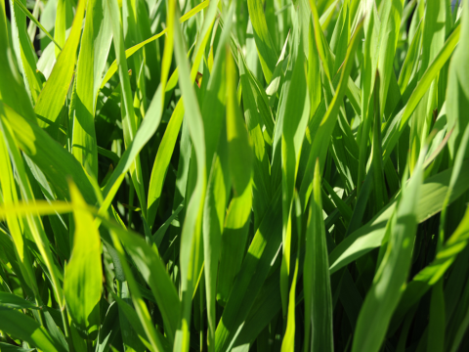
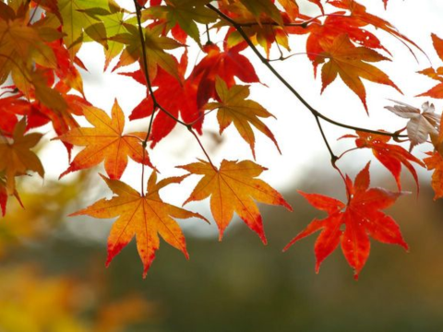

Slide 5
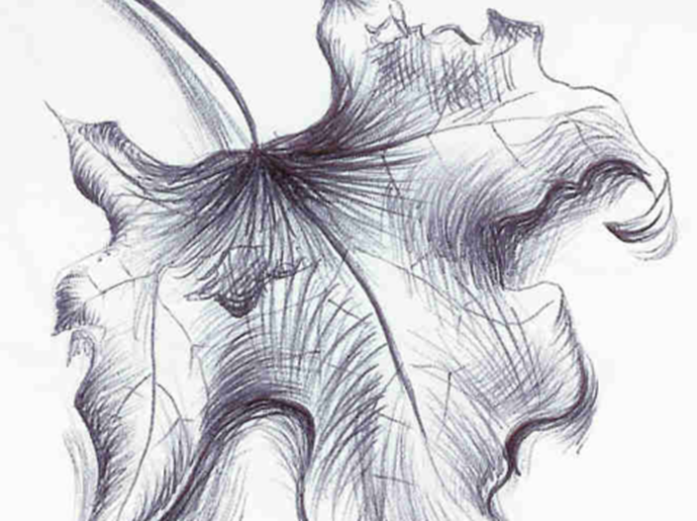
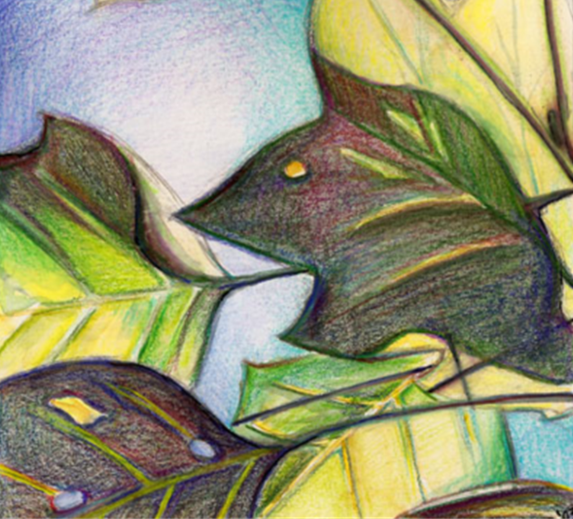
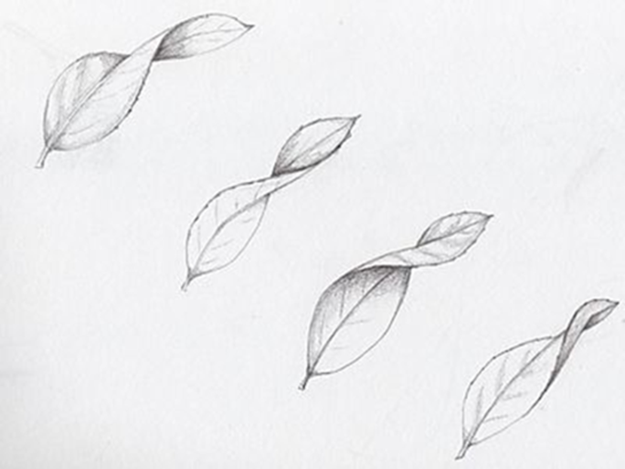
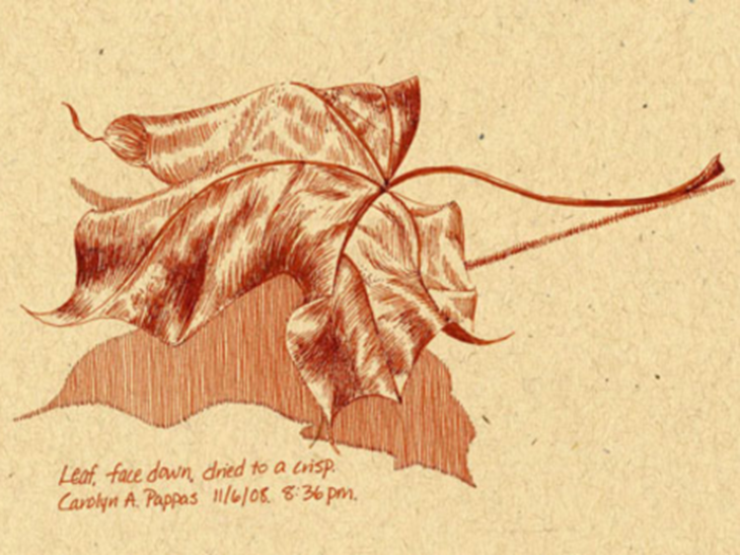
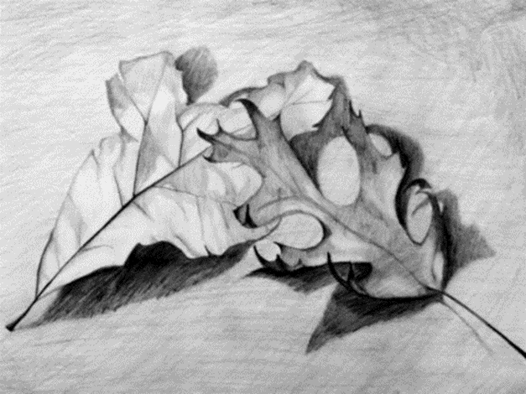
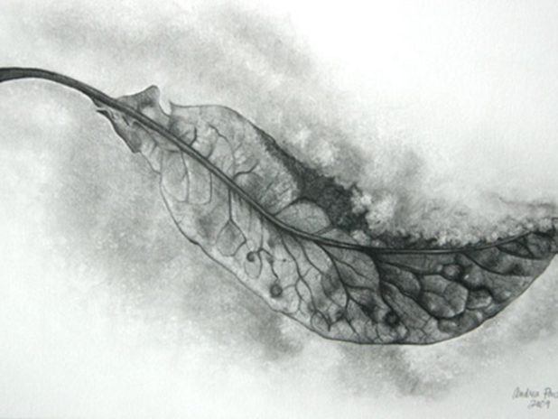
Activity 1
Choose a leaf, which best represents your religion/ belief and draw it in your book.

Slide 6
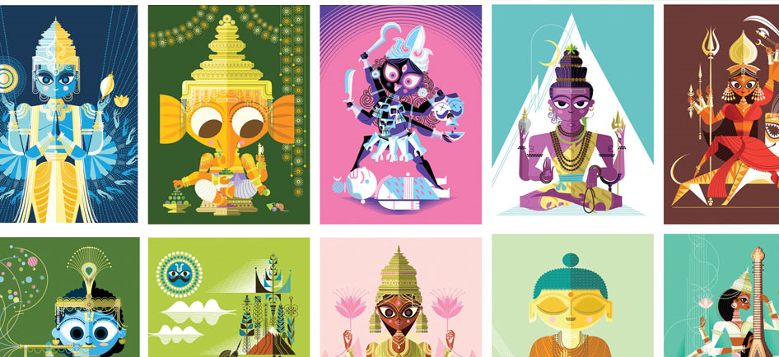
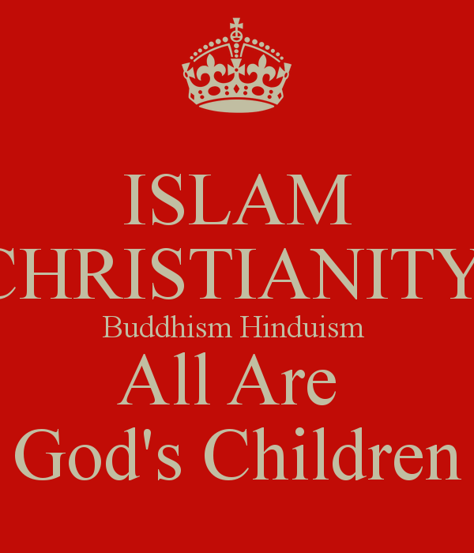
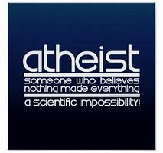
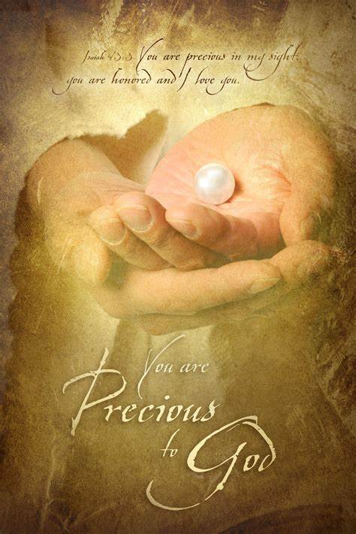
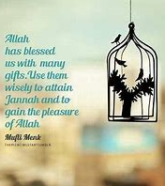
Activity 2
Research a religion or culture of your choice.
Remember your key focus – community
Be creative
Use different media ( colouring pencils, felt tips, paint, watercolours or simply shades of grey pencil) to represent your work.

